Slide 1

Pressure Injury Prevention for CNA’s
Created by:
Henry Okonkwo, Chief Operations Officer/Chief Medical Officer
Skilled Wound Care Surgical Group/Skilled Physicians Group
For:
CAHF Quality Improvement Subcommittee, All Rights Reserved®️, Do not copy without permission.

Slide 2
Learning Objectives:
At completion of this training, the participant will be able to:
Define what a pressure injury is.
Define the role of the Nursing Assistant in wound prevention.
Identify all major pressure points.
Demonstrate different methods of offloading and prevention of pressure injuries.
Describe role of nutrition and hydration.
Created by: Henry Okonkwo, COO/CMO, Skilled Wound Care Surgical Group/Skilled Physician Group
For: CAHF Quality Improvement Subcommittee, All Rights Reserved®️, Do not copy without permission.

Slide 3
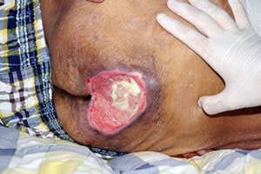
What is a Pressure Injury?
Created by: Henry Okonkwo, COO/CMO, Skilled Wound Care Surgical Group/Skilled Physician Group
For: CAHF Quality Improvement Subcommittee, All Rights Reserved®️, Do not copy without permission.

Slide 4
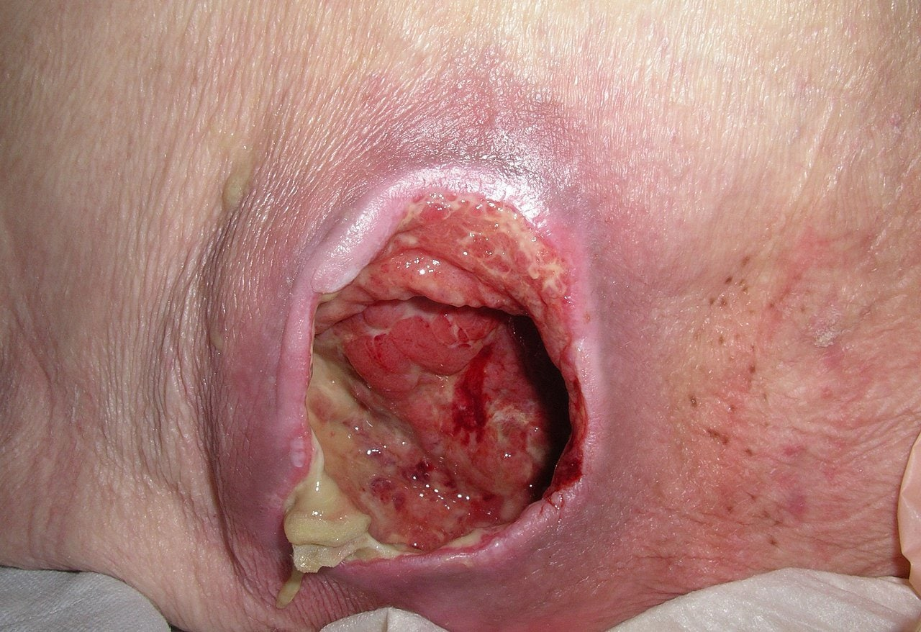
Pressure Injury Definition
(National Pressure Injury Advisory Panel/NPIAP definition)
A pressure injury is localized damage to the skin and underlying soft tissue usually over a bony prominence or related to a medical or other device.
The injury can present as intact skin or an open ulcer and may be painful.
The injury occurs as a result of intense and/or prolonged pressure or pressure in combination with shear.
The tolerance of soft tissue for pressure and shear may also be affected by microclimate, nutrition, perfusion, co-morbidities and condition of the soft tissue.
Created by: Henry Okonkwo, COO/CMO, Skilled Wound Care Surgical Group/Skilled Physician Group
For: CAHF Quality Improvement Subcommittee, All Rights Reserved®️, Do not copy without permission.

Slide 5
Question:
Whose job is it
to prevent
Pressure Injuries?
Created by: Henry Okonkwo, COO/CMO, Skilled Wound Care Surgical Group/Skilled Physician Group
For: CAHF Quality Improvement Subcommittee, All Rights Reserved®️, Do not copy without permission.

Slide 6

Everyone!!!
Including CNA’s….
It’s all about teamwork!
Created by: Henry Okonkwo, COO/CMO, Skilled Wound Care Surgical Group/Skilled Physician Group
For: CAHF Quality Improvement Subcommittee, All Rights Reserved®️, Do not copy without permission.

Slide 7
CNAs and Pressure Injury Prevention
When it comes to wound care, prevention is everything!
The true front-line workers in pressure injury prevention are the Certified Nursing Assistants/Nurses Aides.
CNAs do most of the heavy lifting.
License nurses (LVN’s and RN’s) depend on each CNA.
Thus, the value of ongoing education is priceless.
Created by: Henry Okonkwo, COO/CMO, Skilled Wound Care Surgical Group/Skilled Physician Group
For: CAHF Quality Improvement Subcommittee, All Rights Reserved®️, Do not copy without permission.

Slide 8

CNAs and Pressure Injury Prevention
Although CNAs do not assess, licensed nurses depend on nursing assistants to communicate in a timely manner the findings during each shift.
It has been often said that: nursing assistants are to report what they hear, see, smell, and touch.
Created by: Henry Okonkwo, COO/CMO, Skilled Wound Care Surgical Group/Skilled Physician Group
For: CAHF Quality Improvement Subcommittee, All Rights Reserved®️, Do not copy without permission.

Slide 9
Some daily responsibilities of a CNA that are associated with skin health:
Skills such as:
Bathing( in bed) /showering
Personal hygiene
Skin care
Transfers
Hand washing
Bed making
Mechanical lift use
Repositioning
Nutrition & fluids
Perineal care
Partial bath
Oral hygiene
Shaving
Catheter care
Nail care
Resident feeding
Intake & output
Apply PPE
Documentation
Dressing a resident
Specimen collection
Height & weight
Range of motion
Created by: Henry Okonkwo, COO/CMO, Skilled Wound Care Surgical Group/Skilled Physician Group
For: CAHF Quality Improvement Subcommittee, All Rights Reserved®️, Do not copy without permission.

Slide 10

NPIAP and CNAs
Over half of the the National Pressure Injury Advisory Panel guidelines for pressure injury prevention are items that fall under the scope of a CNAs responsibility.
Created by: Henry Okonkwo, COO/CMO, Skilled Wound Care Surgical Group/Skilled Physician Group
For: CAHF Quality Improvement Subcommittee, All Rights Reserved®️, Do not copy without permission.

Slide 11

What is the most common reason a patient get pressure injuries?
Created by: Henry Okonkwo, COO/CMO, Skilled Wound Care Surgical Group/Skilled Physician Group
For: CAHF Quality Improvement Subcommittee, All Rights Reserved®️, Do not copy without permission.

Slide 12
The patient does
not move!!!
Created by: Henry Okonkwo, COO/CMO, Skilled Wound Care Surgical Group/Skilled Physician Group
For: CAHF Quality Improvement Subcommittee, All Rights Reserved®️, Do not copy without permission.

Slide 13
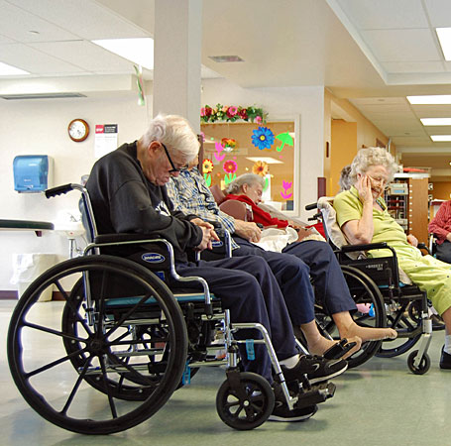
When sitting…
They don’t move!
Created by: Henry Okonkwo, COO/CMO, Skilled Wound Care Surgical Group/Skilled Physician Group
For: CAHF Quality Improvement Subcommittee, All Rights Reserved®️, Do not copy without permission.

Slide 14
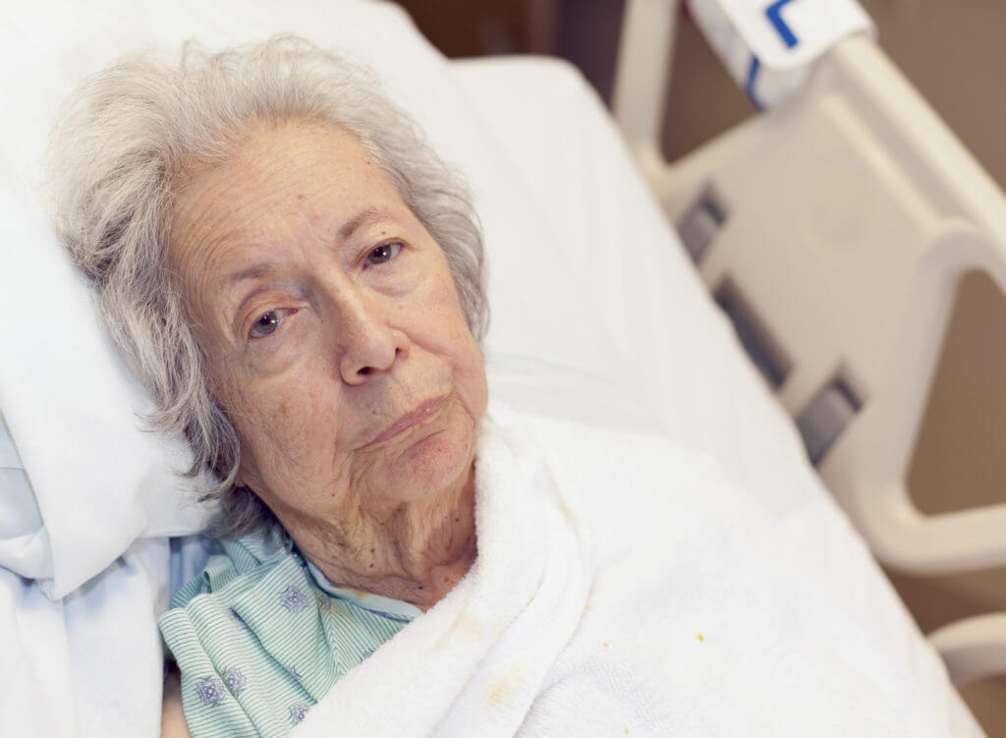
When In bed…
Many of our patients don’t move!
Why:
  They don’t want to move.
  They are not able to move.
  They need support to move.
Created by: Henry Okonkwo, COO/CMO, Skilled Wound Care Surgical Group/Skilled Physician Group
For: CAHF Quality Improvement Subcommittee, All Rights Reserved®️, Do not copy without permission.

Slide 15
So, what are high risk areas for pressure injuries when patients don't move?
Created by: Henry Okonkwo, COO/CMO, Skilled Wound Care Surgical Group/Skilled Physician Group
For: CAHF Quality Improvement Subcommittee, All Rights Reserved®️, Do not copy without permission.

Slide 16

Unloading pressure from high-risk pressure points allow for the prevention of pressure injuries!!!
So where should you look when checking skin for pressure injuries?
Created by: Henry Okonkwo, COO/CMO, Skilled Wound Care Surgical Group/Skilled Physician Group
For: CAHF Quality Improvement Subcommittee, All Rights Reserved®️, Do not copy without permission.

Slide 17
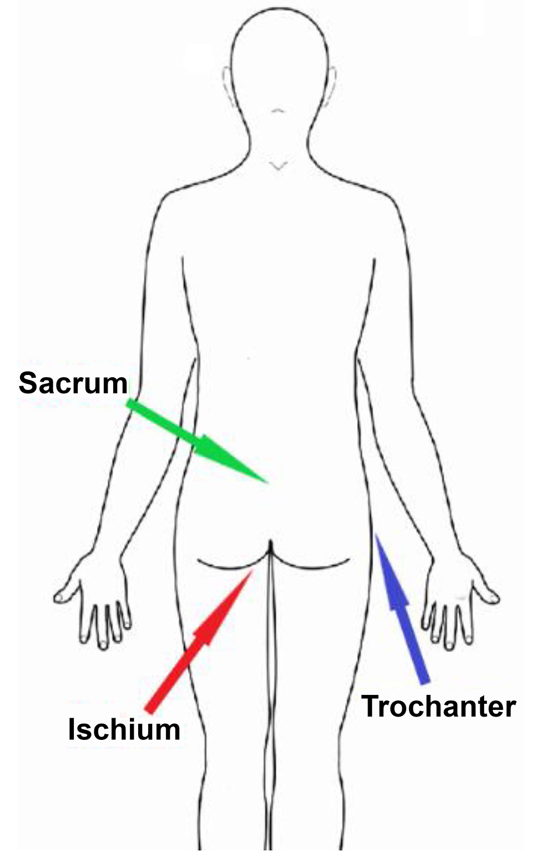
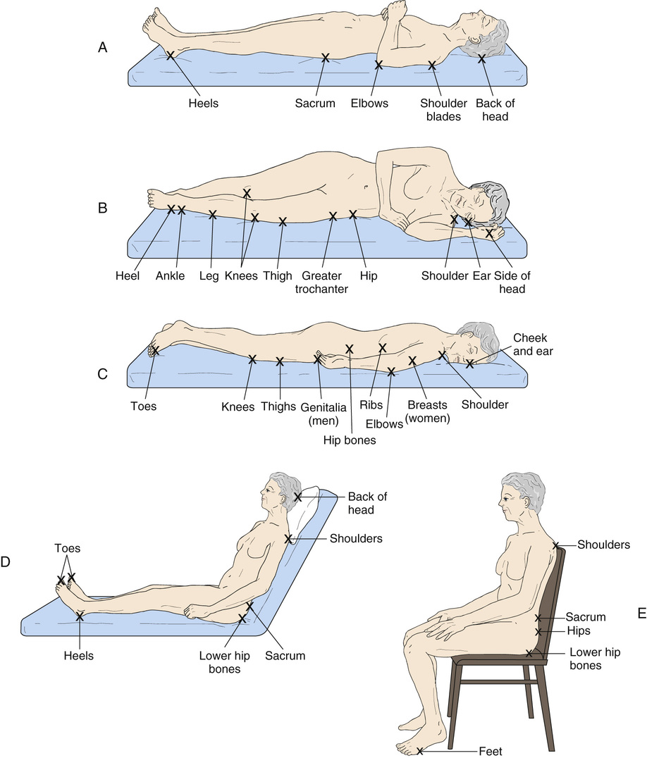
High risk sites for the development of pressure injuries:
Boney prominences are at high risk for pressure injuries when patients are in these positions.
Created by: Henry Okonkwo, COO/CMO, Skilled Wound Care Surgical Group/Skilled Physician Group
For: CAHF Quality Improvement Subcommittee, All Rights Reserved®️, Do not copy without permission.

Slide 18
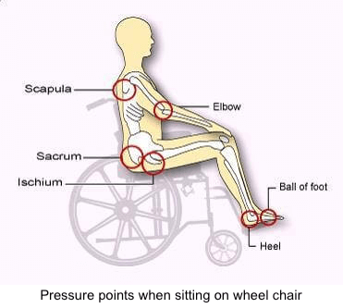
High risk sites for the development of pressure injuries:
Boney prominences are at high risk for pressure injuries when patients are in their wheelchair.
Created by: Henry Okonkwo, COO/CMO, Skilled Wound Care Surgical Group/Skilled Physician Group
For: CAHF Quality Improvement Subcommittee, All Rights Reserved®️, Do not copy without permission.

Slide 19
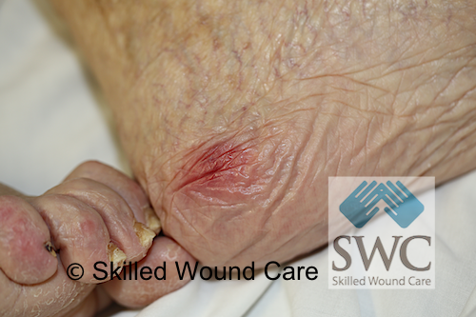
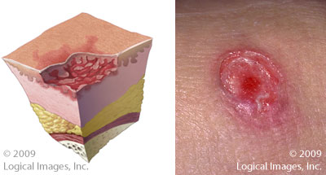
What are you looking for?
Stage 2 Pressure Injury
Stage 1 Pressure Injury
Partial-thickness skin loss with exposed dermis.
Visible red dermal tissue.
Can appear as an intact clear fluid blister or ruptured blister.
No slough, no necrotic tissue.
Intact skin.
Non-blanchable redness.
Generally, over a boney prominence.
Created by: Henry Okonkwo, COO/CMO, Skilled Wound Care Surgical Group/Skilled Physician Group
For: CAHF Quality Improvement Subcommittee, All Rights Reserved®️, Do not copy without permission.

Slide 20
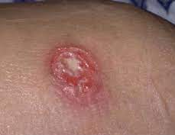
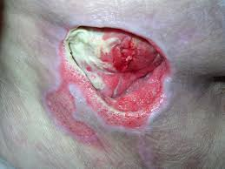
What are you looking for?
Stage 4 Pressure Injury
Full-thickness loss of skin, in which adipose (fat) is visible in the ulcer and granulation tissue and epibole (rolled wound edges) are often present.
Slough and/or eschar may be visible.
Full-thickness skin and tissue loss with exposed or directly palpable fascia, muscle, tendon, ligament, cartilage or bone in the ulcer.
Slough and/or eschar may be visible.
Epibole (rolled edges), undermining and/or tunneling often occur.
Stage 3 Pressure Injury
Created by: Henry Okonkwo, COO/CMO, Skilled Wound Care Surgical Group/Skilled Physician Group
For: CAHF Quality Improvement Subcommittee, All Rights Reserved®️, Do not copy without permission.

Slide 21
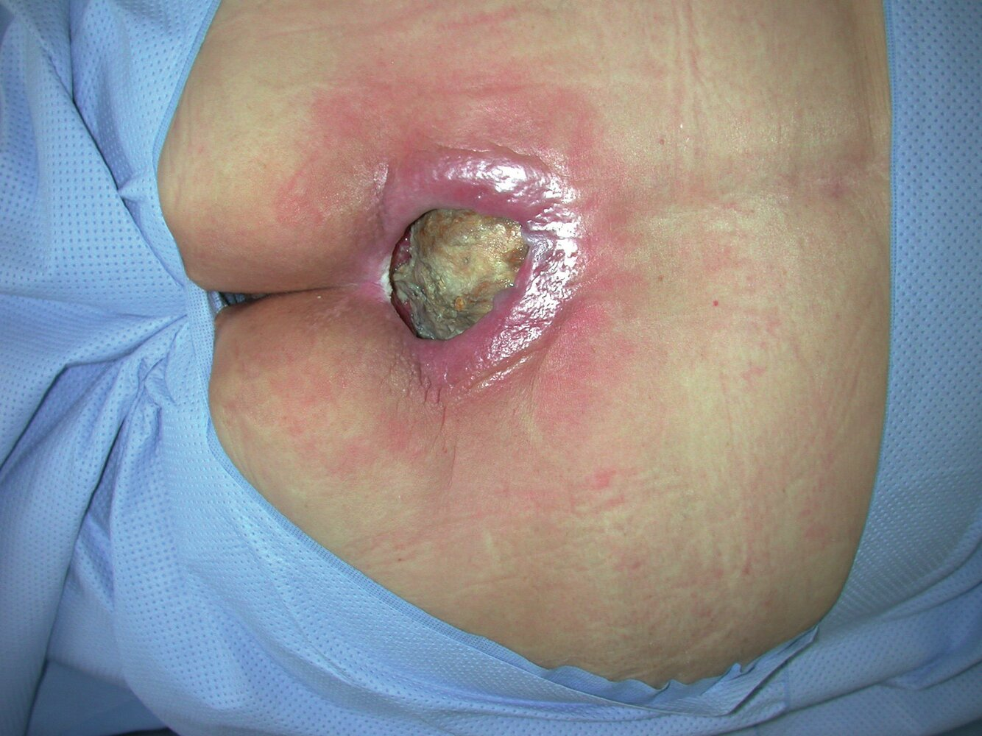
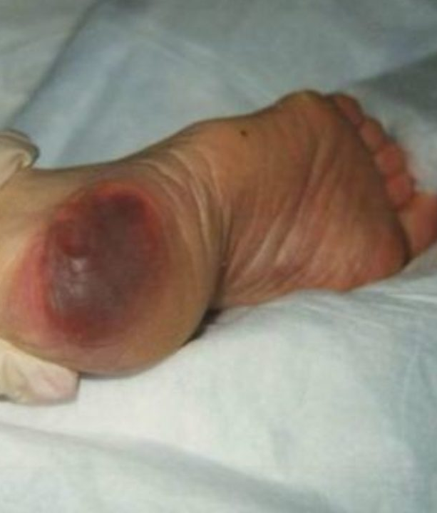
What are you looking for?
Unstageable Pressure Injury
Deep Tissue Pressure Injury
Intact or non-intact skin with localized area of persistent non-blanchable deep red, maroon, purple discoloration or epidermal separation revealing a dark wound bed or blood-filled blister.
Full-thickness skin and tissue loss in which the extent of tissue damage within the ulcer cannot be confirmed because it is obscured by slough or eschar.
Created by: Henry Okonkwo, COO/CMO, Skilled Wound Care Surgical Group/Skilled Physician Group
For: CAHF Quality Improvement Subcommittee, All Rights Reserved®️, Do not copy without permission.

Slide 22
As a CNA,
what can
I do to prevent
skin breakdown?
Created by: Henry Okonkwo, COO/CMO, Skilled Wound Care Surgical Group/Skilled Physician Group
For: CAHF Quality Improvement Subcommittee, All Rights Reserved®️, Do not copy without permission.

Slide 23
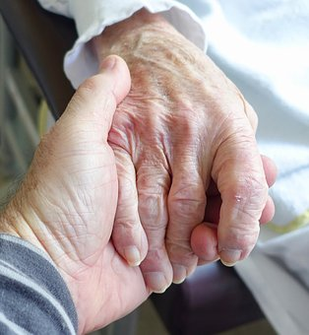
How to help Prevent Pressure Injuries.
Created by: Henry Okonkwo, COO/CMO, Skilled Wound Care Surgical Group/Skilled Physician Group
For: CAHF Quality Improvement Subcommittee, All Rights Reserved®️, Do not copy without permission.

Slide 24
How to help Prevent Pressure Injuries:
  Turn patient multiple times as needed during your shift
  Offer fluids/hydration
  Offload the heels
  Protect the skin(barrier cream, ointment, or paste)
  Moisturize the skin (lotion)
  Offer toilet or urinal
  Perineal Care
  Monitor nutritional intake
Created by: Henry Okonkwo, COO/CMO, Skilled Wound Care Surgical Group/Skilled Physician Group
For: CAHF Quality Improvement Subcommittee, All Rights Reserved®️, Do not copy without permission.

Slide 25
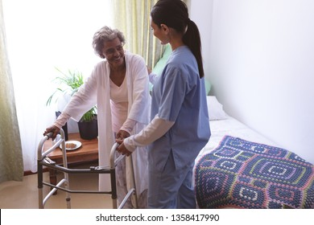
Get your patient out of bed.
Encourage them to help themselves.
Created by: Henry Okonkwo, COO/CMO, Skilled Wound Care Surgical Group/Skilled Physician Group
For: CAHF Quality Improvement Subcommittee, All Rights Reserved®️, Do not copy without permission.

Slide 26
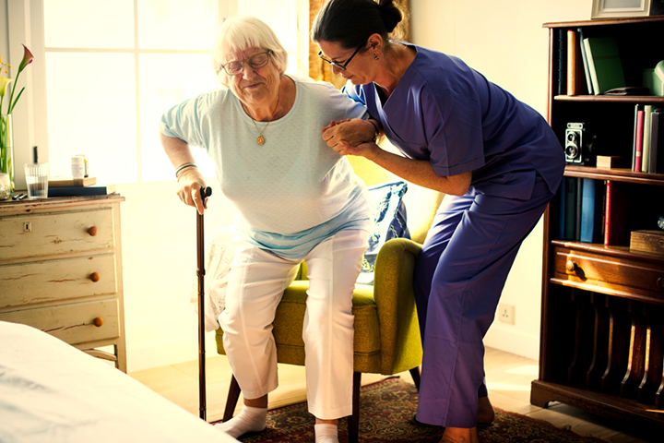
Get patients out of their room!!!
Created by: Henry Okonkwo, COO/CMO, Skilled Wound Care Surgical Group/Skilled Physician Group
For: CAHF Quality Improvement Subcommittee, All Rights Reserved®️, Do not copy without permission.

Slide 27
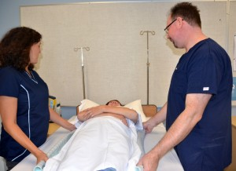
Turn patient multiple times as needed during your shift
Created by: Henry Okonkwo, COO/CMO, Skilled Wound Care Surgical Group/Skilled Physician Group
For: CAHF Quality Improvement Subcommittee, All Rights Reserved®️, Do not copy without permission.

Slide 28
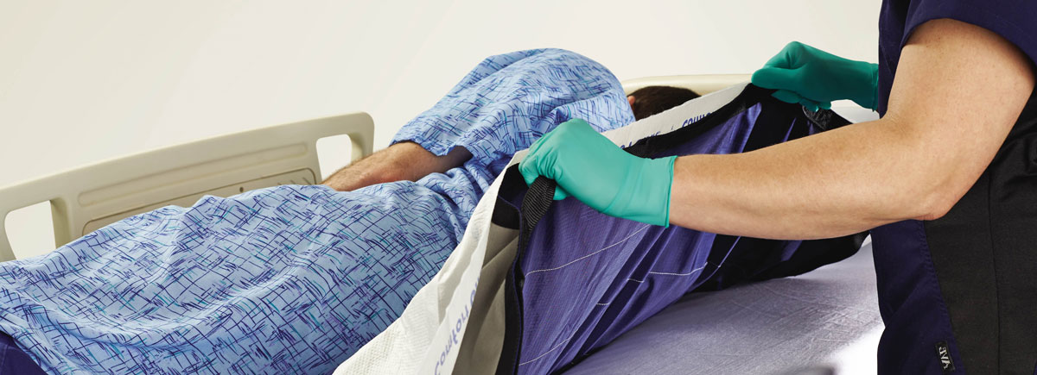

Always use a draw sheet when attempting to reposition a patient while in bed.
Created by: Henry Okonkwo, COO/CMO, Skilled Wound Care Surgical Group/Skilled Physician Group
For: CAHF Quality Improvement Subcommittee, All Rights Reserved®️, Do not copy without permission.

Slide 29
When is a good time to check your patient’s skin for skin injuries?
Created by: Henry Okonkwo, COO/CMO, Skilled Wound Care Surgical Group/Skilled Physician Group
For: CAHF Quality Improvement Subcommittee, All Rights Reserved®️, Do not copy without permission.

Slide 30
All The Time!!!
Created by: Henry Okonkwo, COO/CMO, Skilled Wound Care Surgical Group/Skilled Physician Group
For: CAHF Quality Improvement Subcommittee, All Rights Reserved®️, Do not copy without permission.

Slide 31
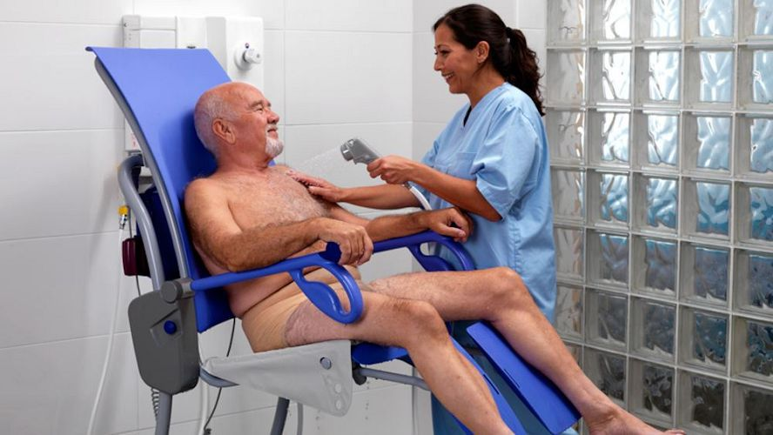
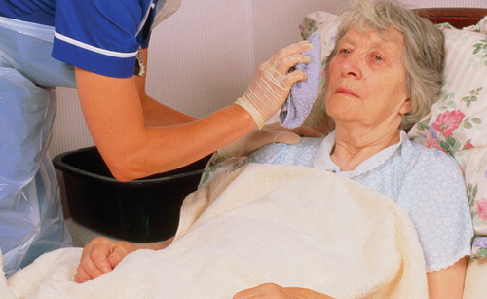
Especially when Bathing… (shower or bed-bath)
Created by: Henry Okonkwo, COO/CMO, Skilled Wound Care Surgical Group/Skilled Physician Group
For: CAHF Quality Improvement Subcommittee, All Rights Reserved®️, Do not copy without permission.

Slide 32
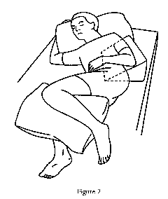
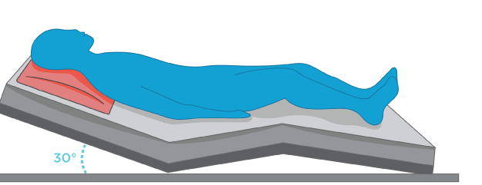
And when repositioning
Raise the head of bed no more than 30°
Lateral turn no more than 30°
Created by: Henry Okonkwo, COO/CMO, Skilled Wound Care Surgical Group/Skilled Physician Group
For: CAHF Quality Improvement Subcommittee, All Rights Reserved®️, Do not copy without permission.

Slide 33
Where else
should you look for skin breakdown?
Created by: Henry Okonkwo, COO/CMO, Skilled Wound Care Surgical Group/Skilled Physician Group
For: CAHF Quality Improvement Subcommittee, All Rights Reserved®️, Do not copy without permission.

Slide 34
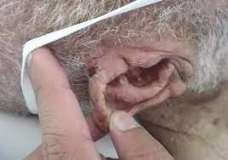
Where else to look…
Under tubing
    Foley catheters
    Feeding tubes
Created by: Henry Okonkwo, COO/CMO, Skilled Wound Care Surgical Group/Skilled Physician Group
For: CAHF Quality Improvement Subcommittee, All Rights Reserved®️, Do not copy without permission.

Slide 35
Where else to look…
Under medical devices
    Splints
    Braces
    Restraints
    Adult incontinence briefs
    Heel protector straps
    Compression stockings
Created by: Henry Okonkwo, COO/CMO, Skilled Wound Care Surgical Group/Skilled Physician Group
For: CAHF Quality Improvement Subcommittee, All Rights Reserved®️, Do not copy without permission.

Slide 36
What should you do when you find a
Pressure Injury?
Created by: Henry Okonkwo, COO/CMO, Skilled Wound Care Surgical Group/Skilled Physician Group
For: CAHF Quality Improvement Subcommittee, All Rights Reserved®️, Do not copy without permission.

Slide 37
What should you do when you find a
Pressure Injury?
Report immediately to the primary nurse or the charge nurse.
Offload the area.
Wait for instructions from the licensed nurse on duty.
Follow your facility protocols.
Created by: Henry Okonkwo, COO/CMO, Skilled Wound Care Surgical Group/Skilled Physician Group
For: CAHF Quality Improvement Subcommittee, All Rights Reserved®️, Do not copy without permission.

Slide 38
Wounds are not the only skin challenges that we should be concerned about.
Other skin challenges???
Created by: Henry Okonkwo, COO/CMO, Skilled Wound Care Surgical Group/Skilled Physician Group
For: CAHF Quality Improvement Subcommittee, All Rights Reserved®️, Do not copy without permission.

Slide 39
What are some examples of other skin breakdown you may find?
Created by: Henry Okonkwo, COO/CMO, Skilled Wound Care Surgical Group/Skilled Physician Group
For: CAHF Quality Improvement Subcommittee, All Rights Reserved®️, Do not copy without permission.

Slide 40
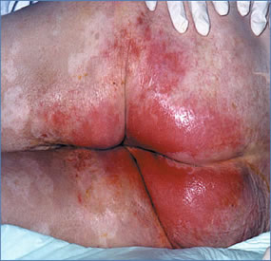
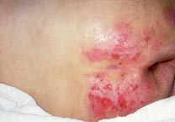
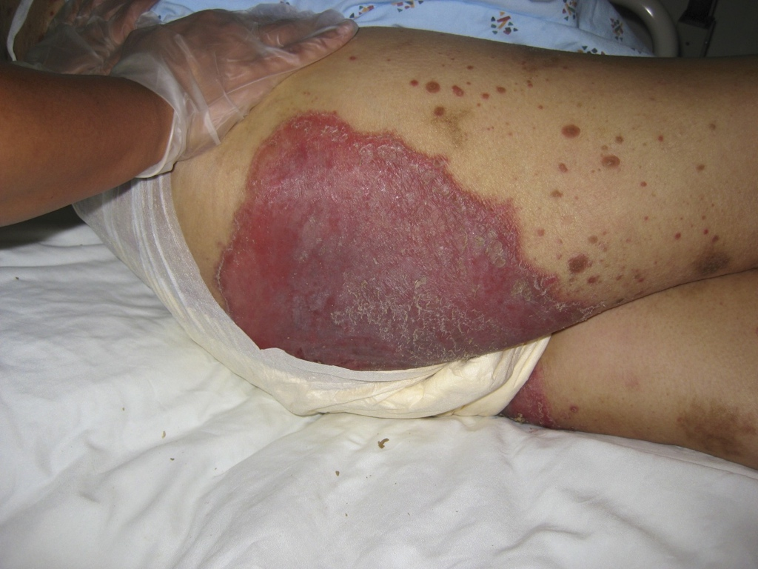
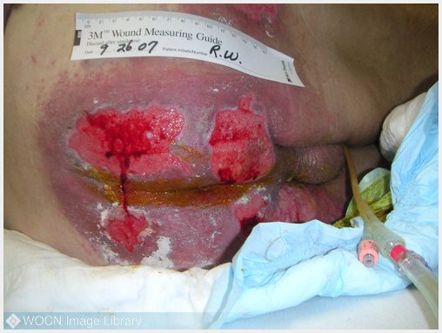
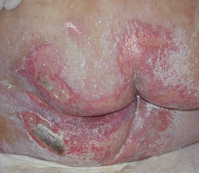
Moisture Associated Skin Damage/MASD……….
Created by: Henry Okonkwo, COO/CMO, Skilled Wound Care Surgical Group/Skilled Physician Group
For: CAHF Quality Improvement Subcommittee, All Rights Reserved®️, Do not copy without permission.

Slide 41
What can I do to prevent MASD?
Created by: Henry Okonkwo, COO/CMO, Skilled Wound Care Surgical Group/Skilled Physician Group
For: CAHF Quality Improvement Subcommittee, All Rights Reserved®️, Do not copy without permission.

Slide 42
Protecting the skin from MASD
Identify high risk patients.
Use barrier creams to protect the skin.
Change adult incontinence briefs as quickly and as often as needed.
Communicate with the charge nurse!
Created by: Henry Okonkwo, COO/CMO, Skilled Wound Care Surgical Group/Skilled Physician Group
For: CAHF Quality Improvement Subcommittee, All Rights Reserved®️, Do not copy without permission.

Slide 43
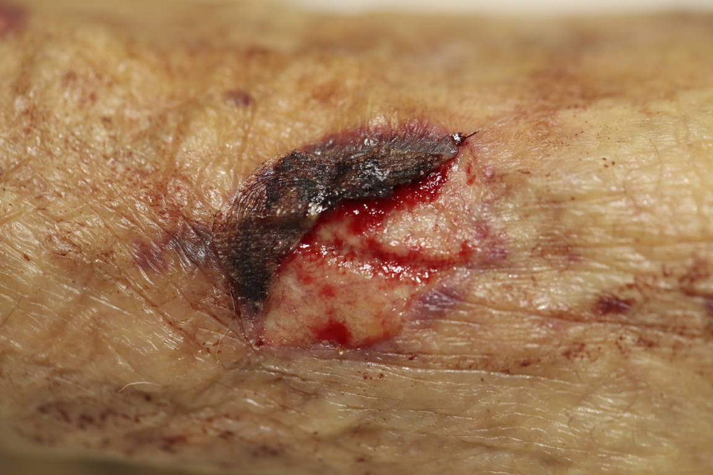
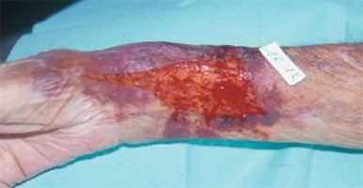
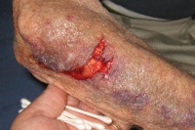
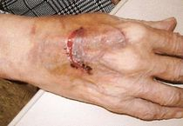
Skin Tears
Created by: Henry Okonkwo, COO/CMO, Skilled Wound Care Surgical Group/Skilled Physician Group
For: CAHF Quality Improvement Subcommittee, All Rights Reserved®️, Do not copy without permission.

Slide 44
What can I do to prevent skin tears?
Created by: Henry Okonkwo, COO/CMO, Skilled Wound Care Surgical Group/Skilled Physician Group
For: CAHF Quality Improvement Subcommittee, All Rights Reserved®️, Do not copy without permission.

Slide 45
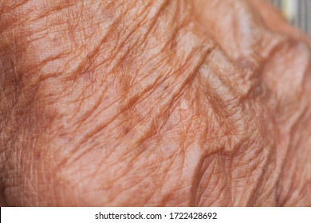
Preventing skin tears…
Keep skin moisturized.
Use appropriate skin moisturizers daily.
Use mild soaps or pH-balanced cleansing products instead of soap.
Identify early signs of skin damage.
Created by: Henry Okonkwo, COO/CMO, Skilled Wound Care Surgical Group/Skilled Physician Group
For: CAHF Quality Improvement Subcommittee, All Rights Reserved®️, Do not copy without permission.

Slide 46
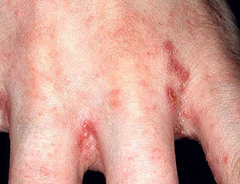
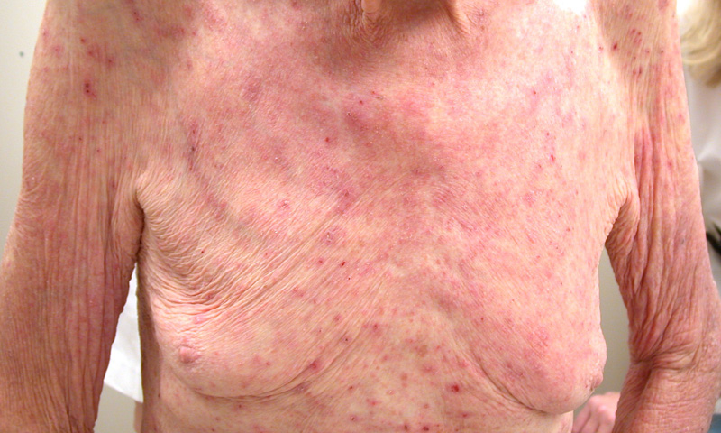
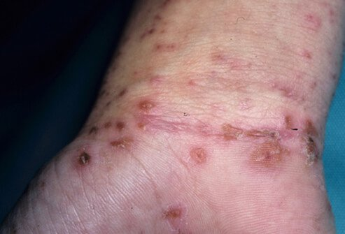
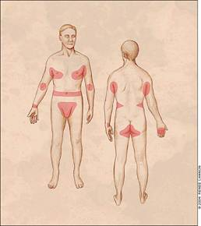
Scabies Rash
Created by: Henry Okonkwo, COO/CMO, Skilled Wound Care Surgical Group/Skilled Physician Group
For: CAHF Quality Improvement Subcommittee, All Rights Reserved®️, Do not copy without permission.

Slide 47
What can you do to prevent the spread of infections from patient to patient?
Created by: Henry Okonkwo, COO/CMO, Skilled Wound Care Surgical Group/Skilled Physician Group
For: CAHF Quality Improvement Subcommittee, All Rights Reserved®️, Do not copy without permission.

Slide 48
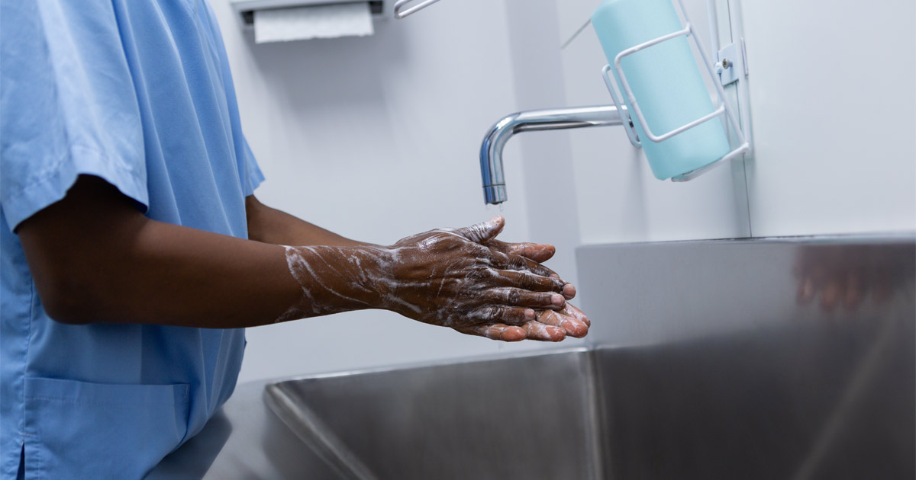
Protect yourself
Wash your hands
Wash your patient’s hands
Follow Enhanced Barrier Precautions (EBP)
Created by: Henry Okonkwo, COO/CMO, Skilled Wound Care Surgical Group/Skilled Physician Group
For: CAHF Quality Improvement Subcommittee, All Rights Reserved®️, Do not copy without permission.

Slide 49
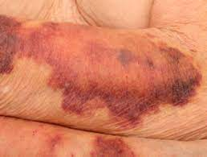
Bruising
Ecchymoses associated with skin thinning.
Traumatic bruise.
Created by: Henry Okonkwo, COO/CMO, Skilled Wound Care Surgical Group/Skilled Physician Group
For: CAHF Quality Improvement Subcommittee, All Rights Reserved®️, Do not copy without permission.

Slide 50
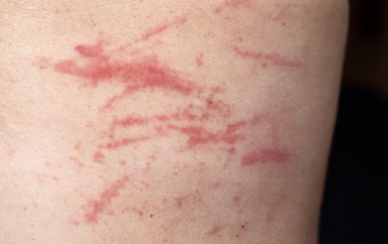
Excoriation
Created by: Henry Okonkwo, COO/CMO, Skilled Wound Care Surgical Group/Skilled Physician Group
For: CAHF Quality Improvement Subcommittee, All Rights Reserved®️, Do not copy without permission.

Slide 51

Created by: Henry Okonkwo, COO/CMO, Skilled Wound Care Surgical Group/Skilled Physician Group
For: CAHF Quality Improvement Subcommittee, All Rights Reserved®️, Do not copy without permission.

Slide 52
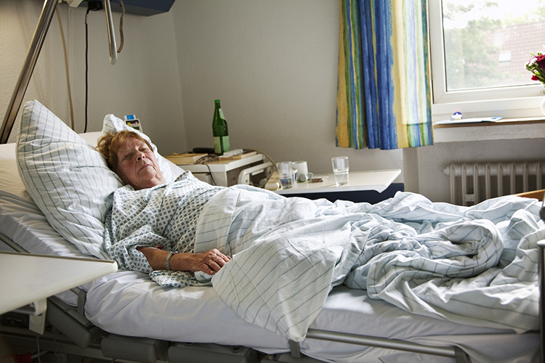
Have you turned me to check my skin?
Created by: Henry Okonkwo, COO/CMO, Skilled Wound Care Surgical Group/Skilled Physician Group
For: CAHF Quality Improvement Subcommittee, All Rights Reserved®️, Do not copy without permission.

Slide 53
As a CNA,
what can
I do to prevent
skin breakdown?
Created by: Henry Okonkwo, COO/CMO, Skilled Wound Care Surgical Group/Skilled Physician Group
For: CAHF Quality Improvement Subcommittee, All Rights Reserved®️, Do not copy without permission.

Slide 54
What can you do to prevent skin breakdown?
  Turn patient multiple times as needed during your shift.
  Encourage patient to get out of bed daily (if possible).
  Offer fluids/hydration.
  Offload the heels.
  Protect the tissue (barrier cream, ointment, or paste).
  Moisturize the skin (lotion).
  Offer bedside commode, toilet, or urinal.
  Monitor nutritional intake.
Created by: Henry Okonkwo, COO/CMO, Skilled Wound Care Surgical Group/Skilled Physician Group
For: CAHF Quality Improvement Sub-Committee, All Rights Reserved®️, Do not copy without permission.

Slide 55

Why is Fluids/ Hydration so important:
Water carries nutrients and oxygen to cells and removes waste matter from the body.
Water helps to regulate an ideal body temperature.
Fluid helps prevent constipation.
Created by: Henry Okonkwo, COO/CMO, Skilled Wound Care Surgical Group/Skilled Physician Group
For: CAHF Quality Improvement Subcommittee, All Rights Reserved®️, Do not copy without permission.

Slide 56
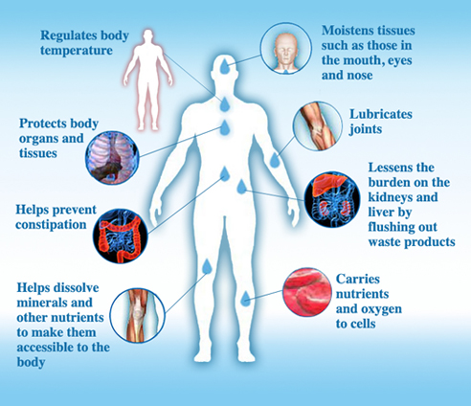
Why is Fluids/ Hydration so important:
Dehydration is lack of sufficient fluid.
Elderly patients need about 6 medium-sized glasses of water per day (unless patient is on fluid restriction).
Created by: Henry Okonkwo, COO/CMO, Skilled Wound Care Surgical Group/Skilled Physician Group
For: CAHF Quality Improvement Subcommittee, All Rights Reserved®️, Do not copy without permission.

Slide 57
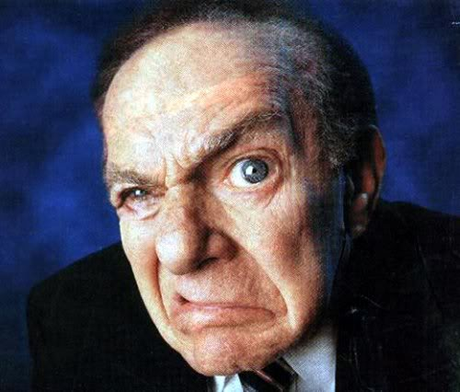
Why is Fluids/ Hydration so important:
Poor fluid intake produces confusion, agitation, and even infections.
Created by: Henry Okonkwo, COO/CMO, Skilled Wound Care Surgical Group/Skilled Physician Group
For: CAHF Quality Improvement Subcommittee, All Rights Reserved®️, Do not copy without permission.

Slide 58
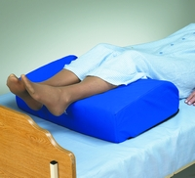
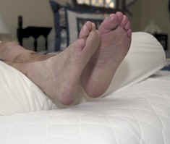
Offload the heels!
Make sure the heels are not touching the bed!
* Be careful not to elevate legs when offloading arterial disease patients.
  Check with your licensed nursing team.
Created by: Henry Okonkwo, COO/CMO, Skilled Wound Care Surgical Group/Skilled Physician Group
For: CAHF Quality Improvement Subcommittee, All Rights Reserved®️, Do not copy without permission.

Slide 59
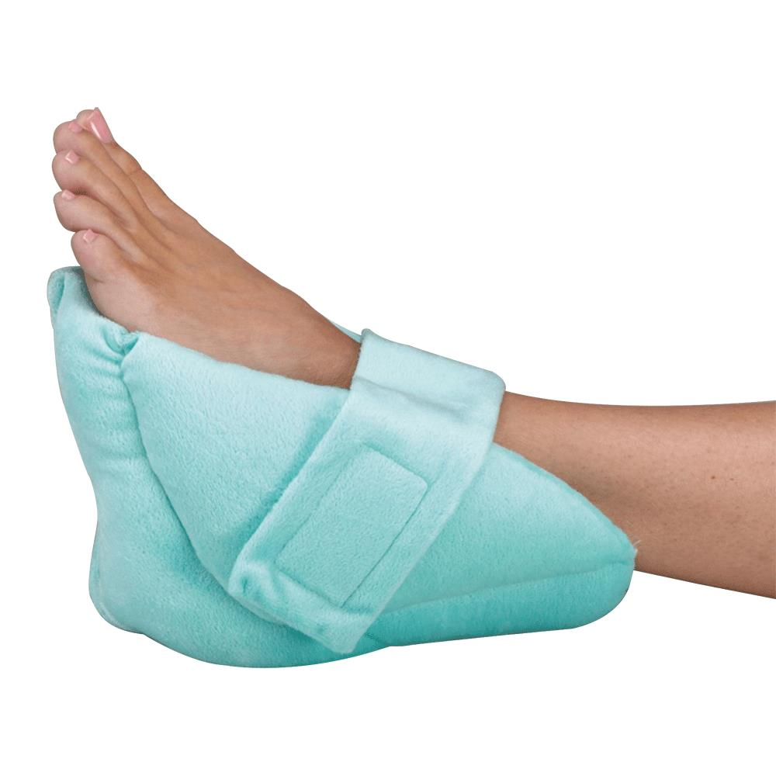
Offloading Note:
Heel Protectors are not used for offloading!!!
Created by: Henry Okonkwo, COO/CMO, Skilled Wound Care Surgical Group/Skilled Physician Group
For: CAHF Quality Improvement Subcommittee, All Rights Reserved®️, Do not copy without permission.

Slide 60
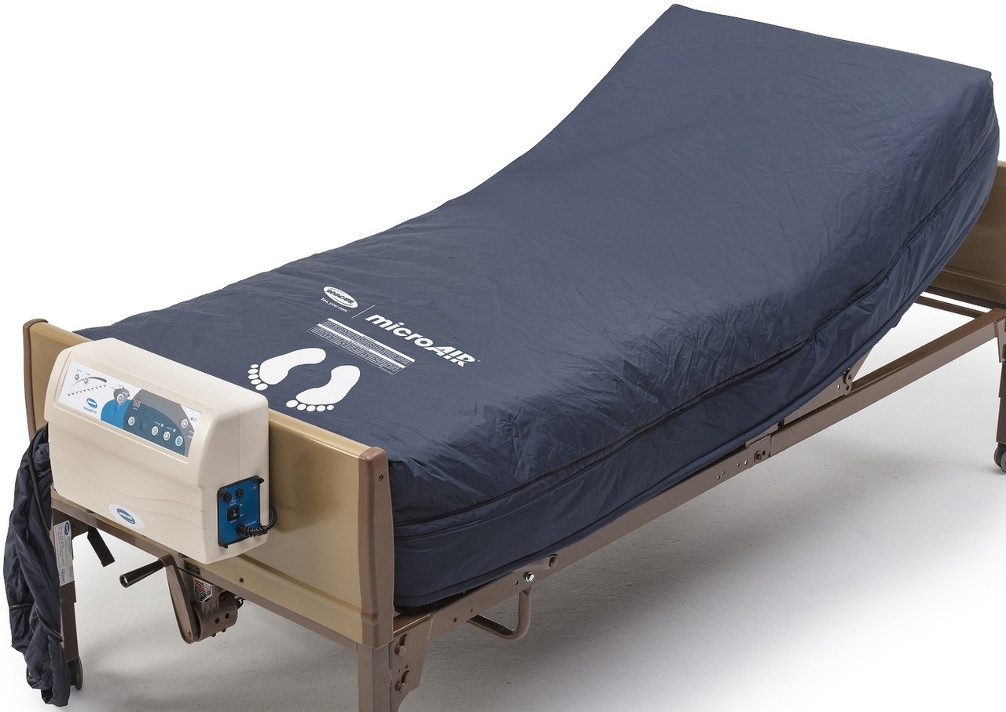
Offloading the heels
NOTE:
* You still need to offload heels from an air mattress surface.
Created by: Henry Okonkwo, COO/CMO, Skilled Wound Care Surgical Group/Skilled Physician Group
For: CAHF Quality Improvement Subcommittee, All Rights Reserved®️, Do not copy without permission.

Slide 61
How do you
protect
the patient’s skin?
Created by: Henry Okonkwo, COO/CMO, Skilled Wound Care Surgical Group/Skilled Physician Group
For: CAHF Quality Improvement Subcommittee, All Rights Reserved®️, Do not copy without permission.

Slide 62
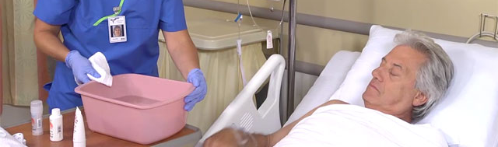
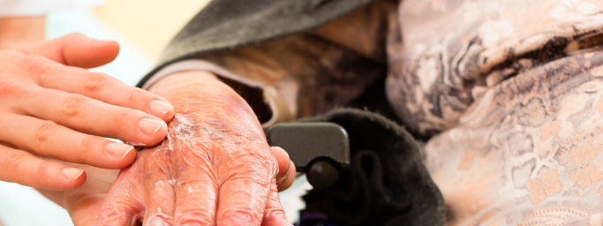
Protect the skin
Cleaning your patient provides excellent protection.
Shower/bath patient only as often as needed.
Don’t forget to wash your patient’s hands!
Moisturize the skin daily.
Created by: Henry Okonkwo, COO/CMO, Skilled Wound Care Surgical Group/Skilled Physician Group
For: CAHF Quality Improvement Subcommittee, All Rights Reserved®️, Do not copy without permission.

Slide 63
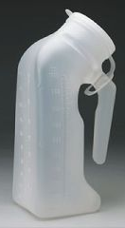



Offer toileting
Every time you enter the
room, offer to assist with
bedside commode, toilet, or urinal.
Created by: Henry Okonkwo, COO/CMO, Skilled Wound Care Surgical Group/Skilled Physician Group
For: CAHF Quality Improvement Subcommittee, All Rights Reserved®️, Do not copy without permission.

Slide 64

Monitor nutritional intake
For high-risk patients and patients with existing wounds, monitor the amount of intake for every meal and if it is not 70% or greater, let the nurse know.
Created by: Henry Okonkwo, COO/CMO, Skilled Wound Care Surgical Group/Skilled Physician Group
For: CAHF Quality Improvement Subcommittee, All Rights Reserved®️, Do not copy without permission.

Slide 65

Monitor nutritional intake
Poor nutritional intake is a contributing factor to skin breakdown, pressure injury development, and poor wound healing.
Encourage your patient to eat their meals as directed by the Nutritionist.
Created by: Henry Okonkwo, COO/CMO, Skilled Wound Care Surgical Group/Skilled Physician Group
For: CAHF Quality Improvement Subcommittee, All Rights Reserved®️, Do not copy without permission.

Slide 66

Powered pressure reducing mattresses:
Low Air Loss Mattress
Created by: Henry Okonkwo, COO/CMO, Skilled Wound Care Surgical Group/Skilled Physician Group
For: CAHF Quality Improvement Subcommittee, All Rights Reserved®️, Do not copy without permission.

Slide 67

Do you know how to operate the bed?
Ask your DSD or charge nurse for an in-service on how your patient’s low air loss mattress works.
Created by: Henry Okonkwo, COO/CMO, Skilled Wound Care Surgical Group/Skilled Physician Group
For: CAHF Quality Improvement Subcommittee, All Rights Reserved®️, Do not copy without permission.

Slide 68

Important notes about:
Specialty Beds & Powered Air Mattresses
Use only ONE layer between the patient and
the special surface!!!
One diaper or one sheet or one breathable under-pad!
Patient must still be repositioned per your facility protocol!
The heels still need to be offloaded!
Created by: Henry Okonkwo, COO/CMO, Skilled Wound Care Surgical Group/Skilled Physician Group
For: CAHF Quality Improvement Subcommittee, All Rights Reserved®️, Do not copy without permission.

Slide 69
In review:
What skin
concerns do you report to the
LVN, Charge Nurse, or RN?
Created by: Henry Okonkwo, COO/CMO, Skilled Wound Care Surgical Group/Skilled Physician Group
For: CAHF Quality Improvement Subcommittee, All Rights Reserved®️, Do not copy without permission.

Slide 70
What things should be reported to the LVN, Charge Nurse, RN?
Skin tears
Bruising
Excoriation
Redness
Rashes
Incontinence Associated Dermatitis
Created by: Henry Okonkwo, COO/CMO, Skilled Wound Care Surgical Group/Skilled Physician Group
For: CAHF Quality Improvement Subcommittee, All Rights Reserved®️, Do not copy without permission.

Slide 71
What other things should be reported?
Meal intake
Fluid intake
And any other concerns!!!
Created by: Henry Okonkwo, COO/CMO, Skilled Wound Care Surgical Group/Skilled Physician Group
For: CAHF Quality Improvement Subcommittee, All Rights Reserved®️, Do not copy without permission.

Slide 72


Don’t forget to report..
any previously resolved wounds on skin.
Created by: Henry Okonkwo, COO/CMO, Skilled Wound Care Surgical Group/Skilled Physician Group
For: CAHF Quality Improvement Subcommittee, All Rights Reserved®️, Do not copy without permission.

Slide 73
Action Plan:
It is important to start interventions immediately, when skin breakdown is found.
If the patient’s primary nurse is not receptive to your concerns, please inform the Charge Nurse immediately.
Always follow your chain of command!
Created by: Henry Okonkwo, COO/CMO, Skilled Wound Care Surgical Group/Skilled Physician Group
For: CAHF Quality Improvement Subcommittee, All Rights Reserved®️, Do not copy without permission.

Slide 74

Remember to…
Document!
Document!
Document!
Created by: Henry Okonkwo, COO/CMO, Skilled Wound Care Surgical Group/Skilled Physician Group
For: CAHF Quality Improvement Subcommittee, All Rights Reserved®️, Do not copy without permission.

Slide 75

And remember to…
Communicate!
Communicate!
Communicate!
Created by: Henry Okonkwo, COO/CMO, Skilled Wound Care Surgical Group/Skilled Physician Group
For: CAHF Quality Improvement Subcommittee, All Rights Reserved®️, Do not copy without permission.

Slide 76

Created by: Henry Okonkwo, COO/CMO, Skilled Wound Care Surgical Group/Skilled Physician Group
For: CAHF Quality Improvement Subcommittee, All Rights Reserved®️, Do not copy without permission.

Slide 77
Created by: Henry Okonkwo, COO/CMO, Skilled Wound Care Surgical Group/Skilled Physician Group
For: CAHF Quality Improvement Subcommittee, All Rights Reserved®️, Do not copy without permission.

Slide 78
Don’t forget!!!
It’s all about teamwork!
Created by: Henry Okonkwo, COO/CMO, Skilled Wound Care Surgical Group/Skilled Physician Group
For: CAHF Quality Improvement Subcommittee, All Rights Reserved®️, Do not copy without permission.

Slide 79

Pressure Injury Prevention for CNA’s
Created by:
Henry Okonkwo, Chief Operations Officer/Chief Medical Officer
Skilled Wound Care Surgical Group
For:
CAHF Quality Improvement Subcommittee, All Rights Reserved®️, Do not copy without permission.
Created by: Henry Okonkwo, COO/CMO, Skilled Wound Care Surgical Group/Skilled Physician Group
For: CAHF Quality Assurance Sub-Committee, All Rights Reserved®️, Do not copy without permission.

Slide 80
References:
Okonkwo, Henry, The Atlas Of Wounds, Ostomy, And Skin Textbook, 2nd Edition, 2019
https://npiap.com
https://cdn.ymaws.com/npiap.com/resource/resmgr/online_store/npiap_pressure_injury_stages.pdf
https://www.cms.gov/Regulations-and-Guidance/Guidance/Manuals/downloads/som107ap_pp_guidelines_ltcf.pdf
Created by: Henry Okonkwo, COO/CMO, Skilled Wound Care Surgical Group/Skilled Physician Group
For: CAHF Quality Improvement Subcommittee, All Rights Reserved®️, Do not copy without permission.
Created by:
Henry Okonkwo, Chief Operations Officer/Chief Medical Officer
Skilled Wound Care Surgical Group
For:
CAHF Quality Assurance Sub-Committee, All Rights Reserved®️, Do not copy without permission.

