Slide 1
MODULE 2:
NHICS Guidebook
Notes:
MODULE 2
Module 2 covers the 2017 NHICS Guidebook.

Slide 2
Objectives - Module 2
  Understand the purpose of NHICS Guidebook
  Review the important changes in NHICS 2017
  Become familiar with the major NHICS functions and Incident Action Planning
  Understand the organization of a Nursing Home Command Center
Notes:
Objectives -- Module 2
The objectives for Module 2:
Understand the purpose of NHICS Guidebook
Review the important changes in NHICS 2017
Become familiar with the major NHICS functions and Incident Action Planning
Understand the organization of a Nursing Home Command Center

Slide 3
Why Use NHICS?
The Nursing Home Incident Command System:
  Is a practical, standardized approach for dealing with emergencies (not the same “business as usual”)
  Uses a common language that all affected facilities and response agencies can recognize
  Is flexible and scalable to accommodate the demands of the incident and optimize your facility’s response
Notes:
Let’s consider why it may be so helpful for a nursing home to become familiar with NHICS. Let’s say a “disaster” is a really big problem that you didn’t expect. Examples include: your facility lost power and the backup generators failed; a tornado ripped away part of your building; or there is an active shooter in your facility. In all of these situations, a number of problems are created and response priorities must be quickly identified (e.g., it would be a priority to safely evacuate residents from a structurally damaged building). NHICS enables you to create an organizational structure and develop a road map to optimally manage the incident relative to the situational circumstances.
Why isn’t the normal, day-to-day organizational system used by each nursing home sufficient to manage a disaster? The answer is that disasters are not “business as usual”; they are, by definition, extraordinary events that place highly unusual stresses on the facility, including the management team and staff that work at the facility. Effectively responding to a disaster requires additional skills that must be acquired before the disaster occurs. If this document conveys only one important point, it is that each facility should commit to preparing in advance for such an event. Preparing in advance is a responsibility each facility has to their residents, staff and visitors; and it also assists the facility with maintaining business operations with a minimum of disruption. NHICS acknowledges that personal and family preparedness is essential so that staff can be available to meet their work responsibilities.
NHICS can be used by anyone who understands the basic functional requirements necessary for establishing goals and objectives to meet the operational needs of an incident.
Using NHICS provides the added benefit of applying a universal “ICS” system. Impacted healthcare facilities such as hospitals and nursing homes and response agencies such as fire, law, emergency management and public health use ICS. So by learning and practicing NHICS, nursing homes can communicate more effectively with response partners, and thereby eliminate much of the confusion that sometimes arises when differently trained entities need to communicate.
NHICS is always scalable – many simple incidents may require only the activation of a single person, the Incident Commander, who can handle all of the necessary tasks. But in a larger, more impactful incident, more Incident Management Team (IMT) positions may be needed. The Incident Commander makes the decision to “size up” the IMT as necessary. The scalability of NHICS, along with other features, makes the system flexible and therefore adaptable to the nursing home’s needs.

Slide 4
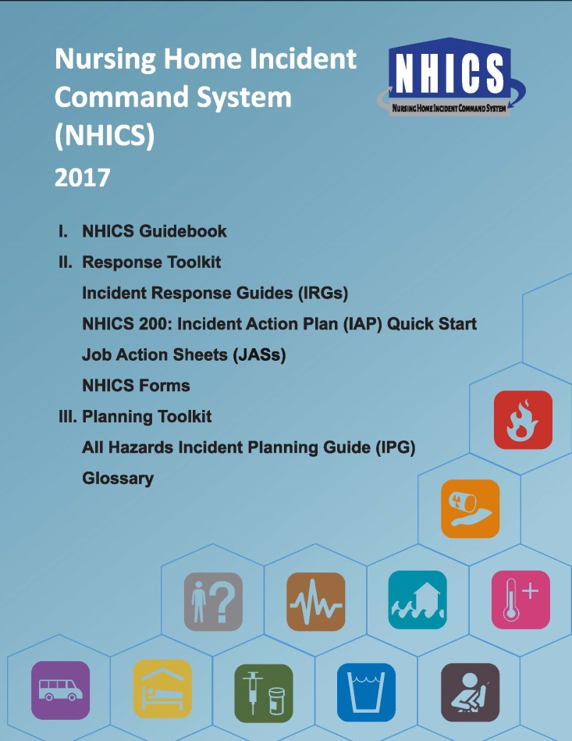
NHICS Sections
NHICS 2017 is divided into the following three Sections:
  NHICS Guidebook
  Response Toolkit
  Planning Toolkit
Notes:
NHICS Sections
NHICS 2017 is divided into the following three Sections:
NHICS Guidebook
Response Toolkit
Planning Toolkit
The Response Toolkit includes:
NHICS Forms,
Incident Response Guides, and
Job Action Sheets
The Planning Toolkit includes the All Hazards IPG and Glossary.

Slide 5
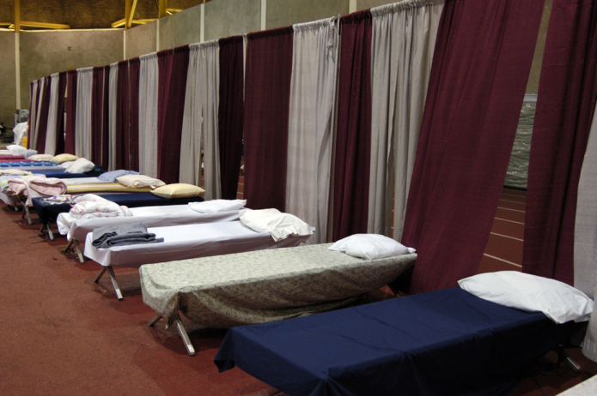
NHICS Guidebook
The purpose of the NHICS 2017 Guidebook is to provide the information necessary for nursing home administrators and staff to understand the principles of NHICS and embrace its implementation before it’s needed.
Notes:
NHICS Guidebook
The purpose of the NHICS Guidebook is to provide the information necessary for nursing home administrators and staff to understand the principles of NHICS and embrace its implementation before it’s needed. All staff should become familiar with NHICS.
Photo credit: Liz Roll - Sep 02, 2005 - Location: Baton Rouge, LA-- Cots at the field house at LSU await evacuees of Hurricane Katrina. This is a special needs shelter for those with disabilities, senior citizens, and people seeking medical attention. FEMA has a DMAT team here to aid with medical needs. New Orleans is being evacuated because of flooding caused by hurricane Katrina.

Slide 6
NHICS Guidebook...
The revised 2017 Guidebook makes it easier for nursing homes to implement NHICS by:
  Recognizing resource limitations and the need to prioritize resident care
  Providing a road map for accomplishing the most essential tasks
  Simplifying NHICS processes while maintaining essential standardization
Notes:
NHICS Guidebook…
The revised 2017 Guidebook makes it easier for nursing homes to implement NHICS by:
Recognizing resource limitations and the need to prioritize resident care
Providing a road map for accomplishing the most essential tasks
Simplifying NHICS processes while maintaining essential standardization

Slide 7
Major Changes in NHICS 2017
Streamlined the Incident Management Team (IMT)
  Reduced 20 positions to 11 positions
Rolled up position-level tasks from eliminated Branches and Units
Added a “Scribe/Runner” to the IMT
Notes:
Major Changes in NHICS 2017
Streamlined the Incident Management Team (IMT)
Reduced 20 positions to 11 positions
Rolled up position-level tasks from eliminated Branches and Units
Added a Scribe/Runner, who may be assigned to any section but is most commonly assigned to the Planning/Intelligence section

Slide 8
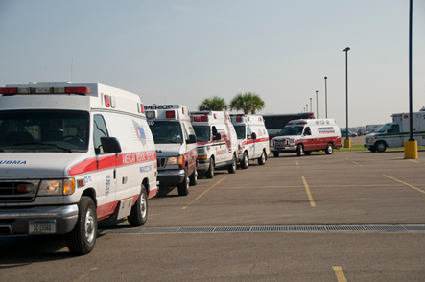
Major Changes in NHICS 2017…
Created 5 new Incident Response Guides (IRGs) including:
  Missing Resident
  Evacuation
  Shelter-in-Place
  Active Shooter
  Hazardous Material/Waste
Notes:
Major Changes in NHICS 2017…
Created 5 new Incident Response Guides (IRGs) including:
Missing Resident
Evacuation
Shelter-in-Place
Active Shooter
Hazardous Material/Waste
Photo credit: Photo by Patsy Lynch/FEMA Photo by Patsy Lynch - Aug 30, 2008 - Location: Beaumont, TX - Ambulances line up for assignments in Beaumont, Texas. These units transport patients with special medical needs out the area in advance of Hurricane Gustav's landfall.

Slide 9
Major Changes in NHICS 2017…
Changes for all Incident Response Guides (IRGs) include:
  Addition of a Rapid Response Checklist
  Tasks are directly assigned to IMT positions
  Security tasks that previously fell under the Operations Section’s Physical Plant/Security Unit Leader are now assigned to the Safety Officer
Notes:
Major Changes in NHICS 2017…
Changes for all Incident Response Guides (IRGs) include:
Addition of a Rapid Response Checklist
Tasks are directly assigned to IMT positions
Security tasks that previously fell under the Operations Section’s Physical Plant/Security Unit Leader are now assigned to the Safety Officer

Slide 10
Major Changes in NHICS 2017…
Major change to the Incident Planning Guides (IPGs):
  A single “All Hazards” Incident Planning Guide is available in NHICS 2017, reducing the redundancy that existed in multiple incident-specific IPGs.
Notes:
Major Changes in NHICS 2017…
Major change to the Incident Planning Guides (IPGs):
A single “All Hazards” Incident Planning Guide is available in NHICS 2017, reducing the redundancy that existed in multiple incident-specific IPGs.

Slide 11
Major Changes in NHICS 2017…
New NHICS 200: Incident Action Plan (IAP) Quick Start combines and simplifies the following five NHICS forms:
  201: Incident Briefing
  202: Incident Objectives
  203: Organization Assignment List
  204: Assignment List (for Sections)
  215A: Incident Action Plan Safety Analysis
Notes:
Major Changes in NHICS 2017…
A new NHICS 200: Incident Action Plan (IAP) – Quick Start (derived from FEMA’s ICS form) has been developed for NHICS. This Quick Start IAP combines and simplifies the following five NHICS forms:
NHICS 201 Incident Briefing
NHICS 202 Incident Objectives
NHICS 203 Organization Assignment List
NHICS 204 Assignment List (for Sections)
NHICS 215A Incident Action Plan Safety Analysis
The completed IAP should be copied and shared with all potential IMT staff so that all team members clearly understand the information most relevant to incident response.

Slide 12
Major Changes in NHICS 2017…
The following NHICS forms were eliminated:
  NHICS 213: Incident Message Form
  NHICS 256: Procurement Summary Report
The optional NHICS 204: Assignment List was added for Section use
Notes:
Major Changes in NHICS 2017…
The following NHICS forms were eliminated:
NHICS 213: Incident Message Form
NHICS 256: Procurement Summary Report
The optional NHICS 204: Assignment List was added for Section use, if useful for your facility.
The NHICS 204 may be used to document Section objectives, strategies and staff assignments for the Operational Period. An abbreviate version of the NHICS 204 is also included in the Incident Action Plan (IAP) Quick Start.

Slide 13
Incident Management Team
INCIDENT COMMANDER
SCRIBE/RUNNER
LIAISON/PUBLIC INFORMATION OFFICER
* The Scribe/Runner may be assigned to work for any IMT position
SAFETY OFFICER
MEDICAL DIRECTOR/SPECIALIST
OPERATIONS SECTION CHIEF
PLANNING SECTION CHIEF
LOGISTICS SECTION
CHIEF
FINANCE/
ADMINISTRATION SECTION CHIEF
RESIDENT SERVICES BRANCH DIRECTOR
INFRASTRUCTURE BRANCH DIRECTOR
Notes:
Incident Management Team
This Incident Management Team (IMT) chart in NHICS 2017 is customizable and available in PDF, Word and Visio format. Keep in mind that any activation may have all or one of the IMT positions activated. The size of the IMT is based on the size and complexity of the incident and its impact on your facility. The IMT chart is available for full editing in Visio Format.
The Scribe/Runner position is a new addition and may be assigned to work for any IMT position.

Slide 14
NHICS Functions
The 5 NHICS Functions include:
  Incident Command (“Leader”)
  Operations (“Doers”)
  Planning (“Planners”)
  Logistics (“Getters”)
  Finance and Administration (“Supporters”)
Notes:
NHICS Functions
The five NHICS Functions include Incident Command, Operations, Planning, Logistics, and Finance and Administration.
For a small incident, the activities of all NHICS sections may be managed effectively by one person, the Incident Commander. For larger incidents, more people are almost certainly needed. NHICS is very specific on how the NHICS organizational structure grows as incidents become larger and more complex.

Slide 15
Essential Responsibilities of NHICS Functions
NHICS FUNCTIONS | ESSENTIAL RESPONSIBILITIES
Incident Command | Lead/Manage
Operations | Do Stuff
Planning | Collect Information, Analyze and Plan
Logistics | Get Stuff
Finance and Administration | Finance, Administration and Clerical Support
Notes:
Essential Responsibilities of NHICS Functions
NHICS Functions and the corresponding Essential Responsibilities are:
Incident Command = Lead/Manage
Operations = Do Stuff
Planning = Collect Information, Analyze and Plan
Logistics = Get Stuff
Finance and Administration = Finance, Administration and Clerical Support

Slide 16


Incident Commander
The “Leader”:
  Activates and directs the response
  Establishes priorities and objectives
  Determines the size of the Incident Management Team (IMT) and assigns roles
  Coordinates with other response partners
    EMS, fire, law enforcement, public health
Notes:
Incident Commander
The Incident Commander is the only position that is always activated in response to an incident. The Incident Commander activates and directs the response by establishing command objectives that direct the response. In many cases, the Incident Commander may be the only position that is activated. A critical responsibility of the Incident Commander is the decision to evacuate the facility. Based on the incident hazard that prompts evacuation, this can be a difficult decision and is based on overall situational information, the projected impact, the threat to life and property, and the capability for safe evacuation.
The Incident Commander is responsible for the following:
Establishes the use of NHICS to manage the incident
Establishes the initial objectives for managing the incident
Identifies the supporting NHICS staff necessary to respond to the incident (also known as incident “size up”)
Recruits assistance as needed, i.e., fills other IMT positions
Keeps senior administration informed
Coordinates with other response partners as necessary, e.g., EMS, fire, law enforcement, public health
There are three additional members of the Command Staff that report to the Incident Commander. These functions must always be addressed regardless of how many people have been activated for the IMT; although in a small incident, the Incident Commander may be able to handle these responsibilities.
Photo courtesy of Cal OES. Icon Credit: OHCA

Slide 17
Command Staff
As needed, the Incident Commander may appoint:
  Liaison/Public Information Officer (PIO)
  Safety Officer
  Medical Director/Specialist
This group is collectively called “Command Staff”
INCIDENT COMMANDER
LIAISON/PUBLIC INFORMATION OFFICER
SAFETY OFFICER
MEDICAL DIRECTOR/SPECIALIST
Notes:
Command Staff
As needed, the Incident Commander may appoint a Liaison/Public Information Officer (PIO), Safety Officer and/or Medical Director/Specialist, to support the response. This group is collectively called the “Command Staff” (vs. the “General Staff” that will be discussed shortly. The Command Staff follow the direction of the Incident Commander.
The roles and responsibilities of all Command Staff are filled by the Incident Commander if these IMT positions are not filled. For example, if a Liaison/PIO is not activated, these duties fall to the Incident Commander.

Slide 18
Liaison/Public Information Officer
The Liaison/PIO:
  Communicates with external partners
  Provides information to residents, staff and family/guardians
  Develops public information/messages
INCIDENT COMMANDER
LIAISON/PUBLIC INFORMATION OFFICER
SAFETY OFFICER
MEDICAL DIRECTOR/SPECIALIST
Notes:
Liaison/Public Information Officer
The Liaison/Public Information Officer is a member of the Command Staff which serves as the communication link between the nursing home and external partners. This position provides information to external response agencies such as public health authorities, emergency management officials, law enforcement and other agencies that have been identified by the facility as key community partners. This position also communicates with the media.
Icon credit: OCHA

Slide 19
Safety Officer
The Safety Officer:
  Ensures the safety of residents, staff, and family/guardians
  Identifies risks to the facility
  Advises IMT Staff about any unsafe condition and recommends corrective action
INCIDENT COMMANDER
LIAISON/PUBLIC INFORMATION OFFICER
SAFETY OFFICER
MEDICAL DIRECTOR/SPECIALIST
Notes:
Safety Officer
The Safety Officer is responsible for the overall safety of the response actions, including modifying or suspending operations if conditions are unsafe to continue. For example, a nursing home may be forced to evacuate all or part of the facility due to an earthquake. The Safety Officer should evaluate the site to which residents are relocated to ensure the location is free of hazards or risk.

Slide 20
Medical Director/Specialist
The Medical Director/Specialist:
  Oversees medical services
  Assists with the medical management of residents and injured staff
  Advises the Incident Commander and staff regarding medical, biological/infectious, ethics, or hazmat implications due to the incident
INCIDENT COMMANDER
LIAISON/PUBLIC INFORMATION OFFICER
SAFETY OFFICER
MEDICAL DIRECTOR/SPECIALIST
Notes:
Medical Director/Specialist
The Medical Director/Specialist is the person with specific expertise in clinical areas such as infectious disease, trauma management, and medical ethics who may be asked to provide the Command staff with needed advice and coordination assistance. This role may be filled by persons outside of the facility but ideally will be filled by the facility’s Medical Director/Specialist who has familiarity with the resident population and the disaster plan for the facility.
The Medical Director/Specialist reports to the Incident Commander; however, during an emergency, this specialist may work directly with operations personnel providing advice or guidance in the response activities

Slide 21
General Staff
General Staff include the:
  Operations Section Chief
  Planning Section Chief
  Logistics Section Chief
  Finance and Administration Section Chief
OPERATIONS SECTION CHIEF
PLANNING SECTION CHIEF
LOGISTICS SECTION
CHIEF
FINANCE/
ADMINISTRATION SECTION CHIEF
Notes:
General Staff
We have previously discussed the Command Staff. Now we proceed to the General Staff, which include the:
Operations Section Chief
Planning Section Chief
Logistics Section Chief
Finance and Administration Section Chief
Incident Management Team (IMT) members are assigned by the Incident Commander. Keep in mind that the Incident Commander fulfills the roles and responsibilities of all of these Sections until he/she appoints a Chief for a specific Section. In a small incident, the Incident Commander may be able to satisfactorily handle all of the required activities. But if the incident grows larger, the Incident Commander should quickly recognize the need to activate Section Chiefs as warranted. Quick decision-making ability is necessary for any appointed Incident Commander.

Slide 22
Operations
The “Doers”:
  Coordinate tactical activities and implement actions consistent with the objectives identified by the Incident Commander
OPERATIONS SECTION CHIEF
PLANNING SECTION CHIEF
LOGISTICS SECTION
CHIEF
FINANCE/
ADMINISTRATION SECTION CHIEF
RESIDENT SERVICES BRANCH DIRECTOR
INFRASTRUCTURE BRANCH DIRECTOR
Notes:
Operations
The Operations Section coordinates all tactical activities. Under the direction of an Operations Section Chief, these people implement actions that are consistent with the objectives initially identified by the Incident Commander and further identified in the Incident Action Plan (IAP).
The oversight of the Operations Section is provided by an Operations Section Chief.
The Operations Section Chief oversees all tactical operations carried out within the response. He/she will activate the additional positions based on the needs of the event, as well as the availability of qualified personnel to fill the positions.
Additional positions, if necessary, may include a Resident Services Branch Director and an Infrastructure Branch Director.
Remember that if a position is needed but there is insufficient staffing to fill that position, the functions associated with that position are assumed by the highest position activated in that Section.

Slide 23
Resident Services Branch
Functions managed by the Resident Services Branch under Operations:
  Admission/Transfer and Discharge
  Nursing
  Medical Records
  Psychosocial
OPERATIONS SECTION CHIEF
RESIDENT SERVICES BRANCH DIRECTOR
INFRASTRUCTURE BRANCH DIRECTOR
Notes:
Resident Services Branch
The following functions are managed within the Resident Services Branch:
Admit/Transfer and Discharge
Nursing
Medical Records
Psychosocial
The Resident Services Branch Director is responsible for the continuation of resident services as well as the provision of care to residents, staff and visitors who are injured or become ill due to the incident. Responsibilities include ensuring that residents are accounted for and tracked; ensuring the continuation of resident services, e.g., rehabilitation and vocational services provided by the facility; medical records; and that services needed to sustain operations are identified and provided.

Slide 24
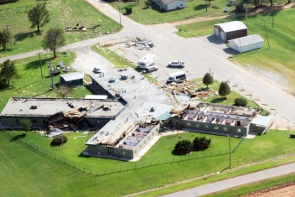
Infrastructure Branch
Functions managed by the Infrastructure Branch under Operations:
  Dietary
  Physical Plant
  Environmental
OPERATIONS SECTION CHIEF
RESIDENT SERVICES BRANCH DIRECTOR
INFRASTRUCTURE BRANCH DIRECTOR
Notes:
Infrastructure Branch
The following functions are managed within Infrastructure Branch:
Dietary
Physical Plant
Environmental
The Infrastructure Branch Director is responsible for the continuation of those services that support the care provided by the facility including dietary, housekeeping, power, lighting, water, sewage, and other essential services. The Infrastructure Branch Director may also be required to assess the structural soundness of the facility in the event of possible damage to the building such as from an earthquake, tornado, or fire, and then advise the Operations Section Chief on the capacity of the structure to sustain occupancy.
Photo Credit: Patricia Brach/FEMA - Aug 19, 2007 - Caddo County, Okla., August 20, 2007 -- This nursing home was damaged by high winds from Tropical Storm Erin. Fortunately there were no fatalities. FEMA and the state conducted joint aerial preliminary damage assessments immediately following the severe weather to determine the extent of the damages and the impact on the state.

Slide 25

Planning
The “Planners”:
  Collect and report status information
  Prepare the Incident Action Plan (IAP) and other necessary forms and reports
  Support incident objectives established by the Incident Commander
OPERATIONS SECTION CHIEF
PLANNING SECTION CHIEF
LOGISTICS SECTION
CHIEF
FINANCE/
ADMINISTRATION SECTION CHIEF
Notes:
Planning
The “Planners”:
Collect and report status information
Prepare the Incident Action Plan (IAP) and other necessary forms and reports
Support incident objectives established by the Incident Commander
The Planning Section (also known as Planning and Intelligence) is overseen by the Planning Section Chief and is responsible for collecting and analyzing relevant situational information, creating plans that support the success of the NHICS process, and maintaining documents or displays that show the current status of relevant resources (e.g., what resources such as staff, heaters, generators, etc.) are assigned where. The Planning Section provides up‐to‐date and accurate information regarding residents, staff, supplies and equipment and projects the ability to sustain operations.
An important duty assigned to the Planning Section is the development of the Incident Action Plan (IAP); the Planning Section also keeps careful track of personnel who report to the IMT (this process is called “Check In”).
The Planning Section will take the lead in coordinating documentation efforts by working with other members of the IMT to document the incident, typically using NHICS Forms. This section is also responsible for archiving the documents created during the response.
Icon credit: OCHA

Slide 26
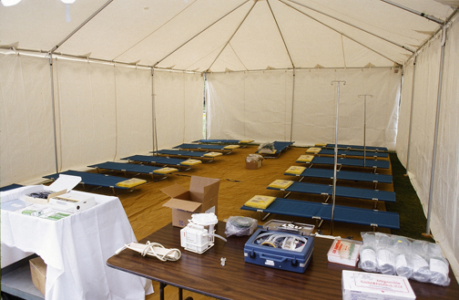
Logistics
The “Getters”:
  Acquire necessary staff, stuff and space
  Support IMT operations
  Ensure preservation of essential services and maintain facility supplies, equipment, transportation and labor pool
OPERATIONS SECTION CHIEF
PLANNING SECTION CHIEF
LOGISTICS SECTION
CHIEF
FINANCE/
ADMINISTRATION SECTION CHIEF
Notes:
Logistics
The “Getters”:
Acquire necessary staff, stuff and space
Support IMT operations
Ensure preservation of essential services and maintain facility supplies, equipment, transportation and labor pool
Logistics basically obtains “staff, stuff and space” to support the ability of the IMT to perform its duties and respond to the incident.
This section’s responsibilities include obtaining personnel/manpower, supplies, equipment, pharmaceuticals, and vehicles. The Logistics Section works closely with the Operations Section, responding to supply requests and their acquisition based on the needs of the response. During pre‐event planning, a staging area (or areas) should be established and identified in the Emergency Operations Plan (EOP). The staging area will be a central location, large enough to allow for the collection of personnel, vehicles, and equipment/supplies that may be needed for the response. The Logistics Section Chief provides oversight and direction at the staging area(s), maintaining an inventory of those supplies.
Logistics ensures the preservation of essential services including communications and information technology. Logistics organizes and maintains the facility’s supplies, equipment, transportation and labor pool in support of the residents, staff, and staff dependents in accordance with facility policies. It must account for the resources used and requested for operations.
Photo courtesy of Cal OES.

Slide 27

Finance and Administration
The “Supporters”:
  Track response costs and expenditures
  Purchase supplies and equipment
  Maintain detailed records
  Prepare payroll
  Perform clerical tasks
OPERATIONS SECTION CHIEF
PLANNING SECTION CHIEF
LOGISTICS SECTION
CHIEF
FINANCE/
ADMINISTRATION SECTION CHIEF
Notes:
Finance and Administration
The “Supporters”:
Track response costs and expenditures
Purchase supplies and equipment
Maintain detailed records
Prepare payroll
Perform clerical tasks
The Finance and Administrative Section may lack glamour but it is vitally important to incident response. It is responsible for all purchasing related to the management of the incident; in addition to tracking and reporting all financial and administrative information, including records management, payroll, and the overall incident budget. Long after the Operations, Planning and Logistics Sections have demobilized, the Finance and Administration Section is still sorting out paperwork, bills due, payroll issues, and tallying response costs. In some cases, it may be possible for private entities to recoup some of their disaster-related response costs, although detailed record keeping is an absolute requirement.
Photo Credit: Photo by Larry Lerner/FEMA New Photo - Oct 22, 2001 - New York, N.Y., Finance Specialist Olga Ramos works the numbers in the DFO's Comptroller section.

Slide 28
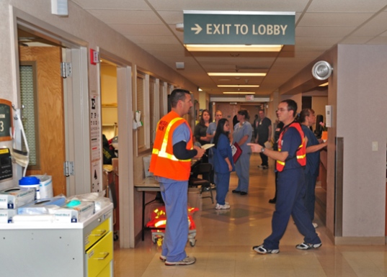
NHICS Flexibility and IMT Size
The size of the IMT is influenced by certain factors including the:
  Type of incident
  Magnitude of impact to your facility
  Span of control
    No IMT member should supervise more than 3 to 7 people (average is 5)
Notes:
NHICS Flexibility and IMT Size
Regarding flexibility, emergencies/disasters come in all shapes and sizes. Consider the need to fully evacuate your facility. A critical factor is whether the evacuation must occur as quickly as possible (emergent evacuation) or could be planned and executed over a more extended time period, e.g., 2-3 days (planned evacuation). Either situation is highly unusual and could be considered an emergency (under the assumption that your facility is the only one impacted) or even a larger, community-wide disaster (under the assumption that a number of healthcare facilities in an affected area must evacuate simultaneously, placing considerable stress on the EMS transport system and the location of destination facilities).
The type of incident, magnitude of impact to your facility or the larger community and many other factors will dictate the size of the Incident Management Team (IMT). A determining factor is called “span-of-control”, i.e., the number of people that can effectively manage the incident is determined by the size and complexity of the incident; no person should manage more people than he or she can do so effectively. In NHICS, the range for span-of-control is 3 to 7 people, but typically no more than 5. If activities cannot easily be managed by the existing IMT, it’s time to expand the IMT. Remember that the entire IMT may be a single person – the Incident Commander, assuming this person can successfully complete all of the required activities to manage the incident. As soon as this is no longer the case, the IMT should be expanded.
Photo credit: Cal OES

Slide 29
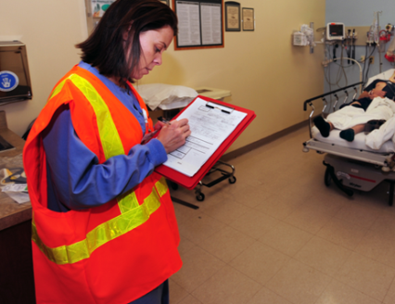
Incident Action Planning
The six essential steps of Incident Action Planning are:
  Understand the nursing home’s policies and direction
  Assess the situation
  Establish incident objectives
Notes:
Incident Action Planning
Incident Action Planning involves six essential steps:
1. Understand the nursing home’s policies and direction
The Command and General Staff must first understand the facility’s mission and policies in order to develop appropriate response actions. For example, the nursing home may be active in community medical disaster planning and have developed plans to provide first aid services during the emergency. This policy should be established in written policy and be clearly understood by the IMT as a component of an established response actions.
2. Assess the situation
Situational understanding is critical for developing effective response actions and projecting the likely duration of the incident. Nursing homes should have access to established mechanisms and systems within the community (city, county, regional, or state) that can provide and/or verify situational information. Another component of assessing the situation is determining the potential impact on the facility itself, based on current resident and employee status, the status of the building(s) and grounds, and the ability to maintain resident services.
3. Establish incident objectives
The Incident Commander sets the overall objectives for the response. Under all circumstances, ensuring the safety of the residents, staff and visitors should be considered the highest priority. The Incident Response Guides (IRGs) provide examples of objectives that apply to the response based on specific hazards. These IRGs may be helpful to the Incident Action Planning process.
Photo Courtesy of Cal OES.

Slide 30
Incident Action Planning…
  Determine appropriate strategies to achieve objectives
  Give tactical direction and ensure that it is followed
  Provide necessary back-up when tactical direction is initiated
Notes:
Incident Action Planning…
4. Determining appropriate strategies to achieve the objectives
After the Incident Commander has established the overall objectives for the response, the Section Chiefs determine the appropriate strategies and actions to effectuate the response within their Sections. This provides an action plan for each section that clearly identifies actions and duties. Section objectives should be developed that provide clear direction in terms of what is to be done. For example, assessing the building for structural damage after an earthquake is a clear and easily understood objective.
5. Giving tactical direction and ensuring that it is followed
Tactical directions provide the responders with the actions to be taken and identify the resources needed to complete the task. For example, assessing the facility after an earthquake will require the necessary tools such as protective equipment, checklists to document the assessment, etc. Actions undertaken should be assessed for their effectiveness, with the objectives and directions adapted if they are unsuccessful.
6. Providing necessary back‐up
When tactical direction is initiated, support may be needed to meet the objectives. This may include revising the actions taken and the assignment of additional resources (personnel, supplies and equipment).

Slide 31
Management by Objectives
The Incident Commander sets the overall objectives for response and recovery
  Once the Incident Commander has established the overall objectives, the IMT staff will develop strategies for each section
  As the response evolves, needs and priorities may change, leading to revisions of the objectives and strategies
Notes:
Management by Objectives
The Incident Commander sets the overall objectives for response and recovery
Once the Incident Commander has established the overall objectives, the IMT will develop strategies for each section
As the response evolves, needs and priorities may change, leading to revisions of the objectives and strategies

Slide 32
Incident Action Planning…
Action | Who | What | Example
Establish INCIDENT OBJECTIVES¹ | Incident Commander | The major priorities for incident response (include in Incident Action Plan) | Ensure the safety of residents, staff and visitors
Establish STRATEGIES² to meet the Objectives | Section Chiefs | The major approaches that will be under taken by each section to achieve the incident objectives established by the Incident Commander and contained in the Incident Action Plan (IAP) | Assess the building for structural damage due to the earthquake
Decide on and implement TACTICS³ to meet the Objectives | Section Chiefs | The specific actions that will be under taken by each section to achieve the objectives established in the Incident Action Plan (IAP) | Equip the assessment team with appropriate protective gear and tools to conduct assessments.
Notes:
This slide provides an example of an Incident Objective; Strategy to achieve the Incident Objective; and specific TACTIC (action) that implements the strategy. The end result of this IAP process is that the objective is accomplished. It may be necessary to modify Objectives, Strategies and Tactics upon re-assessment.

Slide 33



Nursing Home Command Center
The Nursing Home Command Center (NHCC) is the location where IMT staff work during an incident. It should be:
  Safe and secure
  Equipped with adequate technology
  Easily accessible to bathrooms and food
Notes:
Nursing Home Command Center
The Nursing Home Command Center (NHCC) is the location where IMT staff work during an incident. It should be:
Safe and secure
Equipped with adequate technology
Easily accessible to bathrooms and food
Icon Credit: OCHA

Slide 34
Nursing Home Command Center…
The NHCC should have access to:
  Basic office supplies
  NHICS documentation (electronic & hard copy)
  Facility maps & floor plans
    Location of fire extinguishers, utility shut-offs, AEDs, etc.
  Facility Emergency Operations Plan (EOP), including all emergency procedures
  Whiteboard for current status information
  Emergency Resource Directory that includes important information, e.g., contact information for staff, suppliers, community response agencies, etc.
Notes:
Nursing Home Command Center…
The NHCC should have basic offices supplies like pencils, paper, pens, notepads, etc. It should also have back-up copies of all disaster forms (NHICS forms and other facility-specific documentation). For example, your facility may have its own paper timesheet which may be used in lieu of the NHICS 252: Section Personnel Time Sheet. The electronic files should also be backed up on an external hard drive or flash drive for portable use in the event the NHCC is in accessible.
Facility maps and floor plans that document the location of fire extinguishers, fire detection equipment, emergency exits, utility shut offs, AEDs, etc., should be readily available. This information may be requested by first responders.
Copies of all plans (EOP, Continuity Plan, etc.) and emergency procedures should also be accessible.
A whiteboard can also be used to post current status information and be updated regularly to keep staff informed.

Slide 35

Nursing Home Command Center…
Organizational tips include:
  Keep files and supplies organized
  Easy to locate documentation
    Electronic and paper copies of NHICS forms
  Utilize color coding for incident-specific response documents
  Customize documentation to your facility
Notes:
Nursing Home Command Center…
Organizational tips include:
Keep files and supplies organized
Easy to locate documentation
Electronic and paper copies of NHICS forms
Utilize color coding for incident-specific response documents
Customize documentation to your facility
Being organized in advance of an emergency can make all the difference in reducing stress and confusion. Instead of hunting for the Earthquake IRG, you know exactly where it is (for example) in a color-coded folder.
Develop, train and practice using a system that works well for your facility.

Slide 36
Knowledge Check - Question 1
The Safety Officer does all of the following except:
  Attend briefings to share facility safety requirements and recommendations
  Coordinate facility security
  Brief the media on administration-approved information
  Evaluate incident hazards and identify vulnerabilities
Notes:
Knowledge Check – Question 1
The Answer is C. The Safety Officer does not brief the media; this role would more typically assigned to the Liaison/Public Information Officer (PIO).

Slide 37
Knowledge Check - Question 2
When organizing the IMT to respond to an emergency, the least important consideration at the onset of activation is the:
  Type of incident
  Magnitude of impact to your facility
  How much food you have stockpiled
  Maintaining span of control
Notes:
Knowledge Check – Question 2
The answer is C. You should not consider the IMT size based on how much food you have stockpiled. You should always have enough food to sustain the largest activation.

Slide 38
Knowledge Check - Question 3
When is it appropriate to revise the incident objectives?
  Hourly
  Weekly
  You only need to create objectives once, they don’t really change during a long activation
  As the emergency evolves and priorities change
Notes:
Knowledge Check – Question 3
The correct answer is D -- As the emergency evolves and priorities change. A facility could potentially change its objectives as any time. Consider an unexpected pipe bursting and flooding an area with residents. Priorities would shift to evacuate the area immediately.

Slide 39
Knowledge Check - Question 4
Which of the following IMT personnel are not part of the General Staff:
  Liaison/Public Information Officer (PIO)
  Finance and Administration Section Chief
  Logistics Section Chief
  Planning Section Chief
Notes:
Knowledge Check – Question 4
The correct answer is A. The Liaison/PIO is a member of the Command Staff.

Slide 40
Summary
In Module 2, you learned about the:
  Purpose of the NHICS Guidebook
  Major changes to NHICS 2017
  Primary NHICS Functions
  Incident Action Planning
  Value of a well organized Nursing Home Command Center
LINKS TO ADDITIONAL INFORMATION:
NHICS Guidebook and Toolkits: http://www.cahfdisasterprep.com/NHICS/GuidebookTools.aspx
Notes:
Summary
In Module 2, you learned about the:
Major changes in NHICS 2017
Purpose of the NHICS Guidebook
Primary NHICS functions
Incident Action Planning
The value of a well organized NHCC
This concludes NHICS Training Module 2: NHICS Guidebook.

