Slide 1
MODULE 3: Response Toolkit
Notes:
MODULE 3
Module 3 covers the Response Toolkit.

Slide 2
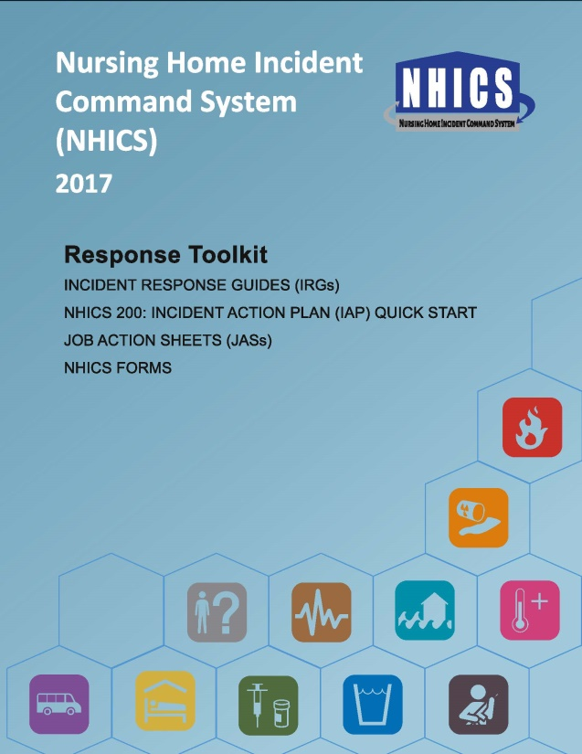
Objectives - Module 3
Become familiar with the NHICS Response Toolkit including:
Job Action Sheets (JASs)
Incident Response Guides (IRGs)
Incident Action Plan (IAP)
Quick Start
NHICS Forms
Notes:
Objectives -- Module 3
In Module 3 you will become familiar with the NHICS Response Toolkit including:
Job Action Sheets which provide activities and tasks for IMT roles
Incident Response Guides (IRGs) which are designed to guide response from the initial mobilization through recovery for specific types of incidents
Incident Action Plan (IAP) Quick Start which can be used for response and documentation of the incident
NHICS Forms that may be useful to your facility in organizing your response.

Slide 3
Job Action Sheets
Job Actions Sheets (JASs) provide IMT staff with position-specific responsibilities
They should be reviewed:
In the planning phase (prior to activation)
Immediately upon receiving an IMT assignment, i.e., at the onset of activation to ensure all tasks and activities are considered and acted on if necessary
Notes:
Job Action Sheets
Job Action Sheets provide IMT staff with position-specific responsibilities. JASs should be reviewed in the planning phase (prior to activation) and immediately upon receiving an IMT assignment, i.e., at the onset of activation, to ensure all tasks and activities are considered and performed if necessary.

Slide 4
Job Action Sheets…
Tasks in the Job Action Sheets are grouped according to time periods:
Immediate Response (0–2 hours)
Intermediate Response (2–12 hours)
Extended Response and System Recovery (greater than 12 hours)
The structure of the JASs mirror the organization of the Incident Response Guides (IRGs)
Notes:
Job Action Sheets…
All JASs are grouped according to time periods:
Immediate Response (0–2 hours)
Intermediate Response (2–12 hours)
Extended Response and System Recovery (greater than 12 hours)
The structure of the JASs mirror the organization of the Incident Response Guides (IRGs).

Slide 5
Job Action Sheets…
The JAS for each IMT position is sub-divided into:
Activities to be completed
Required Documentation to be filled out
Resources that may be needed
Important Communication
Notes:
Job Action Sheets…
For each level of response, JASs for every IMT position are sub-divided into:
Activities to be completed by the activated position
Required Documentation to be filled out which includes NHICS Forms (Activity Log and/or Timesheet, etc.)
Resources that may be needed (e.g., Communication Plan)
Important Communication considerations such as who the IMT member should communicate with on certain issues (e.g., safety concerns should be brought to the attention of the Safety Officer)

Slide 6
Job Action Sheets…
The Documents and Tools section at the end of each JAS includes a list of NHICS Forms most relevant to the position
Depending on the IMT position, the JAS indicates which NHICS Forms must be filled out (or whether the position should receive a copy of a completed NHICS Form)
Notes:
Job Action Sheets…
The Documents and Tools section at the end of each JAS includes the a list of relevant NHICS Forms.
Depending on the IMT position, the JAS indicates which NHICS Forms must be filled out (or whether the position should receive a copy of a completed NHICS Form)
As an example, the Incident Commander has a list of all of the forms because they are in charge and potentially the only person activated in the small activation while the Scribe/Runner has only gets copies and documents his/her activities on an Activity Log and time on a timesheet.

Slide 7
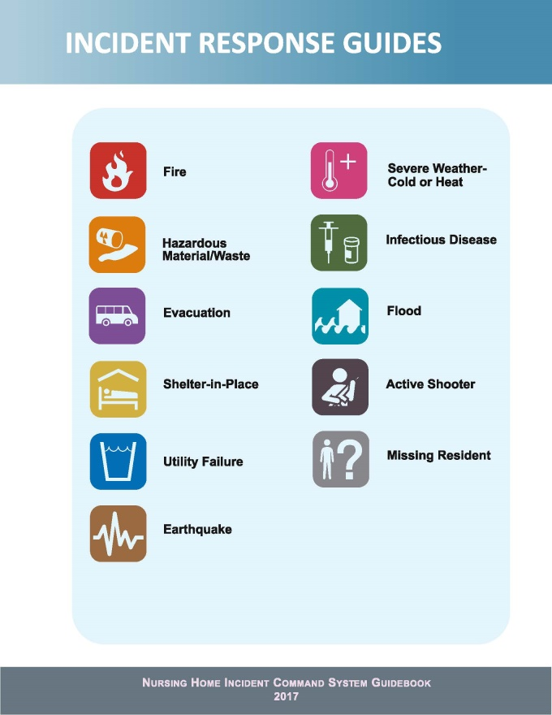
Incident Response Guides
Incident Response Guides (IRGs):
Indicate critical actions to be taken or considered
Are organized by IMT position
Include fields that allow the
IMT member to add his/her
initials when actions are
completed
Notes:
Incident Response Guides
Incident Response Guides (IRGs) :
Indicate critical actions to be taken or considered
Are organized by IMT position
Include fields that allow the IMT member to add his/her initials when actions are completed
The IRGs may be collected after an activation to assist in documentation of the incident.

Slide 8
Incident Response Guides…
Incident Response Guides (IRGs) are grouped according to time periods (similar to JASs):
Immediate Response (0–2 hours)
Intermediate Response (2–12 hours)
Extended Response and System Recovery (greater than 12 hours)
Notes:
Incident Response Guides…
Incident Response Guides (IRGs) are grouped according to time periods (similar to JASs):
Immediate Response (0–2 hours)
Intermediate Response (2–12 hours)
Extended Response and System Recovery (greater than 12 hours)

Slide 9

Incident Response Guides…
A Rapid Response Checklist is included at the beginning of each IRG which includes:
Critical tasks that happen in tandem with mobilization
Example: Evacuation to an alternate site
Notes:
Incident Response Guides…
A Rapid Response Checklist is included at the beginning of each IRG which includes:
Critical tasks that need to happen in tandem with mobilization.
Example: Evacuation to an alternate site
In the photo, residents of Asbury Tower wee evacuated during Hurricane Sandy to a newly constructed hotel. Rapid thinking, planning ahead and forecasting made this evacuation a success.
Photo credit: FEMA Photo by Steve Zumwalt, Asbury Park, N.J., Jan. 15, 2013 -- Mary Schmid and Henriette Katz relax during at Asbury Tower which was evacuated during Hurricane Sandy. FEMA helped the tower residents with housing nearby at a newly constructed Hampton Inn.

Slide 10
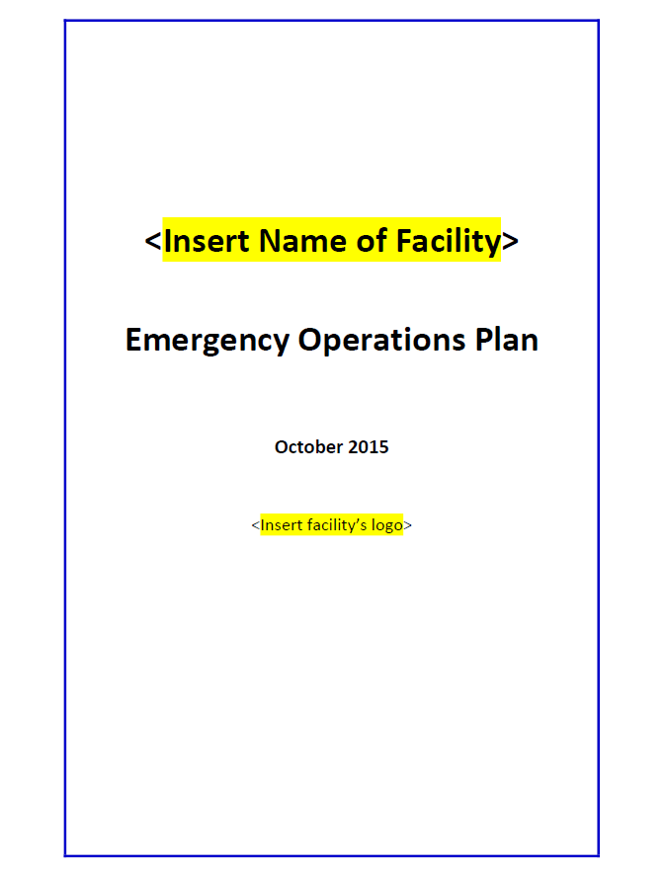
Incident Response Guides…
A Documents and Tools section is included in each IRG. Elements include:
Nursing Home Emergency Operations Plan
Business Continuity Plan
Security Procedures
Fatality Management Procedures
NHICS Forms
Job Action Sheets
Notes:
Incident Response Guides…
A Documents and Tools section is included in each IRG. Elements include:
Nursing Home Emergency Operations Plan (EOP)
Business Continuity Plan
Security Procedures
Fatality Management Procedures
NHICS Forms
Job Action Sheets
A comprehensive list of Documents and Tools is included at the end of each Incident Response Guide (IRG).

Slide 11
Incident Response Guides…
Other Documents and Tools include:
Nursing home organization chart
Campus floor plans, maps and evacuation routes
Television/radio/internet to monitor news
Telephone and cell phone
Satellite, amateur or 2-way radio
Notes:
Incident Response Guides…
Other Documents and Tools include:
Nursing home organization chart
Campus floor plans, maps and evacuation routes
Television/radio/internet to monitor news and collection situational awareness
Telephone/cell phone/satellite radio/internet/amateur radio/2-way radio

Slide 12
Incident Action Plan Quick Start
The new NHICS 200: Incident Action Plan (IAP) Quick Start is designed to:
Be used at the onset of an activation
Assist the Incident Commander by reducing the time spent filling out forms
May be the only form needed for smaller activations
Notes:
Incident Action Plan Quick Start
The Incident Action Plan (IAP) Quick Start (new NHICS 200) is designed to:
Be used at the onset of an activation
Assist the Incident Commander by reducing the time spent filling out forms
May be the only form needed for smaller activations
The IAP Quick Start may be used to document the initial situation, objectives, weather implications, IMT organization, resources required, strategies/tactics, health and safety information for the activation.

Slide 13
NHICS Forms
NHICS 2017 provides 19 NHICS Forms:
Use only the forms you need
Use throughout the life of an activation
OK to customize if necessary but retain the form number and name for standardization
Notes:
NHICS Forms
NHICS 2017 provides 19 NHICS Forms :
Use only the forms you need
Use throughout the life of an activation
OK to customize if necessary but retain the form number and name for standardization

Slide 14
Note on the NHICS 258
In the planning stage (before an emergency occurs) your team should ensure completion and maintenance of the NHICS 258 Facility Resource Directory. It documents all of the entities your facility may need services from during a disaster, including
Utilities
Hospitals
Medical Supply Companies
Notes:
Note on the NHICS 258
In the planning stage your team should ensure completion and maintenance of the NHICS 258 Facility Resource Directory that documents all of the entities your facility may need services from during a disaster, including
Utilities
Hospitals
Medical Supply Companies
Other entities include:
Transportation providers
Fuel distributors
Health department
Fire department
Contractors
Sister facilities
Law enforcement
Licensing and certification district office
Media
Poison Control
Moving Company
Restoration Services

Slide 15
NHICS Forms…
In NHICS 2017, for your convenience, electronic NHICS Forms are available as both:
Fillable Adobe PDF
Fillable Microsoft Word
Any format can be printed and filled out by hand
A customizable IMT chart is included in Visio format for editing
Notes:
NHICS Forms…
In NHICS 2017, electronic NHICS Forms are available as both:
Fillable Adobe PDF
Fillable Microsoft Word
Any format can be printed and filled out by hand
A customizable IMT chart is included in Visio format for editing
NOTE: The Word-based forms may be customized by turning off document protection. To turn off document protection in Word: 1) Select the “Developer” tab, 2) Find the “Protect” group and Select “Restrict Editing”, and 3) Click the button for “Stop Protection”
Forms should always be printed in advance and stored in a safe location in case electronic versions are inaccessible due to an outage or computer issue.

Slide 16
NHICS Forms…
A new one-page Instruction Sheet is included at the end of each NHICS Form that describes:
The purpose of the form
Who completes it
Who it is routed to
Each form field in a summary table
Notes:
NHICS Forms…
A new one-page Instruction Sheet is included at the end of each NHICS Form that describes:
The purpose of the form
Who completes it
To whom it is routed
Each form field is provided in a summary table

Slide 17
NHICS Forms…
The advantages of using NHICS Forms include:
Clear, standardized documentation of response and recovery activities
Quality assurance tool
May assist in reviewing the response
May assist in financial recovery
Notes:
NHICS Forms…
The advantages of using NHICS Forms include:
Clear, standardized documentation of response and recovery activities
Quality assurance tool
May assist in reviewing the response
May assist in financial recovery

Slide 18
NHICS Forms…
NHICS 2017 | Completed by | Recommended or Optional | Purpose
200 Incident Action Plan (IAP) Quick Start | Incident Commander or Planning Section Chief | Recommended* | Provides a fast approach to developing the IAP by combing forms
201 Incident Briefing | Incident Commander or designee | Optional | Documents initial response actions
202 Incident Objectives | Planning Section Chief | Optional | Defines command objectives and key messages
203 Organization Assignment List | Planning Section Chief | Optional. IMT contact information | Documents the IMT positions
204 Assignment List | Planning Section Chief | Optional full form. Abbreviated in IAP Quick Start | Documents the strategies and tactics of an activated Section and resources required
205 Communications List | Logistics Section Chief | Optional full form. Abbreviated in IAP Quick Start | Documents communication technology and contacts.
* Forms highlighted in blue are recommended for every activation.
Notes:
NHICS Forms…
This summary table shows each NHICS Form, who completes it, its purpose and whether it is recommended or optional. Forms highlighted in blue are recommended.
The NHICS 200 Incident Action Plan (IAP) Quick Start is a recommended form which provides a fast approach to developing the IAP by combining forms (completed by Incident Commander or Planning Section Chief)
The NHICS 201 Incident Briefing an optional form which documents initial response actions (completed by Incident Commander or designee)
The NHICS 202 Incident Objectives is an optional form which defines command objectives and key messages (completed by Planning Section Chief)
The NHICS 203 Organization Assignment List is an optional form which documents the IMT positions and contact information for those positions (completed by Planning Section Chief)
The NHICS 204 is an optional form which documents the strategies and tactics of an activated Section and resources required (completed by Planning Section Chief)

Slide 19
NHICS Forms…
NHICS 2017 | Completed by | Recommended or Optional | Purpose
206 Staff Medical Plan | Safety Officer | Optional full form. Abbreviated in IAP Quick Start | Addresses the treatment plan for injured or ill staff members and/or volunteers
207 Incident Management Team Chart | Incident Commander or designee | Optional. Included in Quick Start IAP | Provides a visual display of the personnel assigned to the IMT positions
214 Activity Log | All IMT Personnel | Recommended* | Provides basic documentation of incident activity
215A Incident Action Plan (IAP) Safety Analysis | Safety Officer | Recommended full form. Abbreviated in IAP Quick Start | Records the findings of the Safety Officer after completing an operational risk assessment
251 Facility System Status Report | Infrastructure Branch Director | Recommended | Records the status of various critical facility systems and infrastructure
252 Section Personnel Time Sheet | All IMT Personnel | Recommended | Tracks hours worked during the response
* Forms highlighted in blue are recommended for every activation.
Notes:
NHICS Forms…
This summary table shows each NHICS form, who completes it, its purpose and whether it is recommended or optional.
The NHICS 206 Staff Medical Plan is an optional form which addresses the treatment plan for injured or ill staff members and/or volunteers (completed by Safety Officer)
The NHICS 207 Incident Management Team Chart is an optional form which provides a visual display of the personnel assigned to the IMT positions (completed by Incident Commander or designee)
The NHICS 214 Activity Log is recommended as it provides basic documentation of incident activity (completed by all IMT personnel)
The NHICS 215A Incident Action Plan (IAP) Safety Analysis is recommended as it records the findings of the Safety Officer after completing an operational risk assessment (completed by Safety Officer)
The NHICS 251 Facility System Status Report is a recommended form which records the status of various critical facility systems and infrastructure (completed by Infrastructure Branch Director)
The NHICS 252 Section Personnel Time Sheet is recommended to track hours worked during the response (completed by all IMT personnel)

Slide 20
NHICS Forms…
NHICS 2017 | Completed by | Recommended or Optional | Purpose
253 Volunteer Registration | Logistics Section Chief | Optional, may use own tracking system | Documents volunteer sign in and out for each operational period
254 Emergency Admit Tracking | Resident Services Branch Director | Recommended* | Records the triage, treatment and disposition of emergency admits
255 Master Resident Evacuation Tracking | Resident Services Branch Director | Recommended | Tracks all residents evacuated
257 Resource Accounting Record | All IMT Personnel; under Logistics Section Chief JAS | Optional, may use own tracking system | Documents the request, use, return, and condition of resources used to respond
258 Facility Resource Directory | Planning Section Chief | Recommended | Critical contact information for all facility resources
259 Facility Casualty Fatality Report | Resident Services Branch Director | Recommended | Documents injury or death of residents
260 Resident Evacuation Tracking | Resident Services Branch Director | Recommended | Documents individual evacuated residents
* Forms highlighted in blue are recommended for every activation.
Notes:
NHICS Forms…
This summary table shows each NHICS form, who completes it, its purpose and whether it is recommended or optional.
The NHICS 255 Volunteer Registration is an optional form used to document volunteer sign in and out for each operational period. Other tracking systems may be used instead (completed by Logistics Section Chief)
The NHICS 254 Emergency Admit Tracking is a recommended form which records the triage, treatment and disposition of emergency admits (completed by Resident Services Branch Director)
The NHICS 255 Master Resident Evacuation Tracking is recommended to track all residents evacuated (completed by Resident Services Branch Director)
The NHICS 257 Resource Accounting Record is an optional form which documents the request, use, return and condition of resources used to response (completed by all IMT Personnel under the Logistics Section Chief)
The NHICS 258 Facility Resource Directory is recommended for documenting critical contact information for all facility resources (completed by Planning Section Chief)
The NHICS 259 Facility Casualty Fatality Report is recommended to document injury or death of residents (completed by Resident Services Branch Director)
The NHICS 260 Resident Evacuation Tracking is recommended to document individual evacuated residents (completed by Resident Services Branch Director)

Slide 21
Knowledge Check - Question 1
The Scribe/Runner may be used in which of the following IMT sections:
Operations
Logistics
Planning
Finance/Administration
All of the Above
Notes:
Knowledge Check – Question 1
The answer is “E. All of the Above”. The Scribe/Runner may assigned anywhere on the IMT chart, including under the Command or General staff. They should be assigned by the Incident Commander based on need during the response.

Slide 22
Knowledge Check - Question 2
The NHICS 200: Incident Action Plan (IAP) Quick start can replace the:
NHICS 201
NHICS 202
NHICS 203
NHICS 204
NHICS 215A
All of the above
Notes:
Knowledge Check – Question 2
The Answer is F -- All of the above.

Slide 23
Knowledge Check - Question 3
Which of the following is not true regarding the proper use of NHICS Forms:
Use of NHICS Forms facilitates clear documentation of actions, times, and responsibilities
Use of NHICS Forms supports quality assurance
Filling out as many NHICS Forms as possible is preferable to filling out only those NHICS Forms that are needed
Use of NHICS Forms may assist in financial recovery
Notes:
Knowledge Check – Question 3
The answer is C. NHICS is flexible and the NHICS Forms completed should reflect the incident documentation needs.

Slide 24
Knowledge Check – Question 4
Which NHICS Form should be completed during the planning process?
NHICS 258 – Facility Resource Directory
NHICS 257 – Resource Accounting Record
NHICS 254 Emergency Admit Tracking
NHICS 241 – Facility Status Report
Notes:
Knowledge Check – Question 4
The correct answer is A. NHICS 258 – Facility Resource Directory. By so doing, this important information is readily available for an activation.

Slide 25
Summary
In Module 3, you became familiar with the NHICS Response Toolkit including:
Job Action Sheets (JASs)
Incident Response Guides (IRGs)
Incident Action Plan (IAP) Quick Start
NHICS Forms
LINKS TO ADDITIONAL INFORMATION:
NHICS Guidebook and Toolkits: http://www.cahfdisasterprep.com/NHICS/GuidebookTools.aspx
Notes:
Summary
This module you became familiar with the NHICS Response Toolkit including:
Job Action Sheets (JASs)
Incident Response Guides (IRGs)
Incident Action Plan (IAP) Quick Start
NHICS Forms
This concludes NHICS Training Module 3: Response Toolkit.

