Slide 1
MODULE 4: Implementing NHICS and the Planning Toolkit
Notes:
MODULE 4
Module 4 covers Implementing NHICS and the Planning Toolkit.

Slide 2
Objectives - Module 4
Familiarize yourself with the NHICS planning tools
Learn the 10 steps for implementing NHICS at your facility
Notes:
Objectives -- Module 4
In Module 4 you will become familiar with the NHICS planning tools and learn the 10 steps for implementing NHICS at your facility.

Slide 3
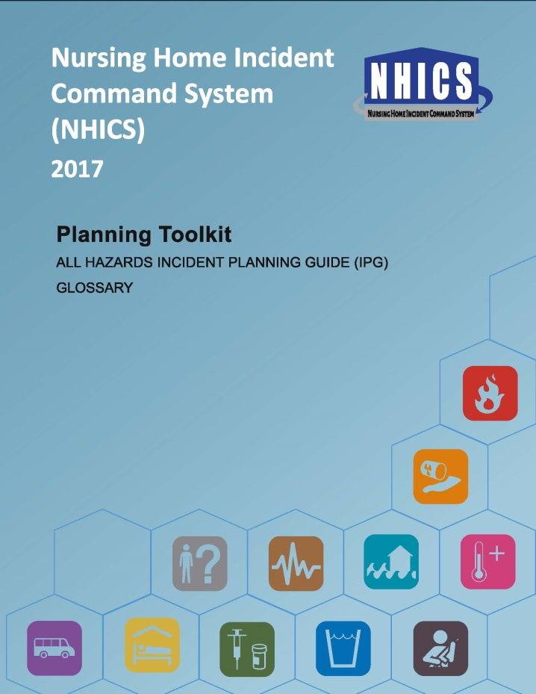
Planning Toolkit
The 2017 Planning Toolkit includes the:
Streamlined All Hazards Incident
Planning Guide (IPG)
Replaces incident-specific IPGs
NHICS Glossary
Notes:
Planning Toolkit
The 2017 Planning Toolkit includes the streamlined All Hazards Incident Planning Guide (IPG) which replaces incident-specific IPGs.
The Planning Toolkit also includes the NHICS Glossary.

Slide 4
All Hazards Incident Planning Guide (IPG)
The All Hazards IPG is:
Used for planning and discussion; are modifications necessary for your facility?
Organized by four phases of emergency management:
Mitigation
Preparedness
Immediate and Intermediate Response
Extended Response and System Recovery
Notes:
All Hazards Incident Planning Guide (IPG)
The All Hazards IPG is:
Used for planning and discussion. Determine if modifications are needed for your facility.
Organized by four phases of emergency management:
Mitigation
Preparedness
Immediate and Intermediate Response
Extended Response and System Recovery

Slide 5
All Hazards Incident Planning Guide (IPG)…
An “All Hazards” approach to emergency management calls for a nursing home to work toward:
Hazard prevention while at the same time preparing for the emergencies that may occur at any time without warning
May be customized to your facility’s needs
Notes:
All Hazards IPG
An “All Hazards” approach to emergency management calls for a nursing home to work toward:
Hazard prevention while at the same time preparing for the emergencies that may occur at any time without warning
May be customized to your facility’s needs

Slide 6
Glossary
The NHICS Glossary is:
A quick reference guide for key terms
Arranged alphabetically
Includes acronyms used in the NHICS Guidebook and Toolkit
Notes:
Glossary
The NHICS Glossary is:
A quick reference of key terms
Arranged alphabetically
Includes acronyms used in the NHICS Guidebook and Toolkit

Slide 7


NHICS Implementation
NHICS can be implemented in 10 basic steps
Notes:
NHICS Implementation
NHICS can be implemented in 10 basic steps!

Slide 8
Step 1 – Getting Started
Appoint a person to lead implementation
Convene a planning workgroup
Read the NHICS Guidebook
Review Toolkit materials
Complete NHICS training
Outline necessary activities
Establish the final approval process
Notes:
Step 1 – Getting Started
Appoint an appropriate person from your facility to lead implementation
Convene a planning workgroup
Read the NHICS Guidebook
Review Toolkit materials
Complete this NHICS training
Outline necessary activities, including training, drills and exercises
Establish the final approval process

Slide 9
Step 1 – Getting Started…
Set up a work schedule
Consider developing an implementation/ training program with other area nursing homes for standardization and mutual aid assistance
Invite public safety, public health, EMS and emergency management officials to participate as appropriate
Notes:
Step 1 – Getting Started…
Step 1 also includes setting up a work schedule. Consider developing an implementation/training program with other area nursing homes for standardization and mutual aid assistance. Working as a community can benefit your facility immensely when disaster strikes. It is also helpful to invite fire, EMS, emergency management and public health officials to participate as needed and appropriate. Establishing these relationships before disaster strikes has been shown to be extremely beneficial during the response phase.

Slide 10
Step 2 – Determine your IMT
Review the NHICS IMT chart
Determine who is appropriate for each role
Remember that a specific person may not be available when the emergency strikes
Ideally, select multiple persons for each position
Limit the number of times a specific person can be listed
Notes:
Step 2 – Determine your IMT
Review the NHICS IMT chart
Determine who is appropriate for each role
Remember that a specific person may not be available when the emergency strikes
Ideally, select multiple people for each position
Limit the number of times a specific person can be listed

Slide 11
Step 3 – Revise Job Action Sheets if necessary
JASs are available for each position on your IMT
Review each JAS to ensure consistency with your facility’s policies and procedures
Make changes as needed to each JAS, but try to limit changes to preserve standardization
Notes:
Step 3 – Revise the Job Action Sheets if necessary
Job Action Sheets (JASs) are available for each position on your IMT
Review each JAS to ensure consistency with your facility’s policies and procedures
Make changes as needed to each JAS, but try to limit changes to preserve standardization

Slide 12
Step 3 – Revise the Job Action Sheets…
Once any adjustments to the JASs are completed, immediately publish the final JASs:
Include in the Emergency Operations Plan (EOP)
Put JASs on computers that can be accessed in the Nursing Home Command Center and other key areas
Be sure that printed JASs are readily accessible in the Nursing Home Command Center in case computers become unavailable
Put JASs into pocket of the NHICS Command Vests
Notes:
Step 3 – Revise Job Action Sheets…
Once any adjustments to the JASs are completed, immediately publish the final JASs:
Include in the Emergency Operations Plan (EOP)
Put JASs on computers that can be accessed in the Nursing Home Command Center and other key areas
Be sure that printed JASs are readily accessible in the Nursing Home Command Center
Put JASs into pocket of the NHICS Command Vests

Slide 13
Step 4 – Review the NHICS Forms
Review the NHICS Forms:
Make limited changes if necessary (to maintain standardization)
Add additional forms you feel may be needed or easier to use based on your facility’s policies or procedures
Publish and share the final NHICS Forms
Notes:
Step 4 – Review the NHICS Forms
Review the NHICS forms and make limited changes if necessary (to maintain standardization). Add additional forms you feel may be needed or easier to use based on your facility's policies or procedures.
Publish and share the final NHICS Forms. They should be readily available at all times (keep in mind that many emergencies occur at night when fewer staff are on site).

Slide 14
Step 4 – Review the NHICS Forms…
Place final documents in the Nursing Home Command Center
Ensure easy access by all that may need access
Maintain electronic and hard copies
Keep forms current with periodic reviews
NHICS 258 Facility Resource Directory (update regularly in the planning stage)
Notes:
Step 4 – Review the NHICS Forms…
As a final step place final documents in the Nursing Home Command Center. Ensure easy access by all that will be using them. Update forms and complete periodic reviews based on your facility needs. Be sure the NHICS 258 Facility Resource Directory is up-to-date and readily available.

Slide 15
Step 5 – Review the IRGs and All Hazards IPG
Study the results of your Hazard Vulnerability Analysis (HVA)
Adjust the All Hazards IPG to meet your facility’s needs based on the HVA
Review the IRGs and modify if needed
Place revised materials where they can be easily accessed
Notes:
Step 5 - Review the IRGs and All Hazards IPG
Study the results of your Hazard Vulnerability Analysis (HVA)
Adjust the All Hazards IPG to meet your facility’s needs based on the HVA
Review the Incident Response Guides and modify if needed
Place revised materials where they can be easily accessed

Slide 16
Step 6 – Develop Activation Kits
Assemble Activation Kits for each IMT position including:
IMT Chart
Color-Coded Vest that indicates IMT role
JAS for the position(s)
NHICS Forms
Other tools – radio/directories/paper/pens
Place in a box or bag, in a secure location
Assess each Activation Kit periodically
Notes:
Step 6 - Develop Activation Kits
Assemble Activation Kits for each IMT position including:
IMT Chart
Color-Coded Vest that indicates IMT role
JAS for the position(s)
NHICS Forms
Other tools – radio/directories/paper/pens
Place in a box or bag, in a secure location
Assess each Activation Kit periodically

Slide 17
Step 7 – Identify the Nursing Home Command Center (NHCC)
Where key IMT staff work
Should be large enough to accommodate necessary personnel
Accessible/safe/secure
Sufficient space for the assigned personnel
Adequate access to computers, phones, NHICS material, etc.
Close to bathrooms and food
Notes:
Step 7 – Identify the Nursing Home Command Center
The Nursing Home Command Center (NHCC) is where key IMT staff work as an organized team. It should be large enough to accommodate personnel, accessible, safe from hazards and secure. It should also be close to restrooms and food.
The room should be large enough to accommodate necessary personnel
Accessible/safe/secure
Sufficient space for the assigned personnel
Adequate access to computers, phones, NHICS materials, etc.

Slide 18
Step 7 – Identify the Nursing Home Command Center (NHCC)…
Necessary technologies for the NHCC include:
Phones
Computers (with all NHICS Forms, etc., pre-loaded)
Radios/communications
Fax/printer
All technologies should be regularly tested
Arrange for maintenance during an incident
Notes:
Step 7 – Identify the Nursing Home Command Center (NHCC)…
Necessary technologies for the NHCC include:
Phones
Computers (with all NHICS Forms, etc., pre-loaded)
Radios/communications
Fax/printer
All technologies should be regularly tested
Arrange for maintenance during an incident; information technology and communication(s) are always a challenge.

Slide 19
Step 8 – Provide Training
Promote individual AND team training
Encourage and reward an understanding of NHICS concepts
Individual reading of materials
Discussions/Presentations/Exercises
Use the NHICS Guidebook and training modules
Notes:
Step 8 – Provide Training
Promote individual AND team training at your facility
Encourage and reward an understanding of NHICS concepts. It is useful to have staff individually read the materials coupled with group discussions/presentations/exercises.
Use the NHICS Guidebook and training modules

Slide 20
Step 9 – Conduct an Exercise
Select an Exercise Committee and Chairperson
Choose an incident from your Hazard Vulnerability Analysis (HVA)
Become familiar with the types of exercises and select the type you want
Establish the exercise objectives
LINK TO ADDITIONAL INFORMATION (Homeland Security Exercise and Evaluation Program):
https://www.fema.gov/media-library/assets/documents/32326
Notes:
Step 9 – Conduct an Exercise
Select an Exercise Committee and Chairperson
Choose an incident from your Hazard Vulnerability Analysis (HVA)
Select the type of exercise* you want (drill, tabletop, functional exercise -- or participate in a broad community exercise)
Establish the exercise objectives
* For more information on planning and executing exercises, see the Homeland Security Exercise and Evaluation Program (HSEEP) at https://www.fema.gov/media-library/assets/documents/32326

Slide 21
Step 9 – Conduct an Exercise…
Consider a disaster drill first (walk before you run)
Incorporate NHICS Forms
Develop an evaluation strategy
Conduct the drill/exercise
Conduct a Hot Wash
Write an After Action Report (AAR) and Improvement Plan
Notes:
Step 9 – Conduct an Exercise…
Consider a disaster drill first (walk before you run).
Incorporate NHICS Forms
Develop an evaluation strategy
Conduct the drill/exercise
Conduct a Hot Wash
Write an After Action Report (AAR) and Improvement Plan
Consider a more “advanced” exercise as you progress in your facility’s preparedness; such as an exercise that would include other area nursing homes and community response partners, e.g., EMS, emergency management agency, etc.

Slide 22
Step 10 – Make Needed Changes Based on “Lessons Learned”
Identify needed revisions to your facility’s EOP and/or NHICS materials
Ensure changes are made consistently across all materials
Discuss lessons learned and changes at meetings and training sessions; get the word out
Notes:
Step 10 – Make Needed Changes Based on “Lessons Learned”
Identify needed revisions to your facility’s EOP and/or NHICS materials
Ensure changes are made consistently across all materials
Discuss lessons learned and changes at meetings and training sessions; get the word out

Slide 23
Knowledge Check - Question 1
The Incident Planning Guide (IPG) is a response tool.
True
False
Notes:
Knowledge Check – Question 1
False: The IPG should be used when planning and training for disasters. The IPG should be discussed and familiarized prior to an emergency.

Slide 24
Knowledge Check - Question 2
When the Planning Team meets to discuss the facility’s response to an earthquake, they should consider that the initial earthquake may lead to additional cascading events, e.g., the need to evacuate the facility.
True
False
Notes:
Knowledge Check – Question 2
True. For example, an earthquake could lead to other disaster impacts such as utility outage, flooding or the need to evacuate residents from the facility.

Slide 25
Knowledge Check – Question 3
Before conducting an exercise, it is prudent to determine:
Who will serve on the exercise committee
The type of exercise, e.g., drill, facilitated discussion, table top exercise, etc.
What is the purpose of the exercise, i.e., what is being tested?
An evaluation strategy
All of the above
Notes:
Knowledge Check – Question 3
The correct answer is E. All of the above. Having an exercise committee to develop your facility exercise, determine the exercise type, what is being tested, and how it will be evaluated are critical to exercise success and identifying lessons learned and areas for improvement.

Slide 26
Summary
In Module 4, you learned about the:
The new All Hazards Incident Planning Guide
NHICS Glossary
The 10 steps for implementing NHICS
LINKS TO ADDITIONAL INFORMATION:
CAHF Disaster Preparedness Program: http://www.cahfdisasterprep.com/
CAHF Disaster Preparedness App: http://dpapp.cahf.org
NHICS Guidebook and Toolkits: http://www.cahfdisasterprep.com/NHICS/GuidebookTools.aspx
Notes:
Summary
In Module 4, you learned about the All Hazards Incident Planning Guide (IPG), NHICS Glossary and 10 steps for implementing NHICS.
This concludes NHICS Training Module 4: The Planning Toolkit and Implementing NHICS.

Slide 27
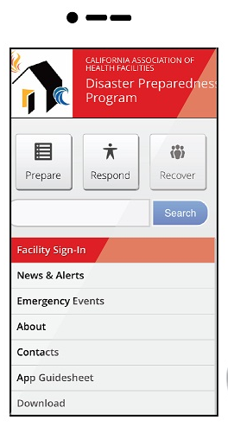
Disaster Preparedness App
Developed by CAHF for long-term care providers to easily:
Populate with general emergency information
Upload facility-specific information
Notes:
Disaster Preparedness App
A useful Disaster Preparedness Application has been developed by the California Association of Health Facilities - Disaster Preparedness Program (CAHF-DPP) for California's long term care providers. It is designed so that long term care providers have emergency information at their fingertips (via smart phone, tablet or computer) regardless of where they are.
The app is available here: http://dpapp.cahf.org and is populated with general emergency information applicable to all types of long term care facilities. It allows providers to upload facility-specific information (contact lists, floor plans, policies and procedures) that they may need in an emergency. The general emergency information on this app is accessible by event (earthquake, flood, fire, etc.) or by action being taken (prepare, respond or recover). The facility-specific information is accessible only to the facility through a secure platform that is password protected (selected by the facility).

Slide 28
Thank you!
By participating in this training and acquiring a working knowledge of your facility’s Emergency Operations Plan (EOP) and NHICS 2017 materials, you should be better prepared to protect yourself, your family, and the residents, staff and visitors at your facility who may be otherwise impacted by future emergencies.

Slide 29
Acknowledgements
This 2017 NHICS training was developed by the California Association of Health Facilities with support from the California Department of Public Health. Please visit the web site below for complete information on the new 2017 NHICS.
California Association of Health Facilities
Sacramento, CA
http://www.cahfdisasterprep.com/

