Slide 1


“Rest is best” initiative
Jasdeep Dhariwal – MBA, BPT, LNHA
2021

Slide 2
Rest is Best – Numbers ______________ Both Q4 2020 and Q1 2021 averaged 25 falls a month. 89% of resident were being woken up before 6 AM in April 2021.

Slide 3

Rest is Best –Goal
Decrease the number of falls by 25% from Q1 2021 by end of Q3 2021.

Slide 4
Rest is Best Interventions
Review activities to engage residents during the day.
Medication regimen reviews for all patients with falls in last 2 quarters to change medication times to daytime if possible.
Interview residents using PSQI.
Inspect mattresses.
Lighting after sunset, distribute night lights to staff.
Noise level at shift change and through out night.
Staff education on conscious effort to promote uninterrupted resident sleep.

Slide 5
What brought on this campaign? “rest is best”
1 of our units has 45 of 51 residents being woke up every night for medications, treatments etc.
Of the 45 residents being awakened at night, 28 of them have recent falls
Another of our units have 37 of 41 residents being woke up every night for medications, treatments, etc
Of the 37 residents being awakened at night, 17 of them have recent falls
More than 50% of the residents that were awakened by staff had a fall.

Slide 6
Interesting Facts ______________ STEADI & Protect sleep initiative
Sleep is crucial for all of us and important for the health of our residents
Lack of sleep in our residents contributes to falls/injuries
Lack of sleep in our residents contributes to memory impairment
Lack of sleep in our residents can contribute to mood changes & behaviors
Lack of sleep can contribute to changes in health such as weight loss, infections, changes in condition

Slide 7
What medications are we waking residents up for and why?
Synthroid, levothyroxine
PPI’s- protonix, nexium, ompeprozole
Insulin and blood glucose testing
Eye drops
Neurontin
Hypertension medications
Because we feel the medication pass needs to be “even” for all shifts
Failing to remember the need for rest

Slide 8
What can we do?
Change medication times to avoid waking residents up at night
Talk to residents about their sleep and the benefits of not being awakened
Talk to the Dr about medication changes
Staff EDUCATION ON THE CHANGES
Care planning patient preferences and education

Slide 9
Rest is Best _____________ Actions & Education
Over the next few months, you will see medication time changes. Remember this is our initiative to ensure rest for our residents, prevent falls/injuries and changes in condition.
If you note a medication being given during sleep hours- say something!
Changing medication times will need to be discussed with DON or Supervisor
Ensuring change of shift goes quickly to assist on coming shifts with changes
Educating residents on change in Med administration times and care planning refusals.
If we are waking residents up at night- speak up!

Slide 10
Medications that we may have to wake residents up for
Antibiotics- these medications are typically ordered to ensure that the resident’s infection is being addressed and often require around the clock administration
Pain Medications- these medications often are needed to ensure that residents have consistent pain management.
Respiratory Treatments- Nebulizer treatments and inhalers may require us to administer during sleep hours to prevent respiratory distress

Slide 11
Speaking to “rest is best” initiative when asked by surveyors, families, residents and others.
It is our goal that every resident experiences uninterrupted rest to enhance their quality of life, prevent falls/injuries, prevent changes in condition and cognitive changes. One of our core values is that “Patient Care is Our Top Priority. We feel that by ensuring that our residents get uninterrupted rest that we are contributing to their overall wellness and living our core values.

Slide 12
Rest is Best – Numbers ______________ Over 350 orders were changed in May 2021 to daytime. 10 residents declined med time change despite education.

Slide 13
Rest is Best Numbers ______________ QAPI process in place to ensure orders are reviewed for any NOC shift medications on monthly basis.

Slide 14
“rest is best” How to keep it going?
Continuous Staff education – Turnover staff creates a barrier.
Continuous Physician education.
IDT meetings, care conferences and resident interviews.
Monthly order reviews.

Slide 15
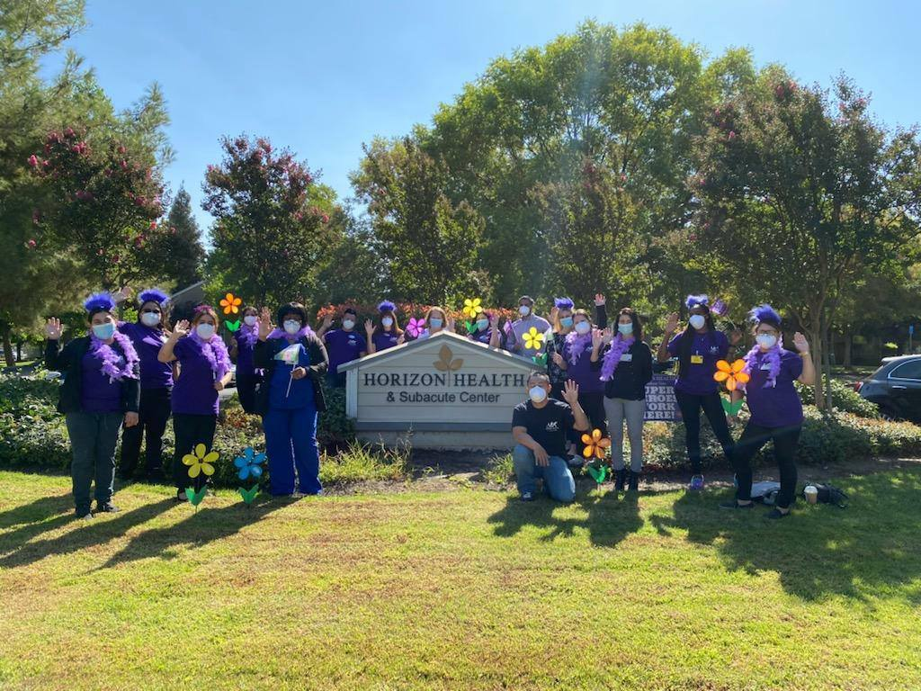
Thank you Questions?

