Slide 1
Skilled Nursing Facility (SNF)
Quality Metrics
Lindsay Holland, MHA
Director, Care Coordination
Health Services Advisory Group (HSAG)
June 26, 2019

Slide 2
Objectives
Define Medicare’s current areas of focus.
Describe how quality improvement programs such as Quality Assurance Performance Improvement (QAPI), SNF Value-Based Purchasing (SNF-VBP) and Quality Reporting Program (QRP) affect reimbursement.
Identify resources on the HSAG website to assist with your quality programs.

Slide 3

Acronyms: What Do all the Letters Mean?
Term | Meaning
CMS | Centers for Medicare & Medicaid Services
FFS | Fee-for-service
HSAG | Health Services Advisory Group
LTCH | Long-term care hospital
MSPB | Medicare Spending Per Beneficiary
NH | Nursing home
NHQCC | Nursing Home Quality Care Collaborative
PDPM | Patient Driven Payment Model
PPR | Potentially preventable 30-day post-discharge readmission
PPS | Prospective Payment System
QAPI | Quality Assurance Performance Improvement
QIN | Quality Innovation Network
QRP | Quality Reporting Program
SNF | Skilled nursing facility
VBP | Value-Based Purchasing

Slide 4
Centers for Medicare & Medicaid Services (CMS) Areas of Focus
Behavioral Health
- Including a focus on opioid-use reduction
Patient Safety/Harm Reduction
Chronic Disease Self-Management
Care Coordination
Nursing Home/Long-Term Care

Slide 5
QRP Measures
Notes:
Whereas previously published quality measures for SNFs were developed specifically for the SNF care setting, the new QRP measures were designed with interoperability in mind so that SNFs, inpatient rehabilitation facilities (IRFs), long-term care hospitals (LTCHs), and home health (HH) all have a common set of metrics. Why is this important? Because the ability to compare different types of facilities may result in hospitals changing referral patterns and relying more heavily on lower cost care settings like HH.

Slide 6
SNF QRP Measures-October 2018
Data for the SNF QRP measures are collected and submitted through two methods:
  Minimum Data Set (MDS) 3.0
  Medicare Fee-For-Service Claims
    No additional data needs to be submitted by the SNF
Notes:
IMPACT ACT-standardized data set of reporting
the Secretary shall reduce the market basket update (also known as the Annual Payment Update, or APU) by 2 percentage points for any SNF that does not comply with the quality data submission requirements with respect to that FY. SNFs utilize the Minimum Data Set (MDS) 3.0 via the Quality Improvement and Evaluation System (QIES) Assessment Submission and Processing (ASAP) system to collect patient assessment data. The implementation of the SNF QRP will not change requirements related to the submission of MDS 3.0 data through CMS’ QIES ASAP system.
The FY 2020 reporting year is based on four quarters of data from 01/01/2018 – 12/31/2018. This means that FY 2020 compliance determination will be based on data submitted for admissions to the SNF on and after January 1, 2018 and discharged from the SNF up to and including December 31, 2018.
For FY 2020, providers must submit 80% or more of all assessments with 100% of the required MDS data elements to be in compliance with SNF QRP requirements.

Slide 7
SNF QRP Measures—MDS 3.0
Measure #1: Application of Percent of Residents Experiencing One or More Falls with Major Injury
(Long Stay) (NQF #0674)
Measure #2: Application of Percent of LTCH Patients with an Admission and Discharge Functional Assessment and a Care Plan that Addresses Function (NQF #2361)
Measure #6: Drug Regimen Review Conducted with Follow-Up for Identified Issues—PAC SNF QRP
https://www.cms.gov/Medicare/Quality-Initiatives-Patient-Assessment-Instruments/NursingHomeQualityInits/Skilled-Nursing-Facility-Quality-Reporting-Program/SNF-Quality-Reporting-Program-Measures-and-Technical-Information.html

Slide 8
SNF QRP Measures—MDS 3.0 (cont.)
Measure #7: Changes in Skin Integrity Post-Acute Care: Pressure Ulcer/Injury
Measure #8: Application of IRF Functional Outcome Measure: Change in Self-Care Score for Medical Rehabilitation Patients (NQF #2633)
Measure #9: Application of IRF Functional Outcome Measure: Change in Mobility Score for Medical Rehabilitation Patients (NQF #2634)

Slide 9
SNF QRP Measures—MDS 3.0 (cont.)
Measure #10: Application of IRF Functional Outcome Measure: Discharge Self-Care Score for Medical Rehabilitation Patients (NQF #2635)
Measure #11: Application of IRF Functional Outcome Measure: Discharge Mobility Score for Medical Rehabilitation Patients (NQF #2636)
Measures Modified from SNF QRP
  Percent of Residents or Patients With Pressure Ulcers
  That Are New or Worsened (Short Stay) (NQF #0678)
  This measure was replaced by a modified version of the measure entitled Changes in Skin Integrity Post-Acute Care: Pressure Ulcer/Injury beginning with the FY 2020 SNF QRP.

Slide 10
SNF QRP Claims-Based Measures
Measure #3: Medicare Spending Per Beneficiary-PAC SNF QRP
  Measure was finalized in the FY 2017 SNF PPS Final Rule, published in the Federal Register August 5, 2016 (81 FR 52014).
Measure #4: Discharge to Community-PAC SNF QRP
  Measure was finalized in the FY 2017 SNF PPS Final Rule, published in the Federal Register August 5, 2016 (81 FR 52021).
Measure #5: Potentially Preventable 30-Day Post-Discharge Readmission Measure—SNF QRP
  This measure was finalized in the FY 2017 SNF PPS Final Rule which was published in the Federal Register on August 5, 2016 (81 FR 52030).
https://www.govinfo.gov/content/pkg/FR-2016-08-05/pdf/2016-18113.pdf

Slide 11
SNF QRP Measures
Short Name | Measure Name
MSPB | Medicare Spending Per Beneficiary (MSPB)—Post Acute Care (PAC) Skilled Nursing Facility (SNF) Quality Reporting Program (QRP)
DTC | Discharge to Community (DTC)—Post Acute Care (PAC) Skilled Nursing Facility (SNF) Quality Reporting Program (QRP)
PPR | Potentially Preventable 30-Day Post-Discharge Readmission (PPR) Measure for Skilled Nursing Facility (SNF) Quality Reporting Program (QRP)
SNF QRP Users Manual
https://www.cms.gov/Medicare/Quality-Initiatives-Patient-Assessment-Instruments/NursingHomeQualityInits/Downloads/SNF-QRP-Measure-Calculations-and-Reporting-Users-Manual-V20.pdf

Slide 12
Medicare Spending Per Beneficiary (MSPB)
Finalized in the fiscal year (FY) 2017 SNF Prospective Payment System (PPS) Final Rule on August 5, 2016.
Evaluates SNF providers’ efficiency relative to the efficiency of the national median SNF provider.
The measures assesses the cost to Medicare for services perform by the SNF during an episode.
No data collection required by facilities, besides claims data submitted during normal course of business.

Slide 13
Discharge to Community
Post-Acute Care SNF QRP
Measure was finalized in the FY 2017 SNF PPS Final Rule on August 5, 2016.
Higher rates are better.
Measure is:
  A SNF’s risk-standardized rate of Medicare FFS residents discharged to the community following a SNF stay, and
  Do not have an unplanned readmission to an acute-care hospital or long-term care hospital (LTCH) in the 31 days following discharge to community, and
  Who remain alive during the 31 days following discharge to community.
No data collection required by facilities, besides claims data submitted during normal course of business.
Notes:
Community, for this measure, is defined as home or self - care, with or without home health services.
Tracking Patients Outside of the SNF
Two of the QRP measures indicate that CMS wants SNFs to focus more attention on what happens to their patients after their stays—the measure on successful discharge back to the community and the rehospitalization measure. Although the latter was held back from the October announcement, it is perhaps the most significant measure in the program. Unlike rehospitalization measures in other CMS programs, the QRP rehospitalization measure begins at the point of discharge from SNF— not the point of admission — and evaluates outcomes 30 days out.
In other words, the entire period of measurement occurs outside of the facility.

Slide 14
Potentially Preventable 30-Day Post Discharge Readmission (PPR)
This measure estimates the risk-standardized rate of unplanned, potentially preventable readmissions for residents (Medicare FFS beneficiaries) who receive services in SNFs.
The measure is currently suppressed, and therefore not available on Nursing Home Compare at this time. However, you will still be able to see these data on your reports.

Slide 15
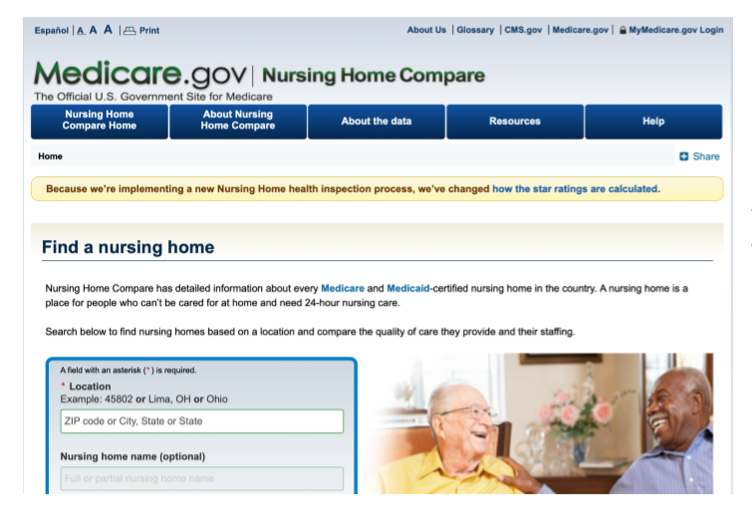
Nursing Home Compare
The SNF QRP quality measures (QMs) are now available under “Additional Measures” on Nursing Home Compare.
https://www.medicare.gov/nursinghomecompare/search.html

Slide 16
Four Intended Purposes of QMs on Nursing Home Compare
Give consumers information about the quality of care to help them choose a nursing home (NH) or SNF.
Understand the data related to common conditions in NH/SNF populations.
Facilitate discussions with NH/SNF staff members regarding quality.
Give NH/SNF staff members data to support their quality improvement efforts.

Slide 17

What’s Next in 2019?

Slide 18
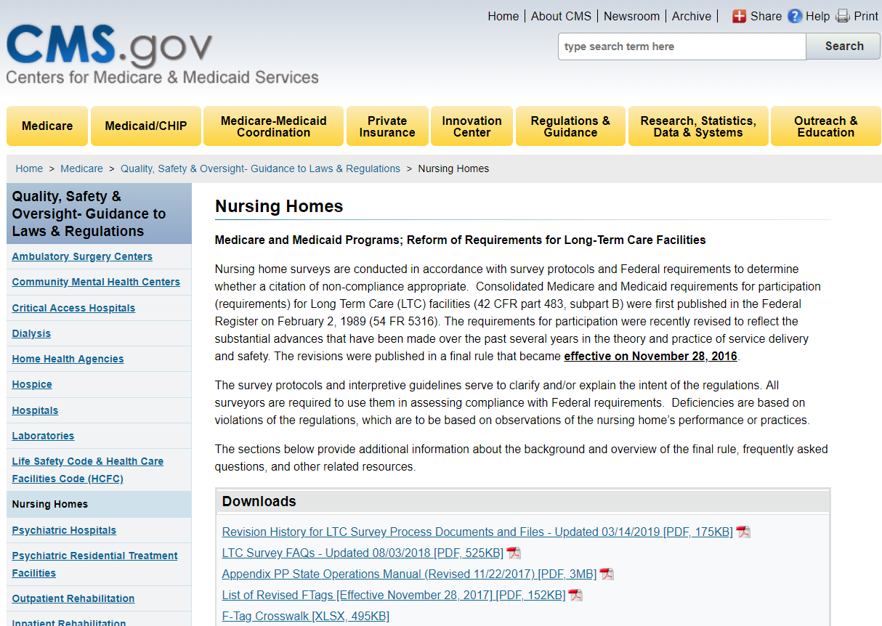
Requirements of Participation
https://go.cms.gov/2Un9t4t

Slide 19
Requirements of Participation (cont.)
Phase 3
November 28, 2019

Slide 20
Requirements of Participation: Phase 3
§483.75(c)
483.75(g)
§483.75(d)
QAPI feedback, data collection, and monitoring
QAPI systemic analysis and systemic action
Infection preventionist with specialized training

Slide 21
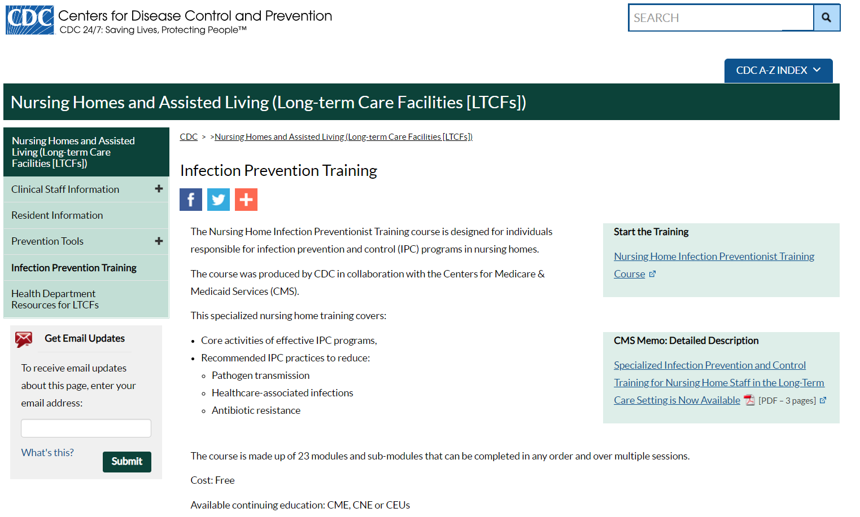
No-Cost Infection Preventionist Training
www.cdc.gov/longtermcare/training.html

Slide 22
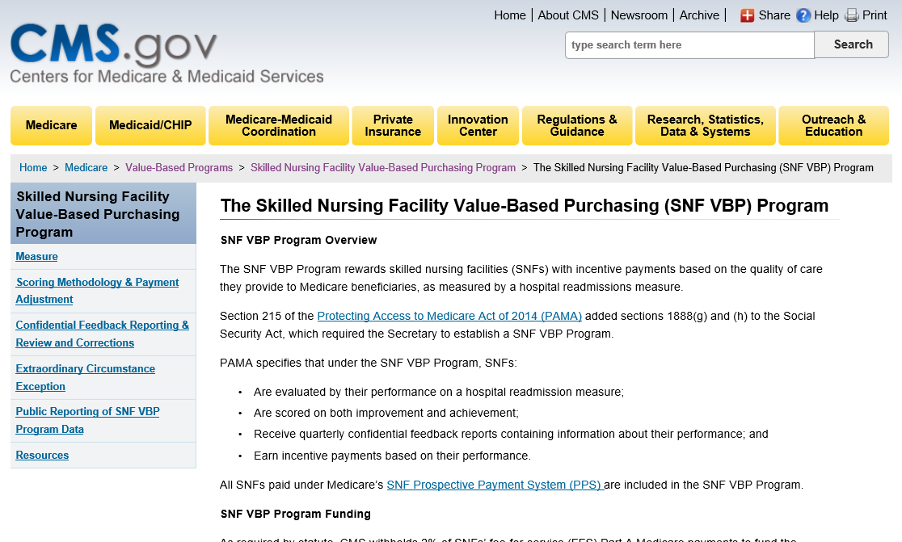
Value-Based Purchasing and Readmissions
https://go.cms.gov/2X5E0u4

Slide 23
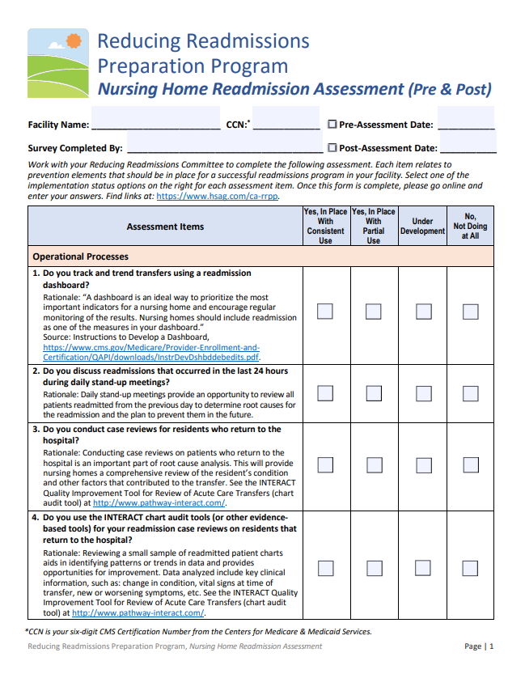
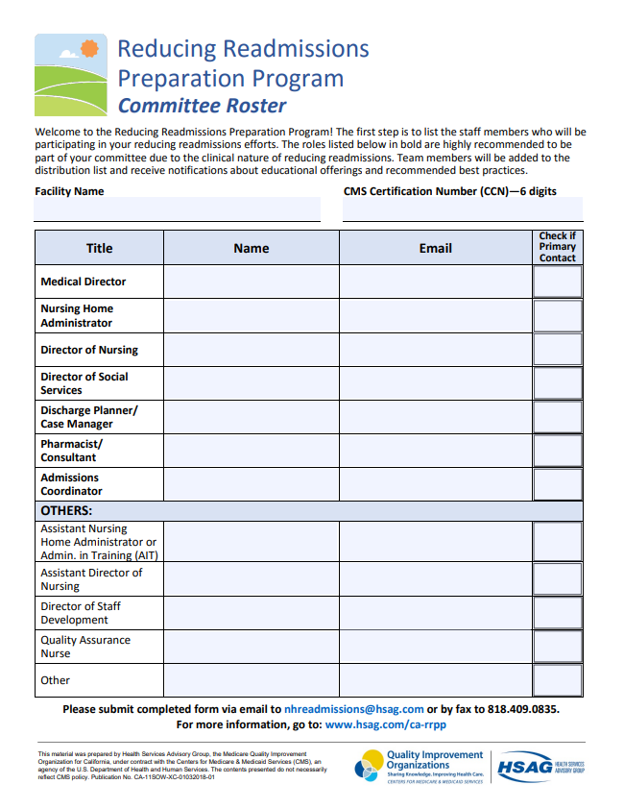
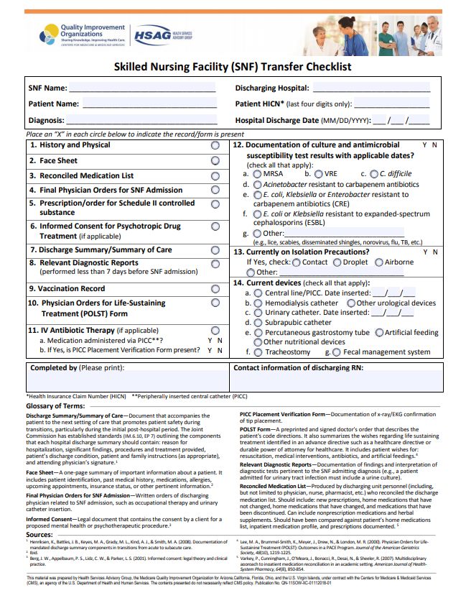
Reducing Readmissions Preparation Program
www.hsag.com/ca-rrpp

Slide 24
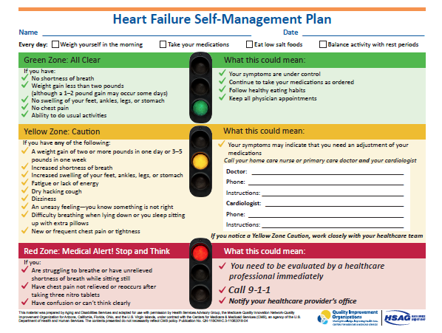
Patient Zone Tools
Downloadable tools that can be adapted to help educate and assist patients in managing their condition at home.
www.hsag.com/zone-tools
Notes:
These tools integrate the importance of tracking and managing symptoms and medications and what actions to take if patients are experiencing specific symptoms.
Example: when a patient leaves and has diabetes/HF
Downloadable tool that can be provided to patients in managing various health conditions including Heart Failure. Improved self-management can reduce hospital readmissions.

Slide 25
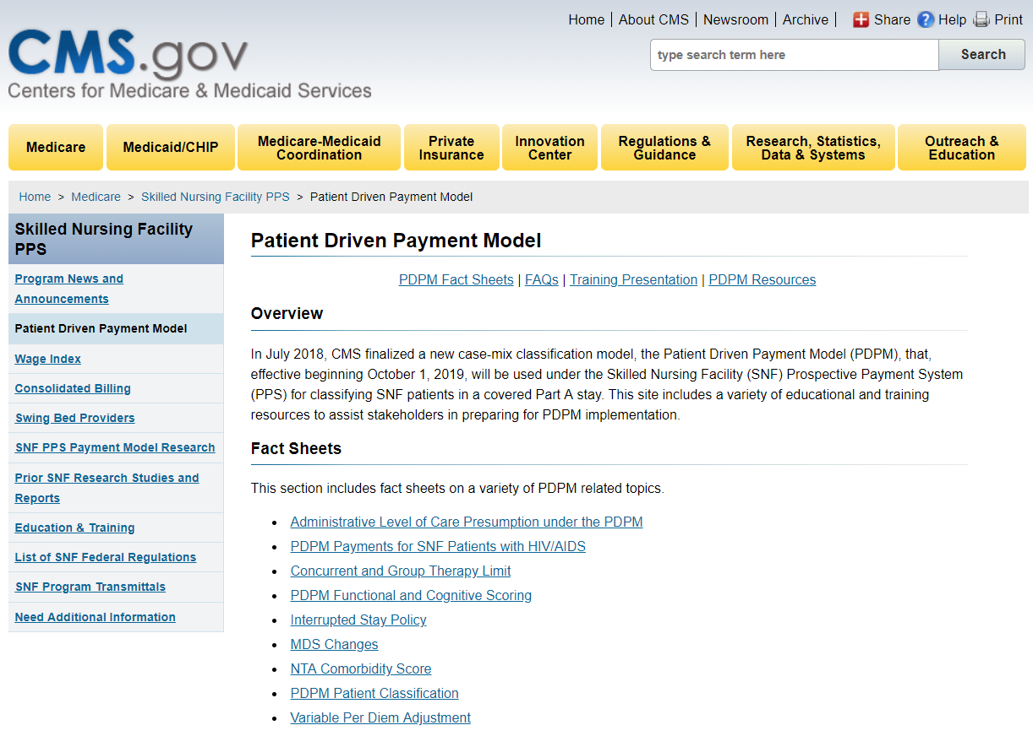
Patient Driven Payment Model (PDPM)
October 1, 2019
https://go.cms.gov/2zpaK3l

Slide 26
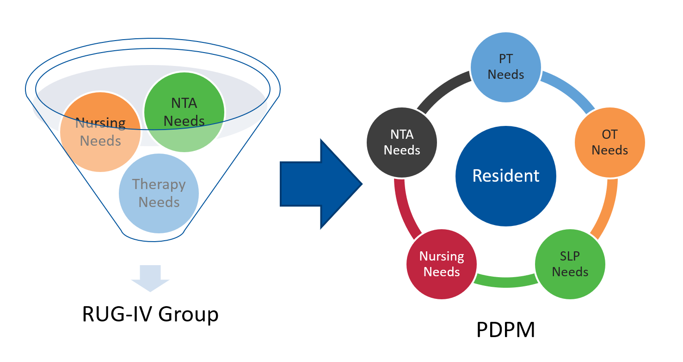
PDPM CMS Training Slides
https://go.cms.gov/2GnX5xw
RUG-IV=Resource Utilization Group, Version IV
PT=Physical Therapy
OT= Occupational Therapy
SLP=Speech Language Pathology
NTA=Non-Therapy Ancillary
Notes:
So why is CMS changing the Medicare payment system?
Under RUG-IV, most patients are classified into a therapy payment group, which uses primarily the volume of therapy services provided to the patient as the basis for payment classification. This creates an incentive for SNF providers to furnish therapy to SNF patients regardless of the patient’s unique characteristics, goals, or needs.
WHILE
PDPM will improve payments made under the SNF PPS in the following ways:
Improves payment accuracy and appropriateness by focusing on the patient, rather than the volume of services provided
Significantly reduces administrative burden on providers (there are less PPS assessments)
Improves SNF payments to currently underserved beneficiaries without increasing total Medicare payments
But really, CMS goal is for patient centered care and increased collaboration between nursing and therapy departments.

Slide 27

Five-Star Changes: April 2019
End the freeze on
Health Inspection Star Rating
Improve the
Quality Measure Domain
Improve the Staffing Domain
April 2019 Technical User’s Guide: https://go.cms.gov/2v6fMj1
Notes:
Health Inspection Domain
Most recent 3 years of data
Staffing Domain
Payroll-based journal system data providing insight into the staffing levels of nursing homes
Quality Measures (QM) Domain
Quality measures that rate each nursing home compared to fixed benchmarks
Started April 24, 2019

Slide 28
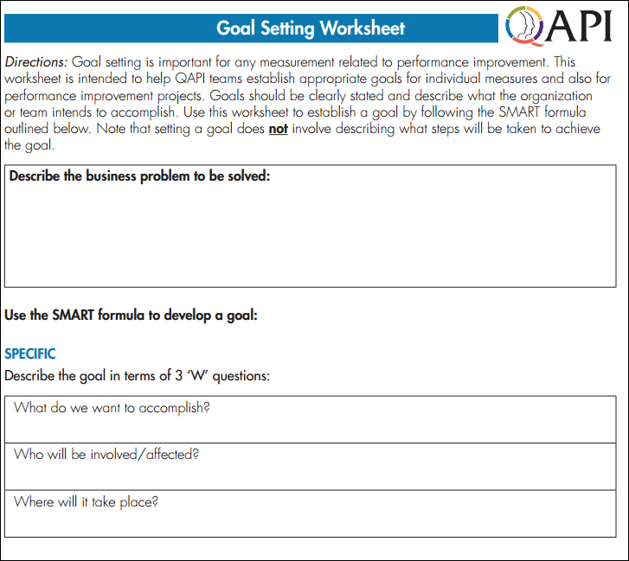
Other QAPI Tools: Goal Setting Worksheet
https://goo.gl/J1z9XA
Notes:
Goal setting tool and SMART goal setting.
Linking to quality, readmissions, outcomes, reporting of data
Six Steps To Prepare For QAPI
1. Use data at a high level to identify major areas of opportunity to prevent readmissions to the hospital.
2. Analyze what the facility is doing right and where it can improve.
3. Focus on one area of improvement.
4. Develop quality improvement processes, training programs, and accountability measures. In parallel, start collecting data on the new processes to track improvement.
5. Continuously alter internal processes and analyze the data to ensure continuous quality improvement and to demonstrate that the facility does not contribute to issues such as the rehospitalization of residents.
6. Monitor, identify, and mitigate high-risk areas, such as falls and injuries, restraint use, pain, pressure sores, wandering, and weight loss.

Slide 29

Develop SMART Goals
Specific: What, who, and where?
Measurable: Count, percent, rate?
Attainable: Rationale for setting the goal.
Relevant: How will the goal address the problem?
Time-bound: Set target date to achieve goal.
By December 2019, Green Acres, with leadership from the Antipsychotic Medication Reduction PIP Team, will decrease the long-stay antipsychotic quality-measure rate at Green Acres from the baseline rate of 25 percent (December 2018) to 10 percent, based on the MDS 3.0 CASPER Reports, and thereby improve the quality of care for residents with discontinued antipsychotics, especially those with dementia.
Notes:
**Here is an example of your SMART goals. Which you will have time to during the action planning activity next. Example of a SMART goal related to antipsychotic.
It should be SMART:
Specific: Describe what do you want to accomplish? Who will be involved or affected? Where will it take place?
Measurable: Include description of the measure you will use, what is the current data for that measure, and what do you want to
increase or decrease that number to?
Attainable: What is the rationale for setting the goal; what is it based on; is the goal set too low that it is not challenging enough,
or too high that you are setting yourself up for failure?
Relevant: How will this goal affect or address the problem you are trying to solve?
Time-bound: A timeline for achieving the goal should always be set or defined.

Slide 30

National Nursing Home Quality Care Collaborative (NNHQCC) Change Package Components
Strategies
Change Concepts
Action Items
www.hsag.com/QAPI
Source: National Nursing Home Quality Care Collaborative Change Package
Notes:
***Another great resource is the change package developed for the collaborative and based on studies from high performing nursing homes. We just got the updated version yesterday.
Change Package
Menu of strategies, change concepts, and actionable items that will be helpful in finding solutions to challenge areas
A great reference during QAPI PIP meetings when trying to problem solve and/or look
for ideas

Slide 31
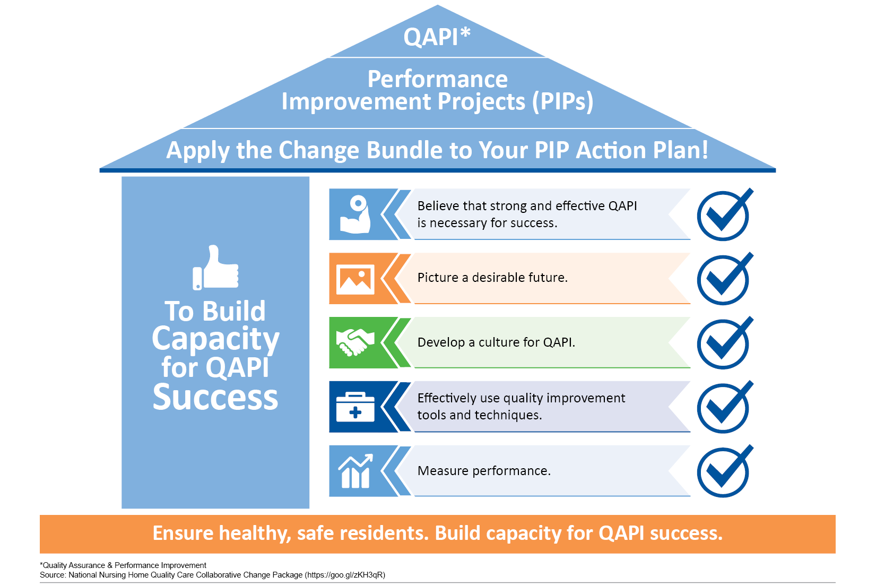
Best-Practice Bundle:
To Build Capacity for QAPI Success

Slide 32
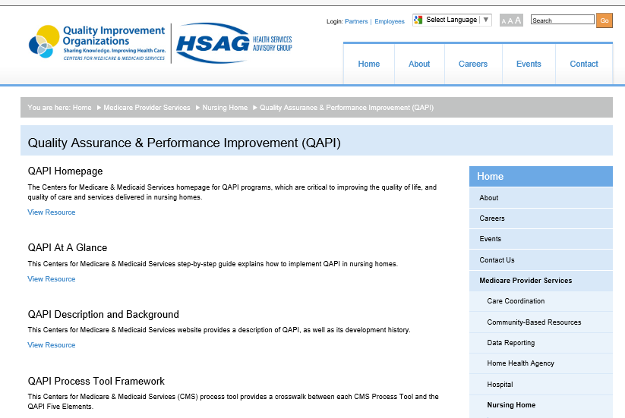
HSAG Tools and Resources
www.hsag.com/QAPI
Notes:
Please note the QAPI resources on our website.

Slide 33
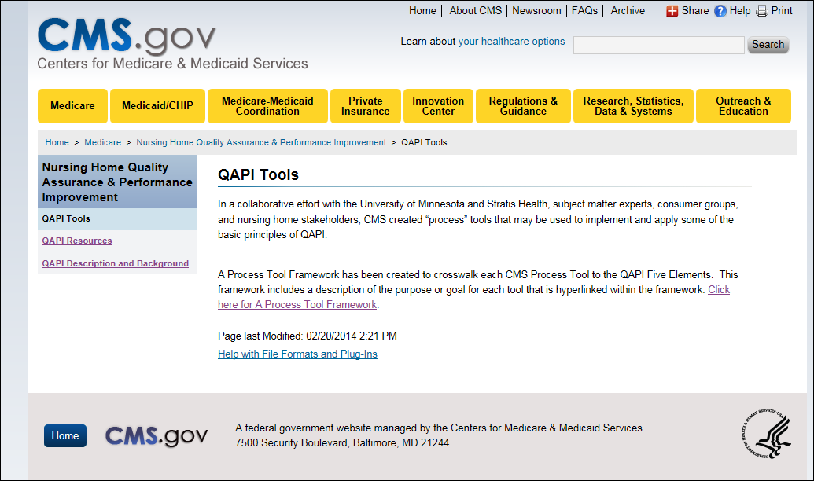
CMS QAPI Tools
https://www.cms.gov/Medicare/Provider-Enrollment-and-Certification/QAPI/qapiresources.html
Notes:
Also, see the CMS website for QAPI materials.

Slide 34

NHQCC Web Resources

Slide 35

Questions?
Notes:
Questions
Provide your email address in case anyone has any follow up questions after today.

Slide 36
Thank you!
Lindsay Holland
HSAG
Lholland@hsag.com

Slide 37
Disclaimer
This material was prepared by Health Services Advisory Group, the Medicare Quality Innovation Network-Quality Improvement Organization for Arizona, California, Florida, Ohio, and the U.S. Virgin Islands, under contract with the Centers for Medicare & Medicaid Services (CMS), an agency of the U.S. Department of Health and Human Services. The contents presented do not necessarily reflect CMS policy. Publication No. CA-11SOW-XC-06242019-01

