Slide 1
California Department of Public Health
Licensing and Certification Program
Orange County District Office
RAP Session Presentation
June 26, 2019

Slide 2
Orange County District Office’s
Management Staff
Jacqueline A. Lincer, Branch Chief
Hang Nguyen, District Manager
Kathleen Davidson, District Administrator (LTC)
Josefina “Jo” Sabino, District Administrator (NLTC)
Bernabela “Belle” Garcia, Supervisor (LTC)
Grace Clerico, Supervisor (LTC)
Jane Sarmiento, Supervisor (LTC)
Leontine Smith, Supervisor (LTC)
Audrey Bui, Supervisor (NLTC)
Porntip Athinan, Supervisor (NLTC)
Kathleen Kirkpatrick, Supervisor (NLTC)
Tu Tonnu, Supervisor (NLTC)
Zeandra Villa, (AGPA)

Slide 3


LTC Updates
Presented by:
Jackie Lincer, Branch Chief
Kathleen Davidson, District Administrator
Josefina “Jo” Sabino, District Administrator
Grace Clerico, Supervisor
Bernabela “Belle” Garcia, Supervisor
Jane Sarmiento, Supervisor

Slide 4
Centers for Health Care Quality,
California Department of
Pubic Health's
Deputy Director
Heidi Steinecker
Appointed in late 2018, she had previously worked as a consultant with Global Health and various capacities at University of California, Davis Medical Center

Slide 5
Due to the recent Supreme Court Decision in Azar vs. Allina (June 3, 2019) you may be aware that CMS leadership placed a hold on all enforcement notifications. The hold has been lifted.
It is the expectation that State Survey Agencies ensure that all Federal citations related to enforcement actions are clearly based on the Code of Federal Regulations (CFRs) versus the State Operations Manual and/or Interpretive Guidelines. While this is not new guidance, the Regional Offices have been asked to reemphasize this point given the recent legal ruling.
Attached is the link to the court decision: https://www.supremecourt.gov/opinions/18pdf/17-1484_4f57.pdf
HOT OFF THE PRESS

Slide 6
Immediate Jeopardy
Three essential components for surveyors to determine the presence of IJ include the following:
1. Noncompliance: An entity has failed to meet one or more federal health, safety, and/or quality regulations; and

Slide 7
Immediate Jeopardy
2. Serious Adverse Outcome or Likely Serious Adverse Outcome: As a result of the identified noncompliance, serious injury, serious harm, serious impairment or death has occurred, is occurring, or is likely to occur to one or more identified recipients at risk; and
3. Need for Immediate Action: The noncompliance creates a need for immediate corrective action by the provider/supplier to prevent serious injury, serious harm, serious impairment or death from occurring or recurring.

Slide 8
Immediate Jeopardy: https://www.cms.gov/Regulations-and-Guidance/Guidance/Manuals/downloads/som107ap_q_immedjeopardy.pdf

Slide 9
Accidents: F689
§483.25(d) Accidents.
The facility must ensure that –
The residents’ environment remains as free of accident hazards as is possible; and
Each resident receives adequate supervision and assistance devices to prevent accidents.

Slide 10
Accidents: F689
Avoidable Accident”
Means that an accident occurred because the facility failed to:
• Identify environmental hazards and/or assess individual resident risk of an accident, including the need for supervision and/or assistive devices; and/or
• Evaluate/analyze the hazards and risks and eliminate them, if possible, or, if not possible, identify and implement measures to reduce the hazards/risks as much as possible; and/or

Slide 11
Accidents: F689
Implement interventions, including adequate supervision and assistive devices, consistent with a resident’s needs, goals, care plan and current professional standards of practice in order to eliminate the risk, if possible, and, if not, reduce the risk of an accident; and/or
Monitor the effectiveness of the interventions and modify the care plan as necessary, in accordance with current professional standards of practice.

Slide 12
Accidents: F689
Evaluation of all of the causal factors leading to a resident fall assists the facility in developing and implementing relevant, consistent, and individualized interventions to prevent future occurrence. Proper actions following a fall include:
Ascertaining if there were injuries, and providing treatment as necessary.
Determining what may have caused or contributed to the fall, including ascertaining what the resident was trying to do before he or she fell.
Addressing the risk factors for the fall such as the resident’s medical conditions, facility environment issues, or staffing issues.
Revising the resident’s plan of care and/or facility practices, as needed, to reduce the likelihood of another fall.

Slide 13
Common Deficiencies cited as a result of:
Investigation are not complete and/or thorough such as:
  When was resident last seen?
  When were they toileted or changed last?
  What was the resident doing before the fall/injury, behaviors which could have lead up to the fall?
  Interviews with staff/residents/visitors who know the resident and might shed light on the situation or behaviors.
  Complete description of what happened and how the resident was found; such as the position of the bed, bed alarm on/off, floor mat, type of bed, roommate present, call light on/off, etc. etc.
  How does the IDT determine interventions when they do not have all the facts?
Facility did not following through on interventions, recommendations or orders.
Not updating the plan of care.
Not notifying the primary physician or Responsible Party.
Failed to provide the required 5-day (working days) summary to CDPH with Facility Reported Incidents (FRI)

Slide 14
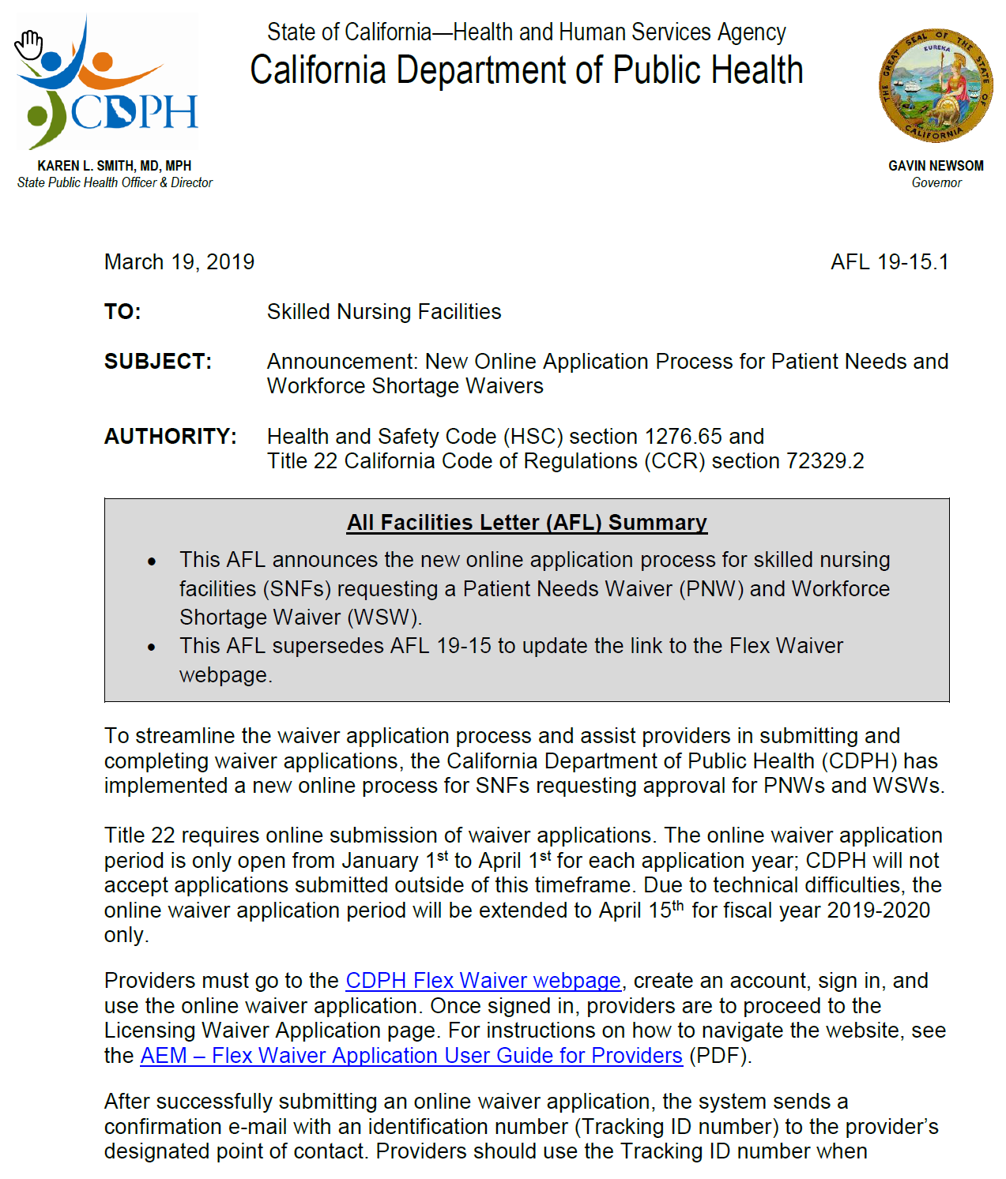
AFL 19-15.1

Slide 15
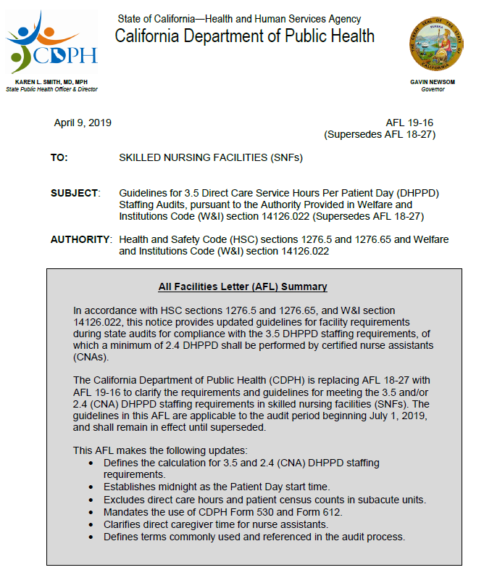
AFL 19-16

Slide 16
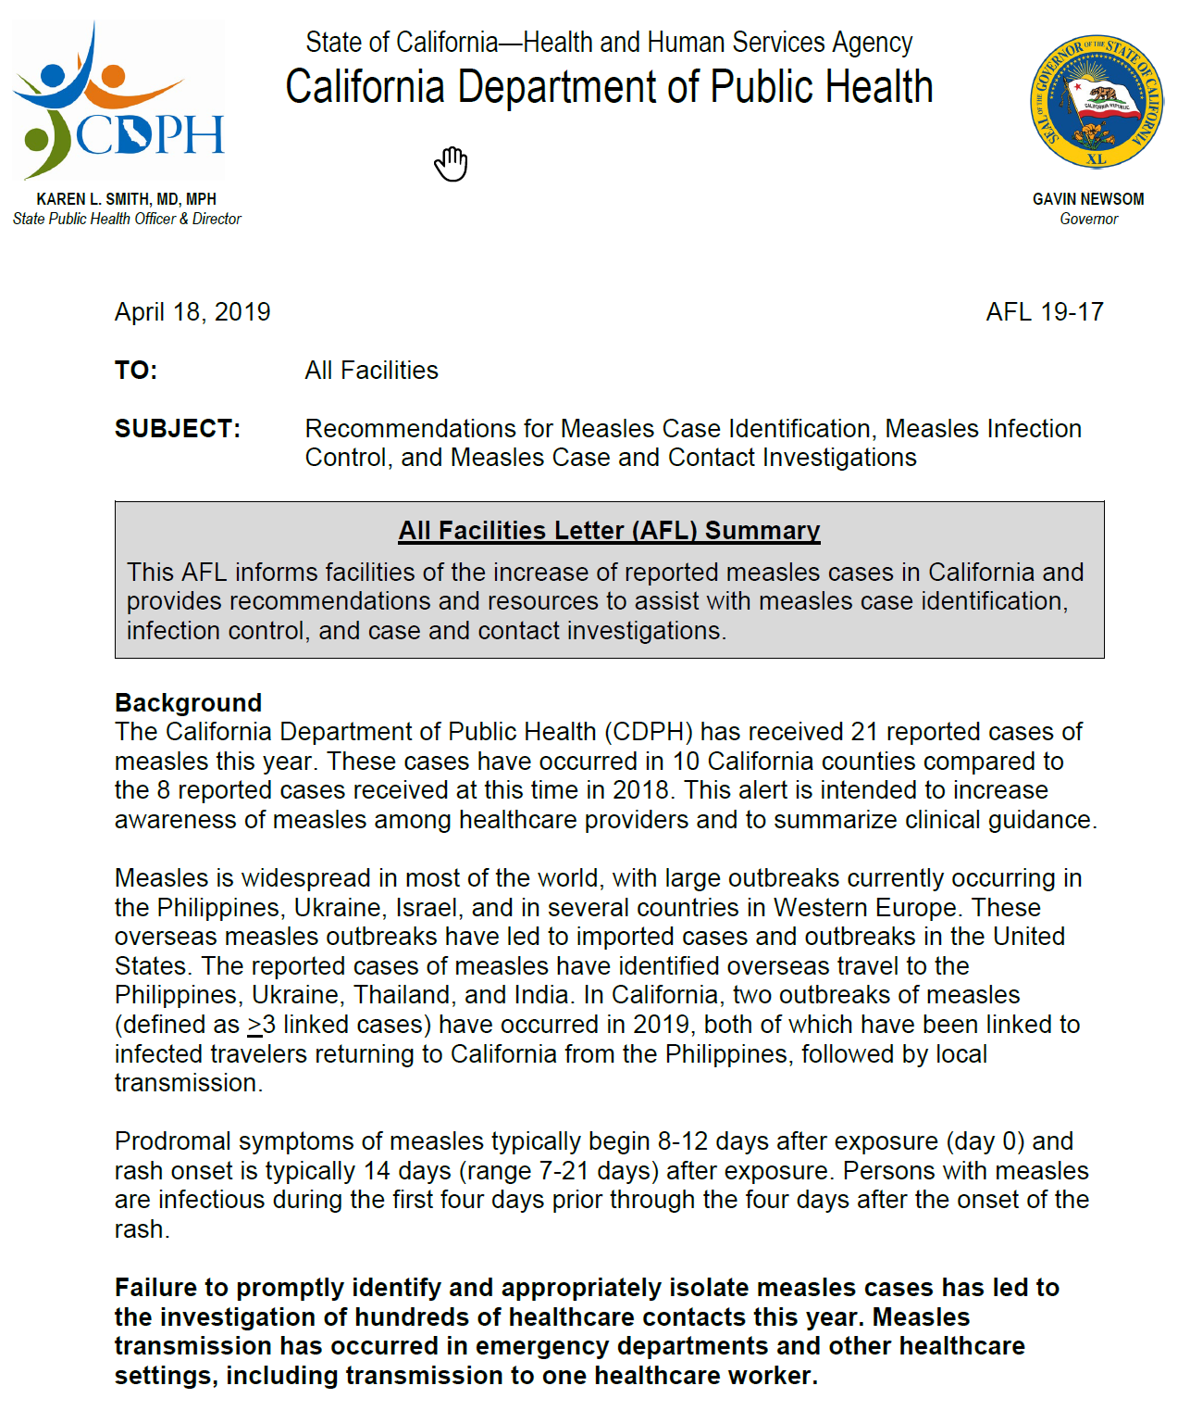
AFL 19-17

Slide 17
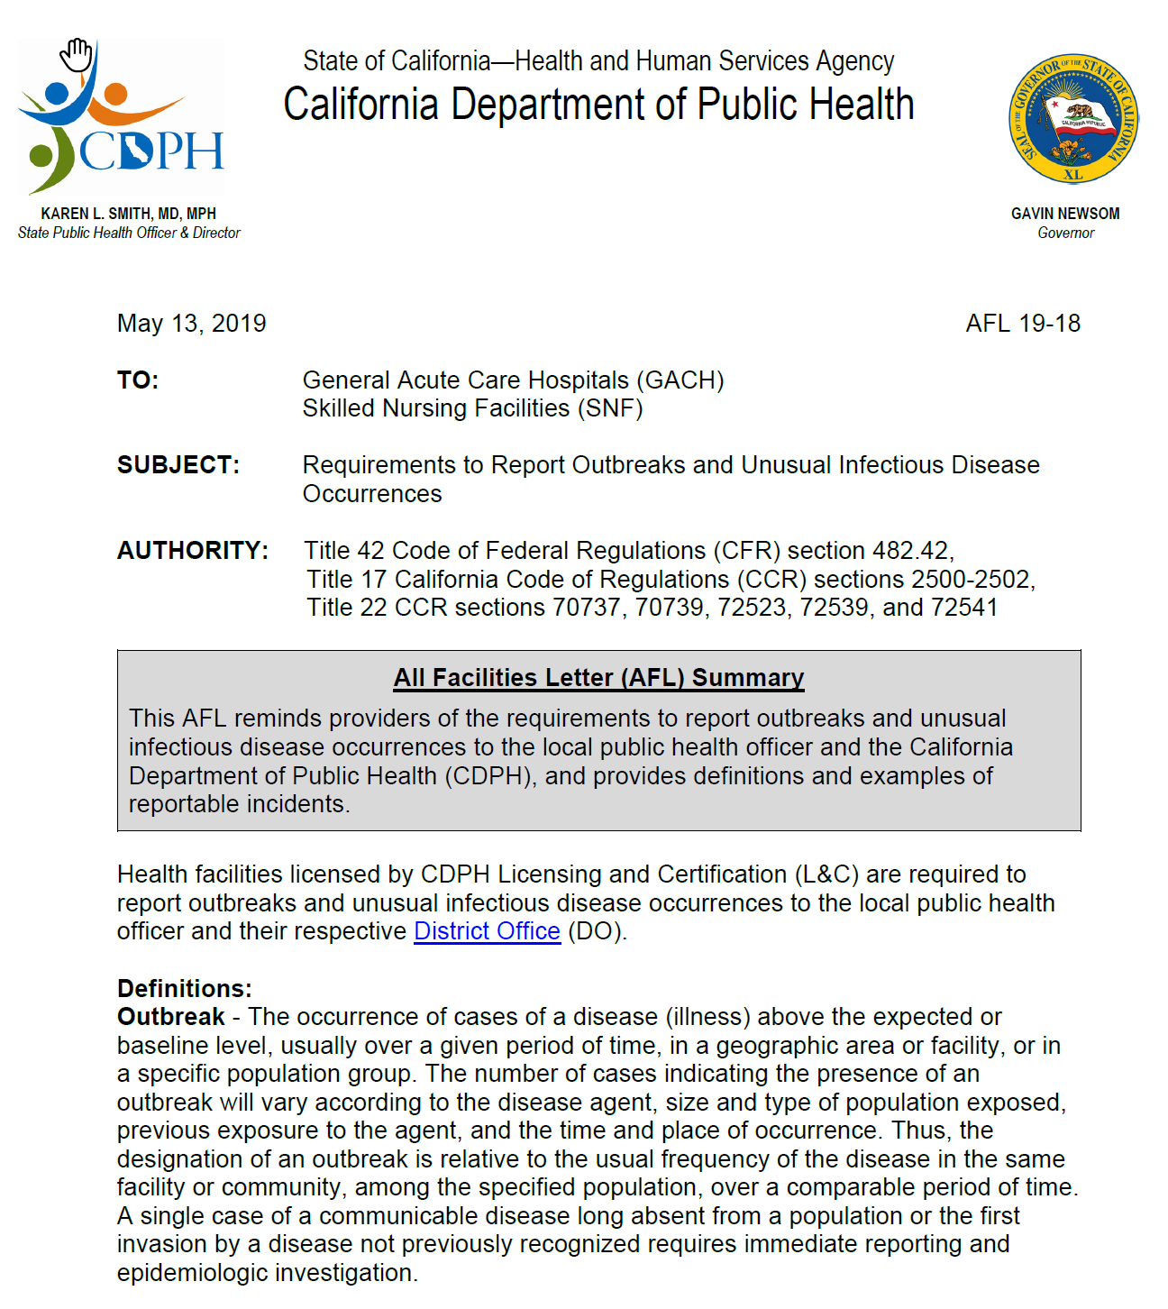
AFL 19-18

Slide 18
Useful Links:
AFL 19-15.1: Announcement: New Online Application Process for Patient Needs and Workforce Shortage Waivers:
https://www.cdph.ca.gov/Programs/CHCQ/LCP/CDPH%20Document%20Library/AFL-19-15.1.pdf
AFL 19-16: Guidelines for 3.5 Direct Care Service Hours Per Patient Day (DHPPD) Staffing Audits, pursuant to the Authority Provided in Welfare and Institutions Code (W&I) section 14126.022 (Supersedes AFL 18-27) https://www.cdph.ca.gov/Programs/CHCQ/LCP/CDPH%20Document%20Library/AFL-19-16.pdf

Slide 19
Useful Links:
AFL 19-17: Informs Facilities of increase reporting of Measles cases in California
https://www.cdph.ca.gov/Programs/CHCQ/LCP/CDPH%20Document%20Library/AFL-19-17.pdf
ALF 19-18: Requirements to Report Outbreaks and Infectious Diseases.
https://www.cdph.ca.gov/Programs/CHCQ/LCP/CDPH%20Document%20Library/AFL-19-18.pdf
All 2019 AFLs:
https://www.cdph.ca.gov/Programs/CHCQ/LCP/Pages/LNCAFL.aspx

Slide 20
Useful Links:
* Link to CMS – Frequently Asked Questions:
https://www.cms.gov/Medicare/Provider-Enrollment-and Certification/GuidanceforLawsAndRegulations/Downloads/LTC-Survey-FAQs.pdf

Slide 21
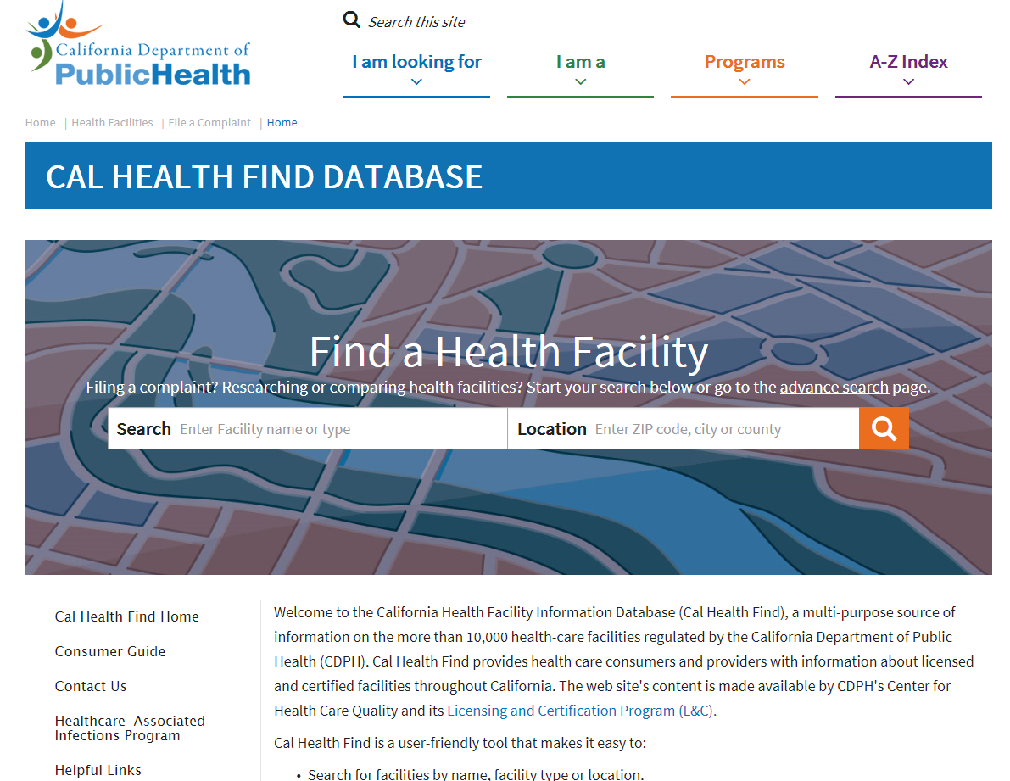
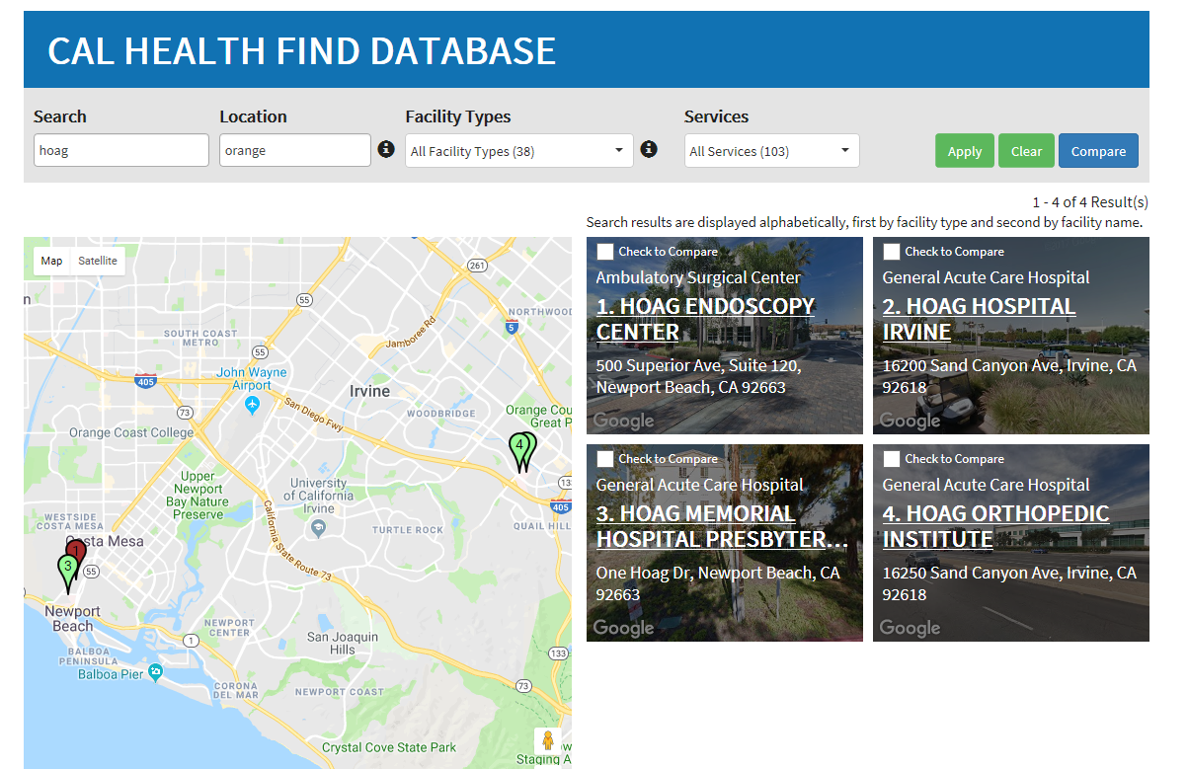
Cal Health Find Database
https://www.cdph.ca.gov/Programs/CHCQ/LCP/CalHealthFind/Pages/Home.aspx

Slide 22
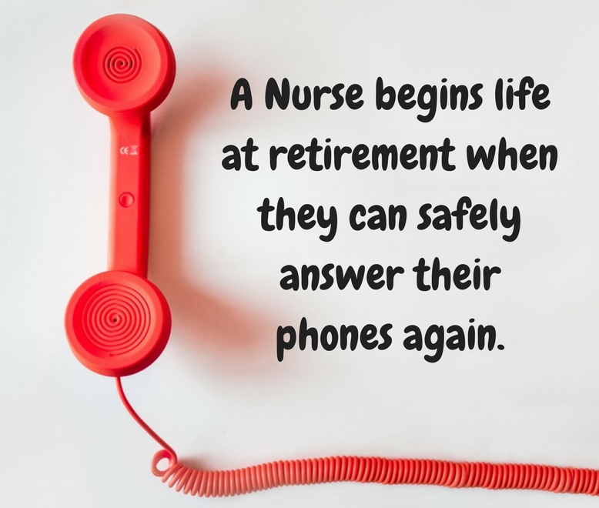
Congratulations to Jo Sabino
on her upcoming Retirement

Slide 23


Slide 24
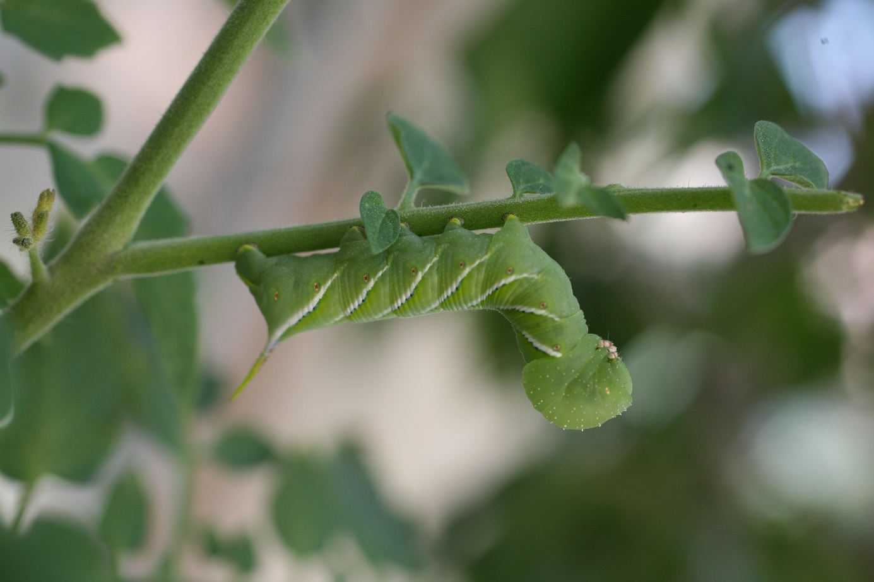
Thank You!

