Slide 1
President’s Address Orange County Annual RAP Session
June 26, 2019
Craig Cornett
CEO/President
CAHF

Slide 2
Welcome! Let’s talk about…
California’s economic picture
What’s happening in Sacramento: a new Governor, a new agenda, a new Administration, a new Legislature, and bills we are following
What’s happening nationally and in D.C.
The challenges ahead for our profession
What we can ALL do to improve our operations, improve quality for our patients and residents, and increase awareness of the challenges we face
Notes:
Economy is key to what we do—labor markets, income distribution, tax revenues, etc.
For new Governor: what we know
A fast trip in 20 minutes

Slide 3
California’s Economic and Fiscal Picture
Very strong economic picture continues
“Full employment”
Approaching longest-ever economic expansion
Strong state tax revenue collections
But risks of a downturn are showing
State revenue volatility
Trade wars
Growing federal deficit
Notes:
Very, very strong economy; 5th largest economy in the world
Unemployment in February: 4.2%
Largest growth in jobs over last year: professional business services, and health and education
we’ve added 3.1 new jobs added since expansion began in February 2010
U.S. Unemployment at 3.8%
Unemployment rates vary widely, with very low rates in coast and urban areas, and higher in rural, Central Valley (but better than normal)
July will mark longest
Big tax revenue increases—overall $200+, General Fund $143+
Risks
Revenues slightly off, from a weak January; April is key
California is dependent on trade—higher tariffs
Interest rates up, but now more stable
Growing federal deficit, meaning harder to increase spending when recession starts
How all of this affects the stock market—because we are dependent

Slide 4
Governor Gavin Newsom
Notes:
Won a landslide victory in November
7.7 million votes, or 62%
Come on like gangbusters

Slide 5
Activist New Governor, Wide-Ranging Agenda
Expanding housing
Pushing back on Washington
Halting the death penalty
Resizing high speed rail
Responding to utility bankruptcy
Confronting homelessness
Expanding healthcare, addressing prescription drug pricing
Preparing for more wildfires and other disasters
Notes:
Housing: more $ and policy changes to encourage more housing construction, particularly for modest incomes
Resilience: Concerned about a recession, so paying down more debt and investing most $ into one-time things
Health: in particular, expanding eligibility for persons up to age 25 no matter status

Slide 6
New Administration, New Players
Governor’s Office
Bigger, more wide-ranging staff
A mix of Sacramento veterans and outsiders
Health and Human Service Agency
New Secretary: Dr. Mark Ghaly
Undersecretary (reappointed): Michelle Baass
DHCS and CDPH
Directors appointed by Brown continue for now
New leadership at some secondary levels, including:
Dr. Charity Dean, assistant director of CDPH
Heidi Steinecker, head of Center for Health Care Quality
Notes:
Chief of Staff
Ghaly: Deputy Director of Community Health for LA County Health Department; worked in L.A. and SF; Ivy League educated, and pediatrician UCSF residency
Michelle: Deputy Secretary prior to Undersecretary; Senate staff
Also OSPHD
Secondary levels: CDPH Chief Deputy for Policy and Programs, an assistant director, new head of the Center for Health Care Quality (what we call L&C)—you will see her this afternoon.

Slide 7
What’s the Governor Doing on Health?
Expanding Medi-Cal coverage for income-eligible young adults, regardless of immigration status
New state “individual mandate”
Using Prop. 56 monies for provider payments
No extension of MCO tax package
Proposals to reduce costs of prescription drugs
Notes:
Currently people are covered to age 18; this would extend that to age 25, adding about 140,000 undocumented immigrants to Medi-Cal
Congress eliminated the penalty, making the individual mandate unenforceable; state would encourage more, especially healthier, to keep coverage
Prop. 56 tobacco tax monies—used to increase payments and services and not offset Medi-Cal costs
MCO: a provider tax, expires this year, brings in $1.5 billion to state
Prescription drugs—move from Medi-Cal managed care to fee-for-service benefit; fee-for-service pharmacy program will increase drug rebate savings and help the state get better prices by allowing the state to negotiate with PharMa on behalf of the state’s large Medi-Cal population
Bulk purchasing program to access public and private payers alike
All will take awhile

Slide 8
What About Stuff Important to CAHF?
3.62% increase to base--worth more than $175 million [BUDGET]
QASP [BUDGET]
Add-ons for 3.5/2.4, minimum wage [BUDGET]
ICF/DD from Prop. 56 [BUDGET]
Licensing fee increases [BUDGET]
“Master Plan on Aging”
Alzheimer’s Task Force
Notes:
“master plan” on aging:
The Golden State is getting grayer. We need to get ready for the major demographic challenge headed our way.
For the first time in our history, older Californians will outnumber young children. Over the next decade, our statewide senior population will increase by 4 million. In 25 years, it will double. And more than half will require some form of long-term care.
Growing old knows no boundaries – aging doesn’t care what race you are, your economic status, or if you’re single with no other family support.
I’ve had some personal – and painful – experience with this recently. I lost my father over the holidays, after years of declining physical health and dementia. He was determined to live out his days with dignity. He also happened to be a retired public official with a pension and a support circle of family and friends.
Even with all those advantages, it was a daily challenge to meet his needs so he could live in place and maintain a good quality of life. Millions of Californians share a similar story, and the numbers will only grow.
It’s time for a new Master Plan on Aging. It must address: person-centered care, the patchwork of public services, social isolation, bed-locked seniors in need of transportation, the nursing shortage, and demand for In-Home Supportive Services that far outpaces its capacity.

Slide 9
A New 2019-20 California Legislature
Turnover continues
Heavy new Democratic majorities in both houses
Ultra super majorities have implications
First year of two-year legislative session
About 2,600 new bills introduced
It is still early in the Legislative session, but…
…Several new bills of concern and interest to CAHF
Notes:
Senate: 2 vacant seats, but we know which party they’ll go to
29 Dems, 11 Reps
61 Dems, 18 Reps, 1 vacancy [Rep.]
On bills, but we’ve already got our eye on several
About 6 that we are following most closely, some we will oppose strongly, some we will oppose unless amended, and some we’ll support

Slide 10
New Legislation: A sampling of what we are watching
AB 506 (Kalra): Long-term care facilities: citations and penalties
Modifies evidence standards to substantiate AA citations
Increases state citation penalties for SNFs
CAHF neutral (bill was amended to address CAHF concerns)
Notes:
In Senate Health
Success story
Did set us up for bad evidence standards
Also reduced penalty provisions from where the bill started

Slide 11
Legislation (cont.)
AB 1695 (Carrillo): Transfer of buildings
Sets up a number of new notification requirements on transfer of ownership of facilities
Concerned that requirements would dis-incentivize changes to a failing facility and prolong the process even more
CAHF opposes
Notes:
Passed Assembly 57 to 17; now in Senate Health
Some amendments pending that are even worse

Slide 12
Legislation (cont.)
SB 305 (Hueso): Access to Medical Cannabis
Requires a healthcare facility to permit a terminally ill patient to use medical cannabis
Concerned about potential impacts on our federal funding for Medicare and Medicaid, given federal government’s views on cannabis
Notes:
We got good modifications, but still somewhat concerned
Passed Senate unanimously
In Assembly Health

Slide 13
Legislation (cont.)
SB 749 (Durazo): Public records
Recently amended
Broadens public access to information on employee wages, benefits, hours and other terms of employment
CAHF opposes
Notes:
In Assembly Appropriations Committee

Slide 14
Legislation (cont.)
AB 1042 (Wood): Medi-Cal: home upkeep allowances and transitional needs funds
CAHF supports
SB 512 (Pan): Long-term services and supports
CAHF supports
Several other bills related to aging masterplans that we will likely support
Notes:
1042—In Senate Health
312—IN Assembly Human Services

Slide 15
And What About Things Nationally?
Nationwide occupancy continues to decline
Nationwide margins continue to compress
Unfriendly federal budget from President, but unlikely to move, given divided government
Medicaid risk is minimal
Increased Congressional oversight likely

Slide 16
Many, Many Challenges for Our Profession
Workforce challenge continues (our “perfect storm”)
3.5/2.4 waivers
Need for 23,000 more CNAs by 2022, plus other caregivers
UPDATE on current waiver process
Continued financial stress all over the sector
Tough regulatory and liability environment – unlikely to change
Demographics change will make our work more important
14 million people on Medi-Cal in California
1,100 Californians turning 65 every day

Slide 17
Challenges (cont.)
Negotiating new AB 1629 rates and QASP at the top of priorities
Have to keep the sector healthy, in order to accommodate the aging population
PDPM is promising, but will require major retooling of how you do business
Keeping up with strange, new public health risks
Quality improvement continues to be key
State, feds, consumers demand it—plus it is right thing

Slide 18
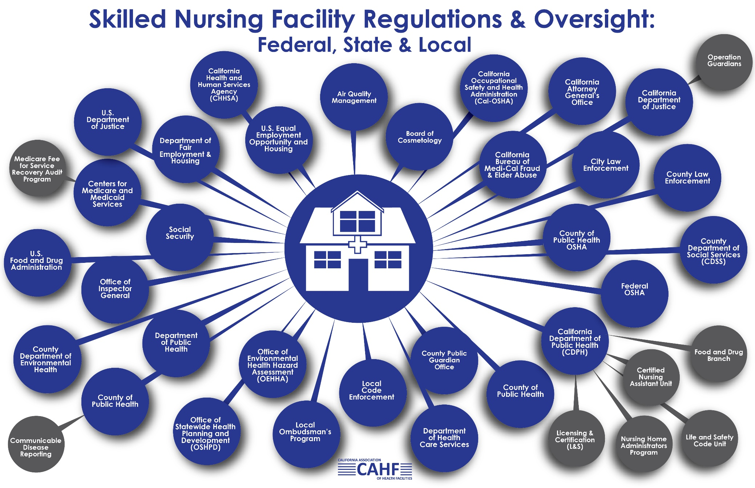

Slide 19
Where does CAHF and the Orange County Chapter come into all of this?
Value of QCHF’s education offerings have never been greater
Grassroots engagement of CAHF members—essential to our future
Political engagement—with members of the Legislature, Congress, and statewide elected officials has never been more important
The essential role of contributions
We’ve got a great story to tell – let’s tell it
Notes:
Budget Advocacy Day in January
--training on how to do it

Slide 20
Grassroots Engagement
Engage with CAHF
Attend your chapter meetings
Participate in training and conferences
Great opportunities for education, engagement, networking
Invite a state legislator to tour your facility, especially a facility in his/her district
Orange County has a dynamic and relatively new Legislative delegation

Slide 21
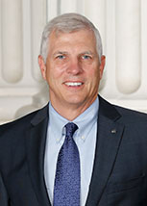
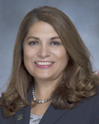
Some public servants you should get to know…
Senator
Tom Umberg
Assembly Member Sharon Quirk-Silva
Assembly Member
Tom Daly

Slide 22
Upcoming CAHF and QCHF Events: Sign up!
CAHF Summer
Education Conference
San Diego: July 14 to 17
DON/Nurse Leadership Training
Sacramento: August 28 and 29

Slide 23
Upcoming Events (cont.)
DSD 24-Hour Education Training
Anaheim: July 9 to 11
Sacramento: September 3 to 5
Statewide Infection Prevention Conference:
Glendale: October 22 and 23
MDS 3.0 Basic, RAI/MDS 101 Clinical, Medicare ICD-10 Coding

Slide 24
Upcoming Events (cont.)
CAHF Annual Convention and Expo
Palm Springs: November 10 to 13
And don’t forget about Orange County Chapter events!

Slide 25
Thank you!

